Slide 1


RESOLUTION & ADVOCACY DEPARTMENT
The RAD Team
PUTTING TOGETHER THE PUZZLE PIECES
How to Identify, Support, and Refer an Individual of Concern
Tell-A-Giant – Report it!
January 2026

Slide 2

BEHAVIORAL INTERVENTION TEAMS
Behavioral Intervention Teams (BIT Teams) are small groups of school officials who meet regularly to collect and review concerning information about at-risk students and develop intervention plans to assist. BIT is tasked with intake of referrals from the community, reviewing them to determine the level of risk or concern, and then developing action plans to address the risk.
At College of the Sequoias, this work is done through a unit called the Resolution & Advocacy Department (The RAD Team), which falls under the Office of the Deans of Student Services. The multi-disciplinary team receives initial information through an incident reporting process that includes both individual of concern reports and student conduct reports, as well as other types of reports.
The focus of the RAD Team is to support student success in a holistic approach, looking at various aspects of the student’s life that can impact student success. Our RAD team is committed to creating a safe, supportive learning and working environment for all member of the campus community. Intervention plans are intended to balance the needs and rights of the individual student and the well-being of the campus community.
Our Team uses best practices and training offered by the National Association of Behavioral Intervention & Threat Assessment (NABITA).
2022
Company

Slide 3

MEET THE RAD TEAM
Courtney Sallam, Dean of Student Services
RAD Chair
courtneys@cos.edu, D| 737-5441
​
Juan Vazquez, Dean of Student Services
juanv@cos.edu, D| 737-5440​
​
Elise Garcia, Dean of Student Services
eliseg@cos.edu, D| 737-5443​
​
Milli Owens, Dean of Business, CFS & SS, Acad. Svcs.,
Business & Soc. Sci.
jessew@cos.edu , D|737-6281 RAD Academic Integrity​
​
Miriam Sallam, Director of Foster Ed & Basic Skills
miriams@cos.edu , D| 737-4842 RAD Basic Needs
Jill Maze, Faculty Mental Health Counselor
RAD Mental Health Counselor
jillm@cos.edu , D| 730-3988​
​
Donnie Charles, Chief of Police
RAD Safety Officer​
donniec@cos.edu, D|730-3862
Kevin Mizner, RAD Case Manager/Trainer
kevinm@cos.edu, D| 737-6240
Christy Ortega, Administrative Assistant
christym@cos.edu, D|737-6238
Morghan Cheney, Administrative Assistant
morghanc@cos.edu, D|737-5470
2022
Company

Slide 4
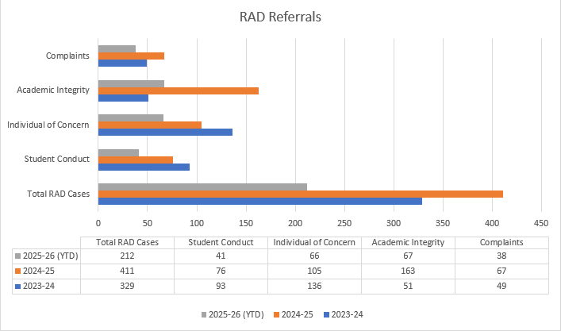
Snapshot
This is a 10% increase in cases
from previous year

Slide 5

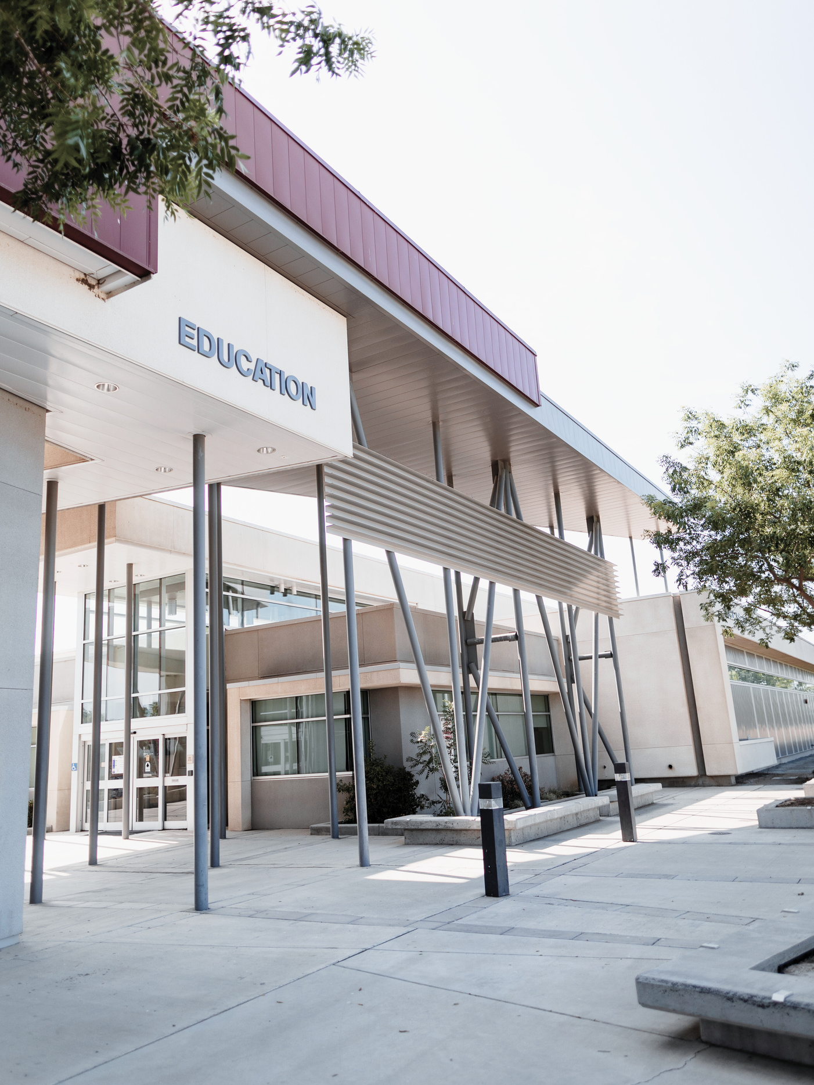
TOGETHER WE SEE THE WHOLE PICTURE.
The College of the Sequoias is committed to creating a safe, supportive learning and working environment for all members of the campus community. Campus safety is our top priority, and we take all reports of misconduct and reports of students-in-need seriously to protect everyone’s health and well-being.
The College depends on its community members to identify and report behaviors of concern so that the College can provide distressed students and employees with appropriate support services and resources. We are all responsible for the well-being of our campus community, so if you become aware of a problem, use the reporting forms we will discuss to get some help.

Slide 6
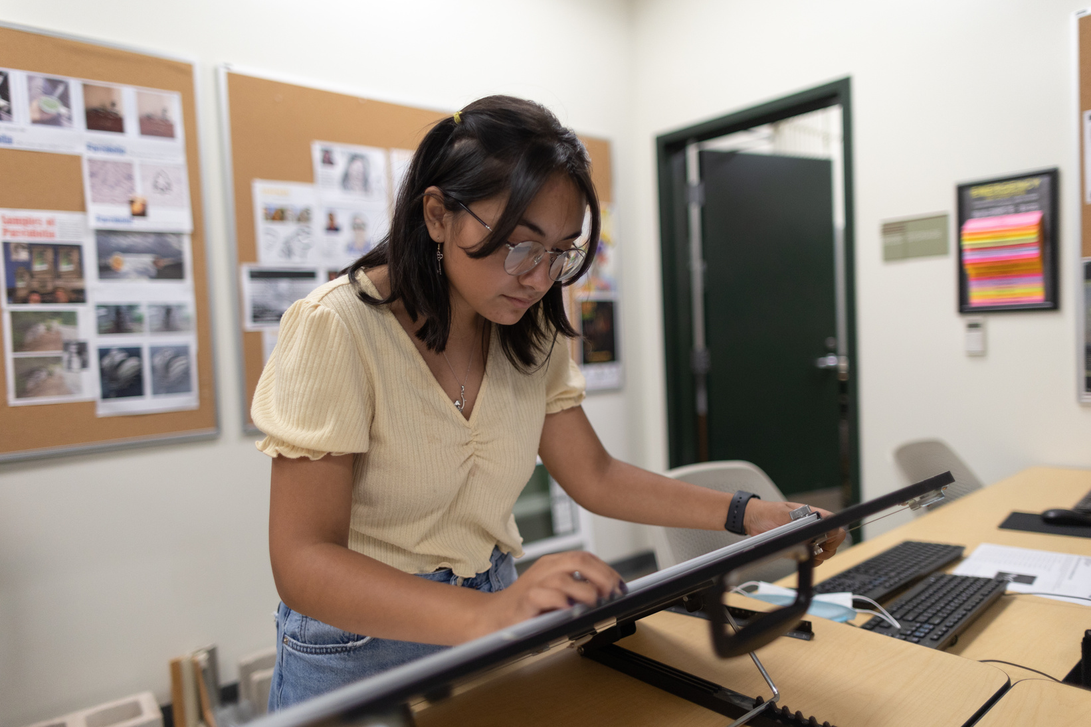

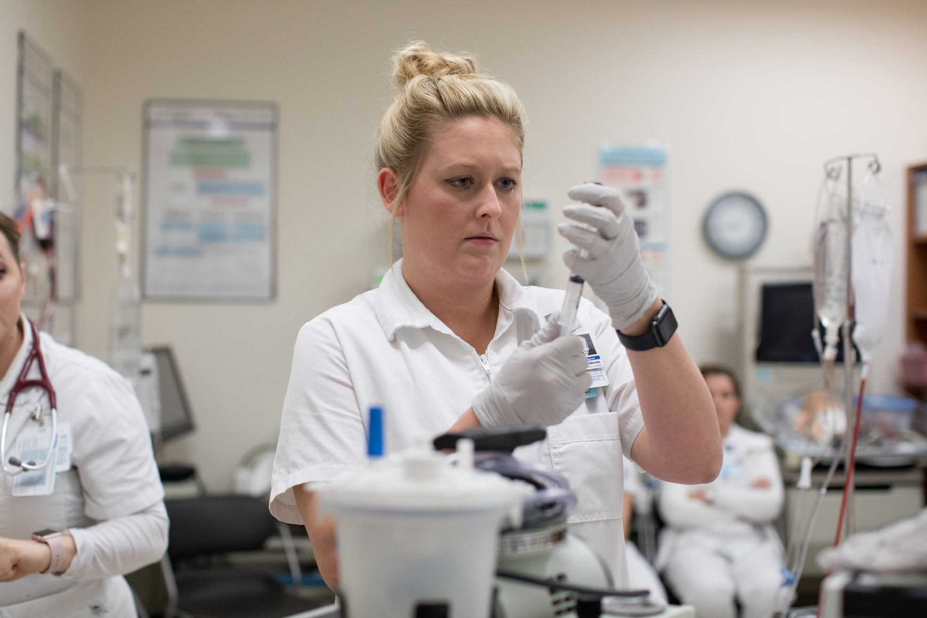

RECEIVING THE
PUZZLE PIECES
The Resolution & Advocacy Department (RAD) is not a proactive entity, seeking out issues on campus. They are designed to receive referrals from faculty, staff, students, and family/community members.
Referrals can be made on any student, employee, or any individual connected with one of the campuses or a campus activity.
When you’re worried about someone, or have a piece of information, hand your puzzle piece off to the team. There may be other similar referrals that you are not aware of.

Slide 7
REPORT, REPORT, PLEASE REPORT!
Individually, pieces of information may seem small and insignificant, but when the small pieces are collected together, a LARGER picture begins to appear.
RAD NEEDS YOUR PIECE
OF THE PUZZLE!

Slide 8
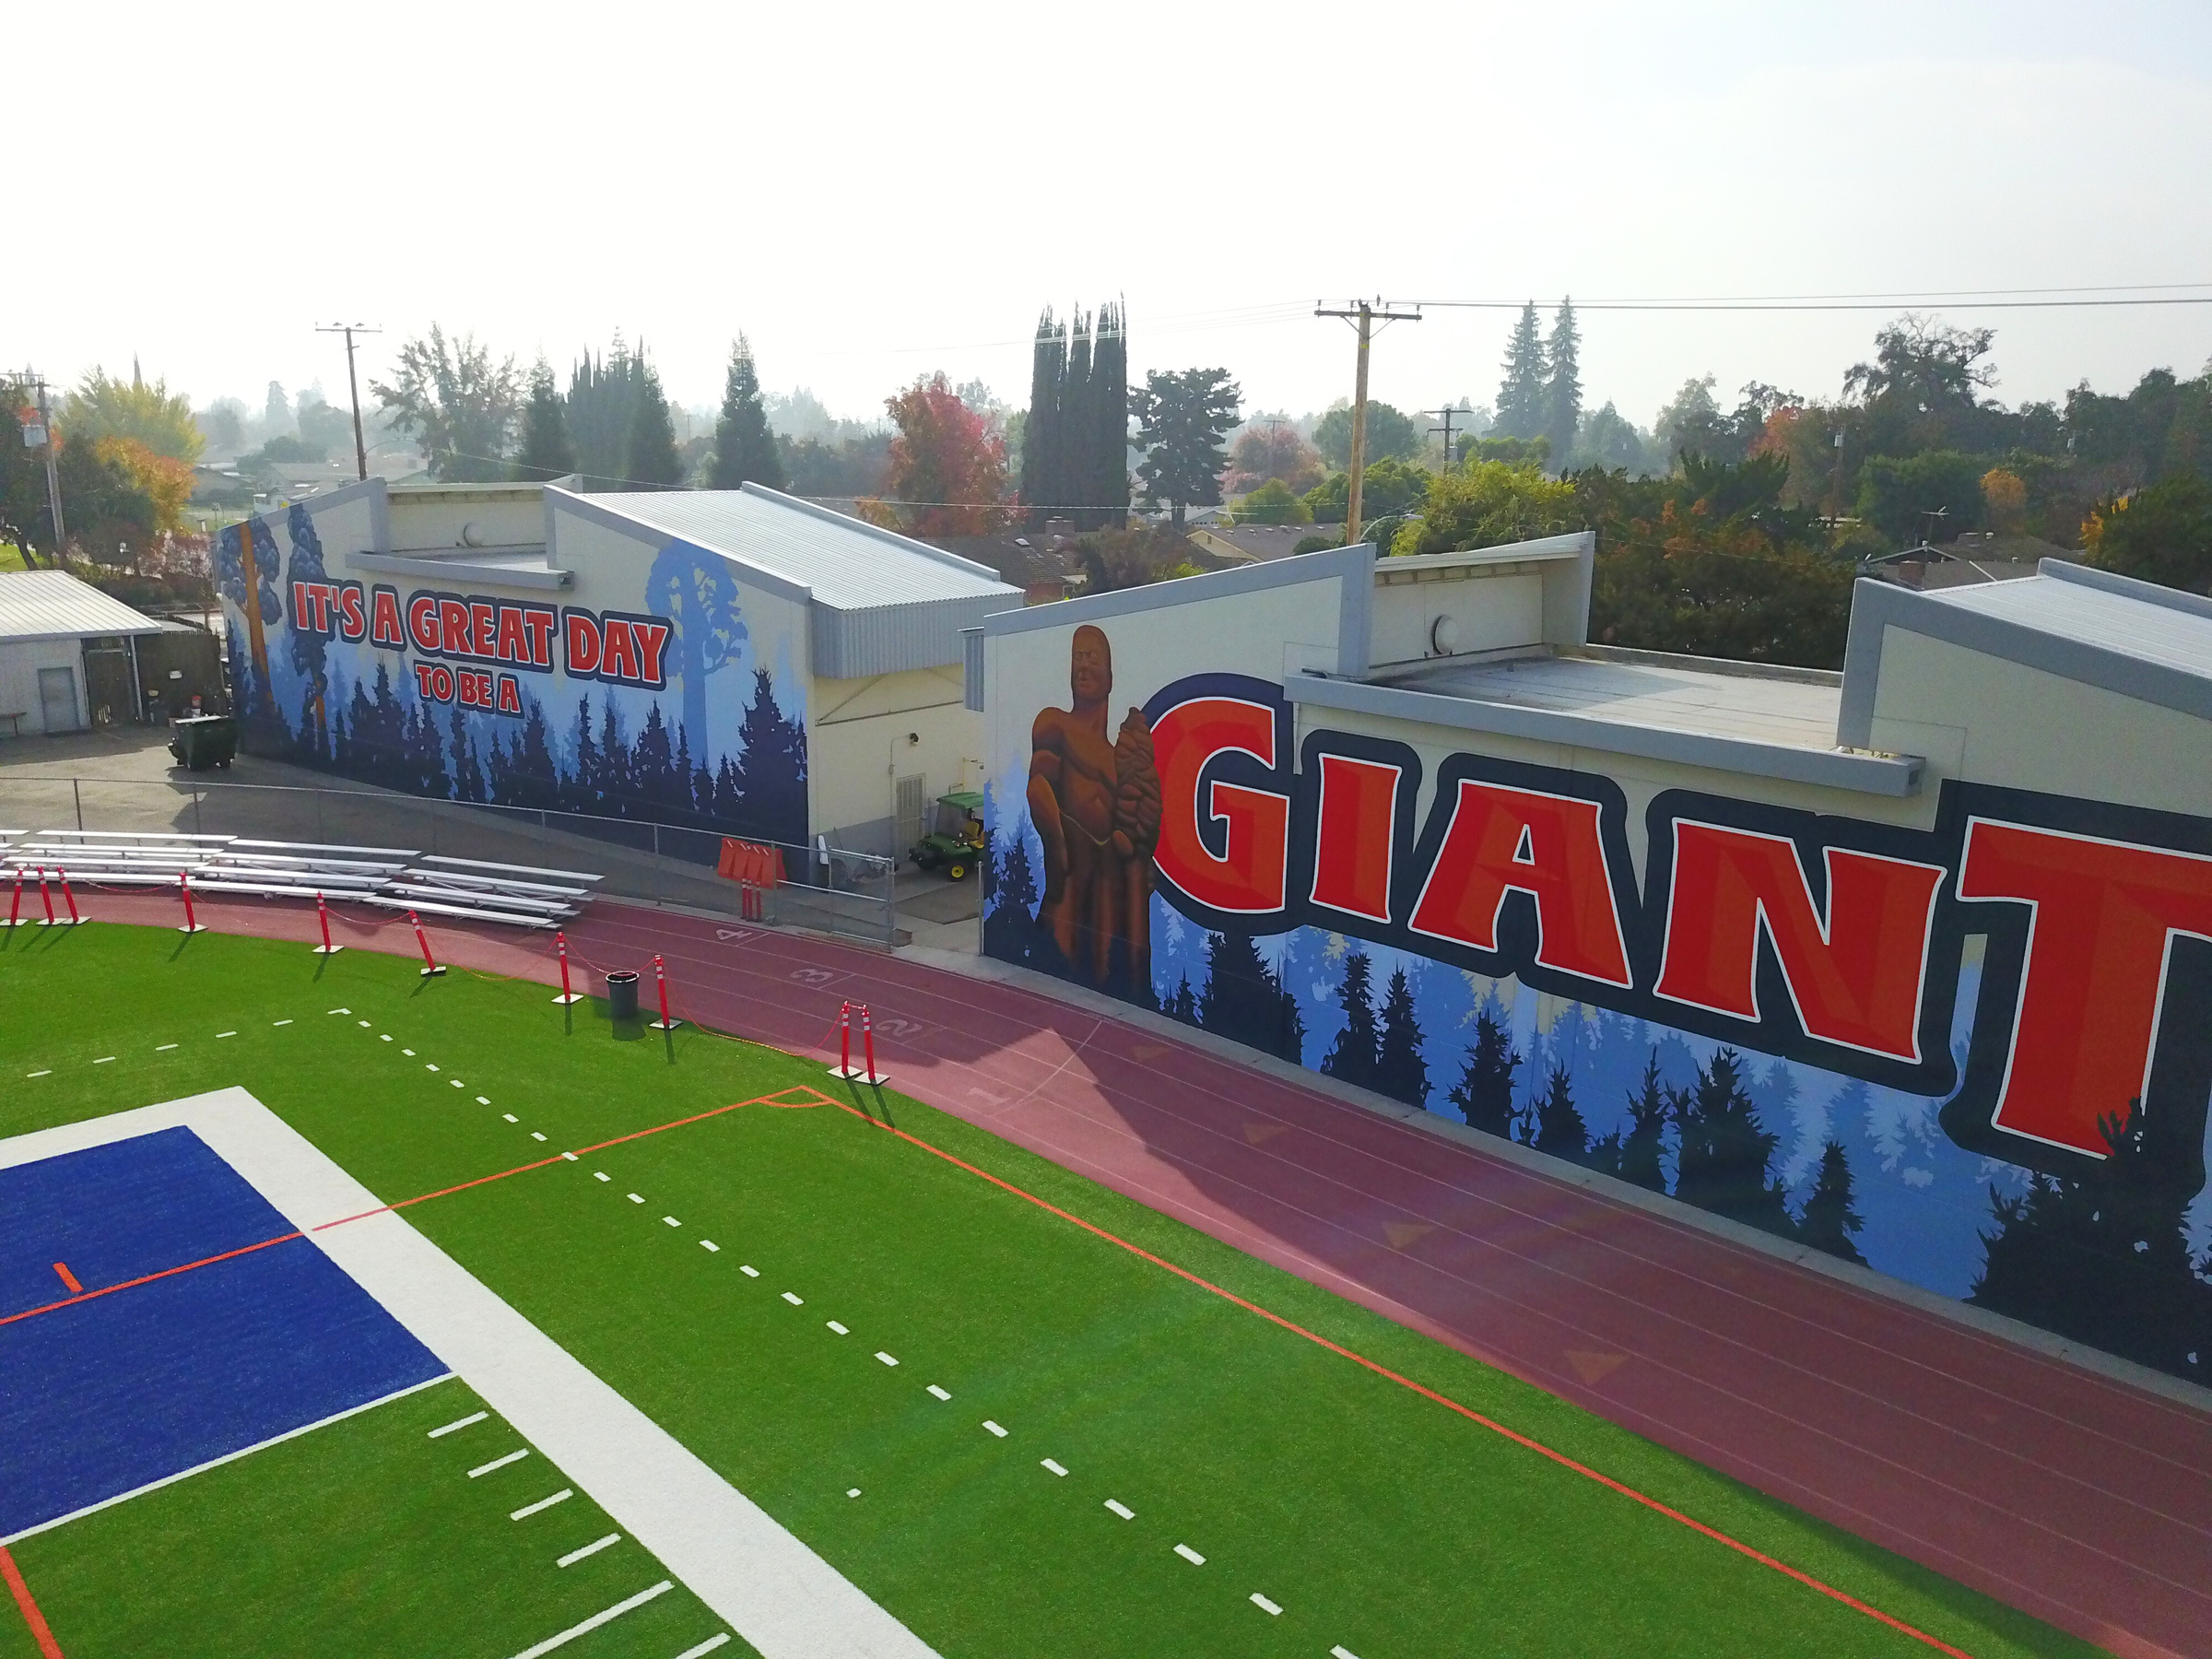
WHO
WHEN
AND
DO I REFER?

Slide 9
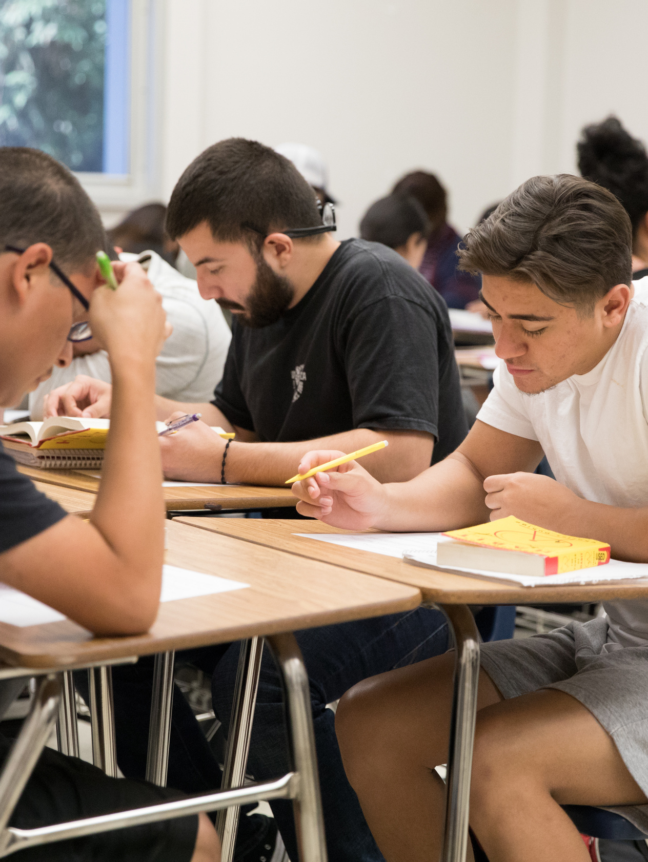
WHO TO REFER?
Students...
- struggling with basic needs or needing supportive resources
- who pose a threat or risk to the wellbeing of themselves or
others on campus
- with academic integrity violations
- desiring a place to voice a complaint
(direct them to the student complaint report form)
- Title IX- Sex based discrimination or harassment
(applies to students and employees)
NOTE: Pay attention to your own social biases, and respond with wisdom and respect for the student's experience - and encourage students to report themselves.

Slide 10
WHO TO REFER
ACADEMIC RED FLAGS
1.
A sudden or unexpected change
in classroom performance
4.
Disruptive or hardened behavior in class (e.g. questions off topic, argumentative in discussions)
2.
Decline in enthusiasm for class (e.g. no longer participating in class discussions)
5.
Strange or bizarre writing (e.g. writing is off topic to prompt, writing includes violent imagery, fantasy)
3.
Frequent requests for special provisions (e.g. late papers, extension requests, postponed exams)
6.
Poor focus or attention during class
Note: At times academic red flags may also overlap with Early Alert Reporting, but keep in mind, these two reports are not the same (students see the Early Alerts, but do not see the RAD reports)

Slide 11
Suicide & Crisis Lifeline / Crisis Text Line (24/7) – Call or Text 988 or Text 741741
WHO TO REFER
EMOTIONAL INDICATORS
1.
7.
Explosive or impulsive behavior
Talking to or seeing things that aren’t there
2.
Mentions dealing with depression, anxiety, substance use, eating disorder, etc.
8.
Delusional or paranoid speech or actions
3.
Change in typical personality (more outgoing or more withdrawn than usual)
9.
Difficulty connecting to others
4.
10.
Social withdrawal, isolation, loneliness, etc.
Expressions of hopelessness, worthlessness, etc.
5.
Difficulty dealing with an event (e.g. death of loved one)
11.
Talks about themes of suicide, loss of will to live, etc.
6.
12.
Directly mentions self-harm, suicide, or harm to others
Marked irritability, anger, hostility, etc.

Slide 12
WHO TO REFER
PHYSICAL INDICATORS
1.
5.
Chronic fatigue or falling asleep at inappropriate times
Confused, disjointed thoughts, speech, or actions
2.
6.
Marked change in personal hygiene or appearance
Attends class or work hungover or intoxicated, or frequently appears hungover or intoxicated
3.
7.
Noticeable change in energy level
Signs of self-injury (cuts, burns, etc.)
4.
Dramatic weight loss or gain

Slide 13

HOW DO I
SUPPORT
STUDENT?
THE

Slide 14





HOW TO PROVIDE SUPPORT
(The First Step in Most Cases)
Name your concern
Ask open-ended questions to allow the student to share at their comfort level
Demonstrate empathy
Summarize what you heard
Note: Remember you are only one piece of the support network - you're not expected to be their counselor!

Slide 15

HOW TO PROVIDE SUPPORT
NAME THE CONCERN
OPEN-ENDED QUESTIONS
DEMONSTRATE EMPATHY
SUMMARIZE
"I noticed that..."
"How have things been going for you?"
"Lately you've seemed..."
"So what I heard you say..."
"It seems like..."
"Wow, thank you for sharing that. It must be difficult."
"What has been difficult for you lately?"
"Ok, let me make
sure I understand..."
"What I'm hearing from you..."
"You're dealing
with a lot right now."
REASSURE THE STUDENT THAT HELP IS AVAILABLE!

Slide 16
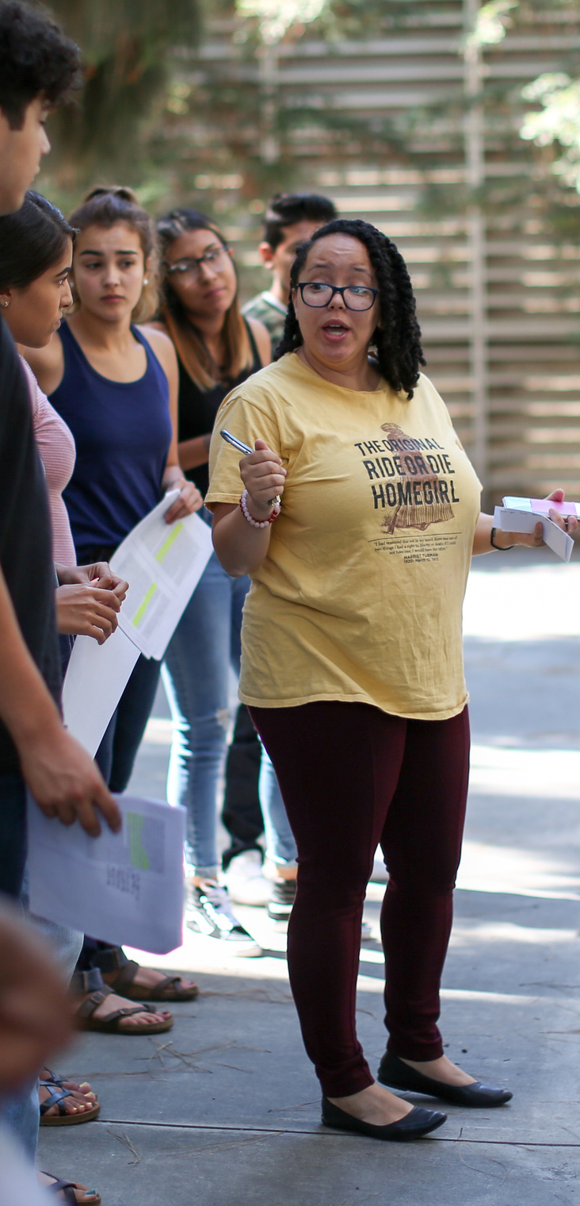
IF RISK IS IMMINENT
IF YOUR SAFETY OR THE SAFETY OF OTHERS IS AT RISK...
- REMAIN CALM
- USE A MODULATED VOICE
- IF THEIR VOICE GETS LOUDER YOU GET SOFTER
- DO NOT BECOME DEFENSIVE OR ARGUMENTATIVE
- ALLOW PHYSICAL DISTANCE
- VALIDATE THE OTHERS EMOTION
- KNOW YOU HAVE THE CHOICE TO LEAVE
(you will usually know within 2-3 min. if de-escalation is working)
CALL 911 IF DE-ESCALATION IS UNSUCCESSFUL

Slide 17
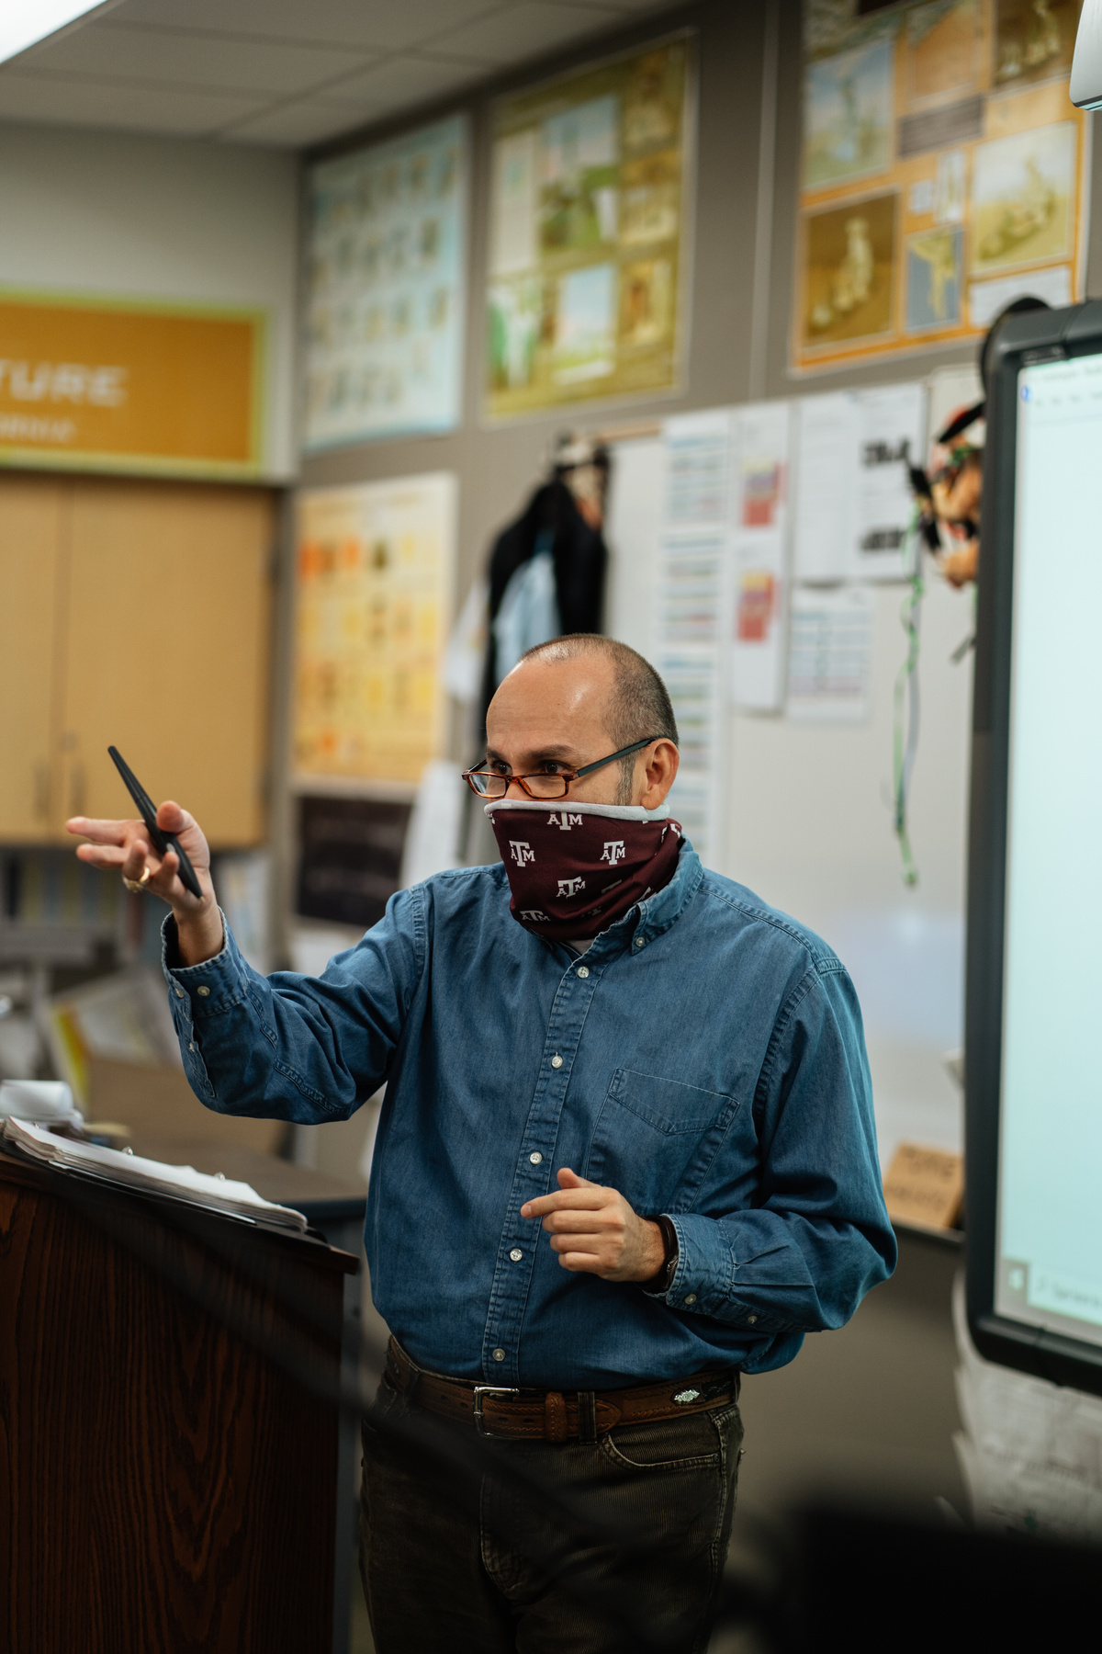
HOW TO PROVIDE SUPPORT
A FEW OTHER KEY QUESTIONS THAT CAN ASSIST RAD...
"Have you ever reached out for counseling in the past? Or are you connected to any services or support at this time?"
"Would you be interested in the mental health services offered at COS?"
"Are you in a safe environment right now?"

Slide 18

MAKING A
REFERRAL

Slide 19
HOW TO MAKE A REFERRAL
LOW-MEDIUM RISK
HIGH RISK
If there is not an immediate health or safety concern, make a referral by:
If there is an emergency related to safety (themes of or direct statement of, self-harm, suicide, or harm to others, seems out of touch with reality, displays delusional or aggressive behavior, etc.) get immediate help by:
- Preferred method:
Completing the referral form at your
MyGiant portal or COS website
- Call/email your Division Chair or Dean for
support
- Contacting 911: V|730-3999, H|583-2599,
T|688-3299
- Call/email RAD Team members
- Once you’ve gotten immediate help, make a
referral to the team

Slide 20
RAD REFERRALS
ARE MADE VIA "TELL-A-GIANT" REPORTS
- Faculty, Staff and students can submit reports using MyGiant or the District’s website.
- Reports are made by clicking on the “Tell A Giant” link at the bottom of COS.edu homepage or in your MyGiant portal.
INCIDENT REPORT CATEGORIES INCLUDE...
- Student Conduct Reports (staff and faculty referral only) (AP 5500)
- Academic Dishonesty (staff and faculty referral only)
- Student Complaints (any student)
- Individuals of Concern (concern about the well-being of a student)
- Sexual Assaults or Harassment (Title IX complaints)
SUBMITTED REPORTS OR COMPLAINTS ARE HANDLED BY A RAD MEMBER
https://www.cos.edu/en-us/student-support/tell-a-giant

Slide 21
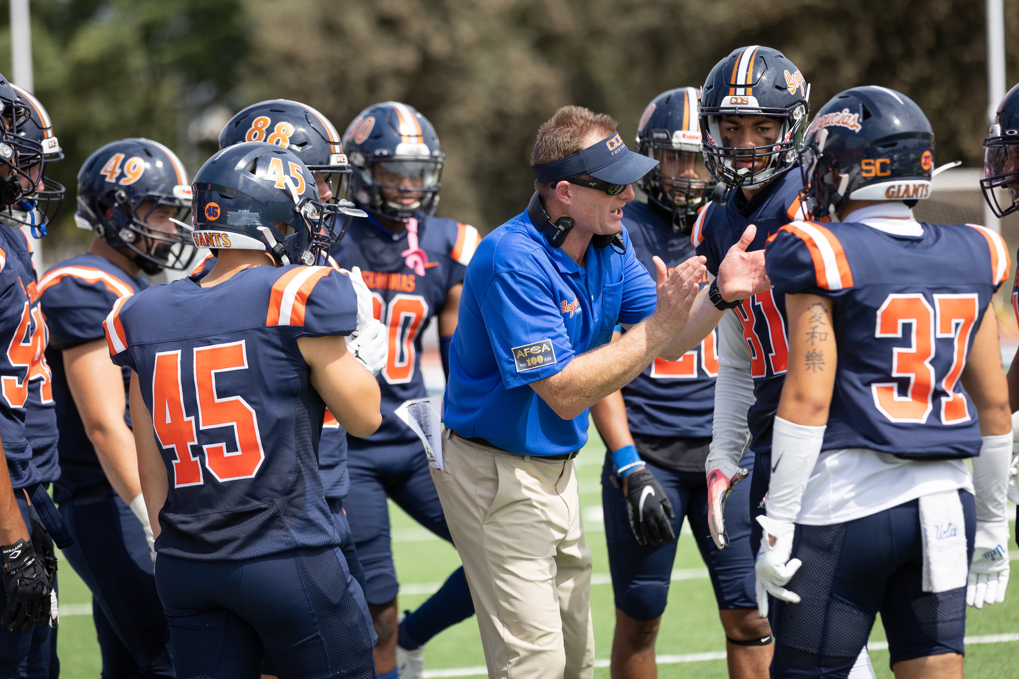

HOW TO MAKE A REFERRAL
INFORMATION TO INCLUDE...
- Any demographic information known: name, contact information, etc.
Objective description of actual observed behavior, statement, written communication, etc., that led to your concern.
- Specific examples, including direct quotes of what was said, emails exchanged, assignments submitted, etc., that are relevant to your concern.
FACULTY LINK TO REPORT FOUND IN YOUR
MYGIANT DASHBOARD - “MAXIENT” ICON.
TO REPORT:
https://www.cos.edu/en-us/student-support/tell-a-giant

Slide 22



WHAT HAPPENS AFTER A REFERRAL?
Gather Data
Assess Concern
Deploy Interventions
Once the BIT team receives the referral, we will begin collecting any additional information to put together the pieces of the puzzle.
In order to determine how to best intervene and support the student, the BIT team reviews the data collected to assess the level of concern, risk, or threat.
Based on the level of concern, risk or threat, the BIT team will deploy interventions such as a meeting with the individual, case management services, restorative justice, police/campus safety response.

Slide 23
FREQUENTLY ASKED QUESTIONS
AND ANSWERS!
Q:
What if the person asks me to keep their information confidential and they don’t want me to make a referral?
A:
Unless you are a licensed counselor, doctor, or clergy, you are not bound to a confidentiality clause. FERPA allows you to share this information with the team for the safety and wellbeing of the student and of the campus at large.
If you’re worried, or you have information that would be important to share, make the referral.
The referral is designed to help the student and connect them with resources, not get them in trouble.
Try saying something like…. “Thank you for sharing this with me. I am pretty worried about you and everything you’ve been going through. There is a team on campus, the RAD Team that helps with these types of issues. I’m going to make a referral and they will reach out to you to check in and offer support”.

Slide 24

QUESTIONS?

Slide 25
CONTACT INFORMATION
Email the RAD Team - RAD@COS.edu
Call the Office of the Deans of Student Services - 559-737-5441
Contact any RAD Team Member
College of the Sequoias | Resolution and Advocacy Department (RAD Team)
RAD NEEDS YOUR PIECE
OF THE PUZZLE!

