Slide 1




Habits of the Heart:
Power of Positive Thinking and Reinforcement
Mehmet "Dali" Ӧztürk, Ph.D.
Research, Planning & Institutional Effectiveness
2016 COS Management Institute
June 8-9, 2016
Tulare College Center
Tulare, CA

Slide 2
Elevating Educational/Academic Profile
Habits of the
Heart…
And positive institutional culture

Slide 3

The Three Habits*
Elevating Educational/Academic Profile
Habit of the Mind
Habit of the Hand
Habit of the Heart
*Lee Shulman, Past president of the Carnegie Foundation for the Advancement of Teaching

Slide 4

The Three Habits
Elevating Educational/Academic Profile
Habit of the Mind- As an intellectual who thinks about issues and finds solutions

Slide 5

The Three Habits
Elevating Educational/Academic Profile
Habit of the Hand- As a practitioner who is actively engaged in practicing what is learned

Slide 6
The Three Habits
Elevating Educational/Academic Profile
Habit of the Heart- As a caring person who is passionate, optimistic, and inspiring

Slide 7
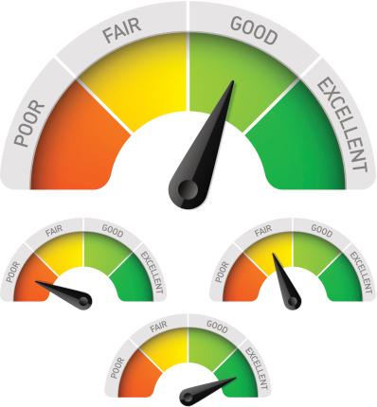
Habit of the Heart-
Elevating Educational/Academic Profile
Measuring Passion
Yes, passion
counts!
Likert Scale

Slide 8

Power of Positive Thinking and Reinforcement
Optimistic people become successes and optimism helps at work.
*
True
True
False
* Seligman, M.E.P. (2006). Learned Optimism. Vintage Books; p.255.

Slide 9
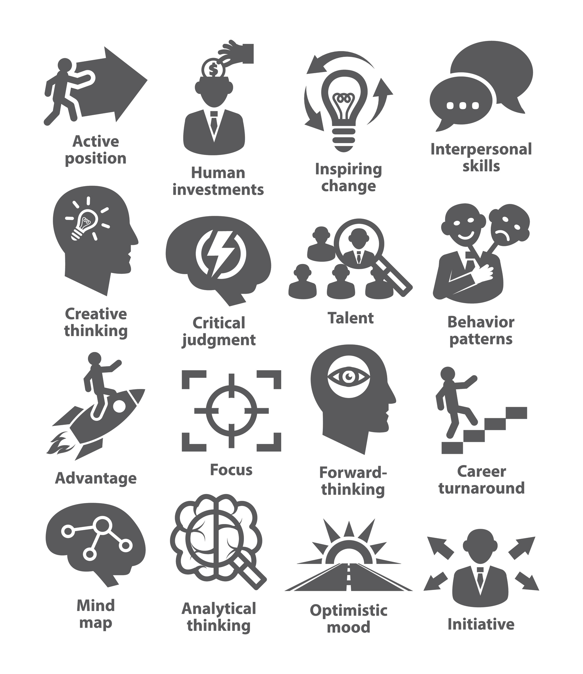
Power of Positive Thinking and Reinforcement
Positive thinking and feedback can be very powerful.

Slide 10
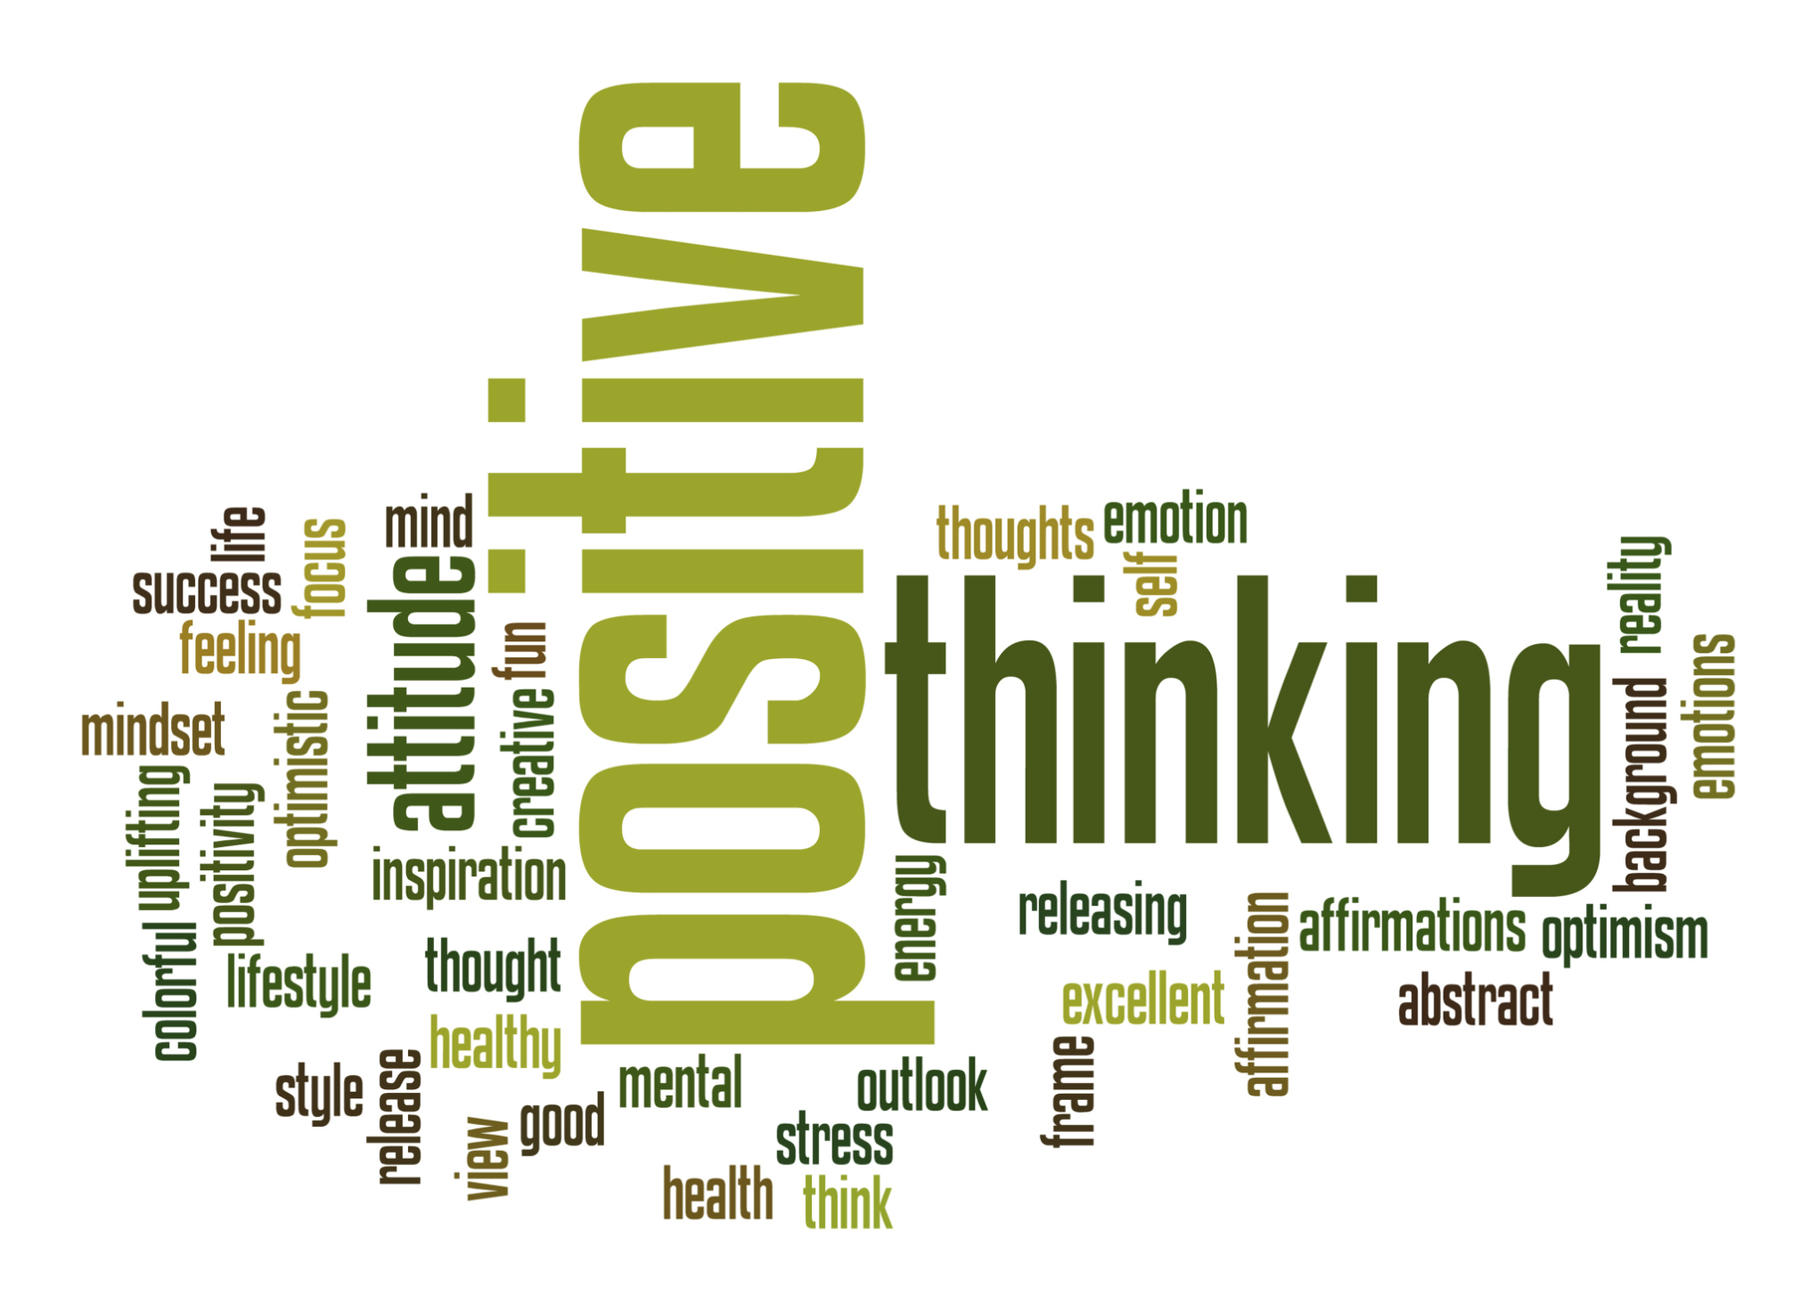
Power of Positive Thinking and Reinforcement
Positive thinking can be very powerful.
What comes to mind when you hear positive thinking?

Slide 11
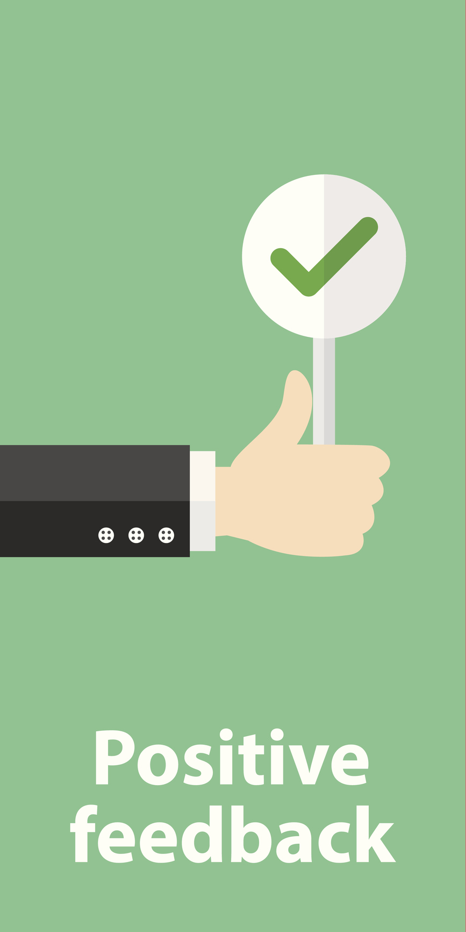
Power of Positive Thinking and Reinforcement
Positive feedback can be very powerful.
Be caring, humble and take time to
Praise
Compliment
Acknowledge
Appreciate
Simply recognize good work and behavior

Slide 12
Power of Positive Thinking and Reinforcement
Activity
Please discuss and share what positive things (feedback) you can say to your colleague/co-worker/employee.
Report Out

Slide 13
1. I’m grateful for you. 2. You make us proud. 3. Your words are meaningful. 4. You have great ideas. 5. I love being your colleague/boss 6. You don't have to be perfect to be great. 7. Your opinions matter. 8. You are important. 9. You are respected 10. I believe you. 11. I believe in you. 12. This place wouldn't be the same without you. 13. You are valuable. 14. You can say no. 15. You can say yes. 16. I know you did your best. 17. You were right. 18. I accept who you are. 19. We can try your way. 20. You are helpful. 21. You are worth it. 22. You make everyone happy. | 23. I love your creativity. 24. Being around you is productive. 25. I can't wait to hear about it. 26. Don’t be afraid to be you. 27. You’re making a difference. 28. I’m excited to work with you. 29. You are intelligent. 30. I love seeing the world your way. 31. It’s good to be curious. 32. I love the way you tell stories. 33. What you did was awesome. 34. I admire your work. 35. That’s a great question. 36. We are lucky to have you. 37. I trust you. 38. That was a really good choice. 39. Seeing you being successful makes us happy. 40. Being your boss is my favorite job. 41. I learn new things from you every day. 42. You make us better. 43. You are a good employee/colleague. 44. Thank you for being a good employee/colleague. | 45. I’m so glad you're here. 46. This sounds great. 47. I understand you. 48. Watching you grow professionally is the best. 49. That was really brave. 50. I forgive you. 51. I appreciate you. 52. We all make mistakes. 53. Yes, me too. 54. You are very good at that! 55. You can try again tomorrow. 56. Nobody is perfect. 57. I love how you said that. 58. Not everyone will like you, and that's OK. 59. You did that so well. 60. I’m listening. 61. That’s a very fair point. 62. You are skillful. 63. You are innovative. 64. You are engaging. 65. You are enough. 66. You make us all look good.
What will you say to your colleague/co-worker/employee today?
Notes:
Adapted from 66 Positive Things You Should Be Saying to Your Child (With permission from Alessia Santoro; March 2016)

Slide 14

Thank
You!
Questions?

