Slide 1
Complio
American Databank

Slide 2
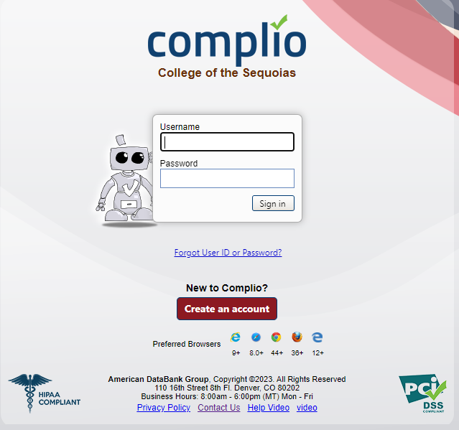
Complio Overview
Complio Overview Video
COS Complio Website:
https://cos.complio.com
Note: Use only your COS giant email when creating an account.
No personal email.
Make sure you have access to your giant email.
- Make sure you spell your name correctly and enter your social security number correctly.

Slide 3
Creating a Complio Account
Do NOT use “!” as a special symbol at the beginning or end of your password. You will have trouble with logging-on

Slide 4
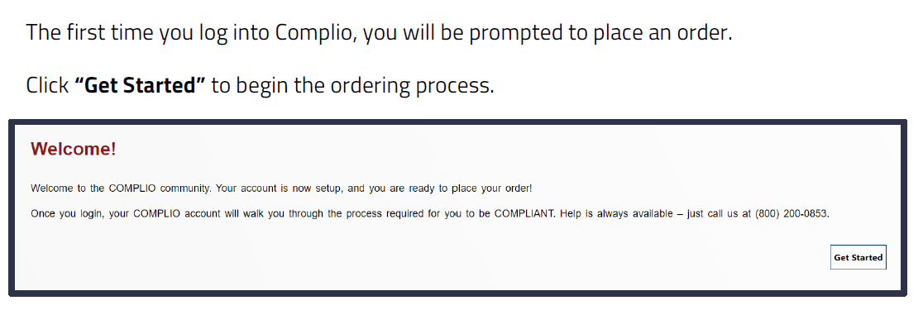
Activate your Complio Account
May need to check your spam folder
Email can take a few minutes to 24 hours to receive.
If you have NOT received it within the 4 hours, you’ll need to call American Databank customer service line.
Email: complio@americandatabank.com Phone: 1-800-200-0853 or 1-303-573-1130
Once you activate your account, you’ll need to login with your Complio username and password. Trouble signing on: reset your password without a special symbol at the beginning or end of your password.

Slide 5
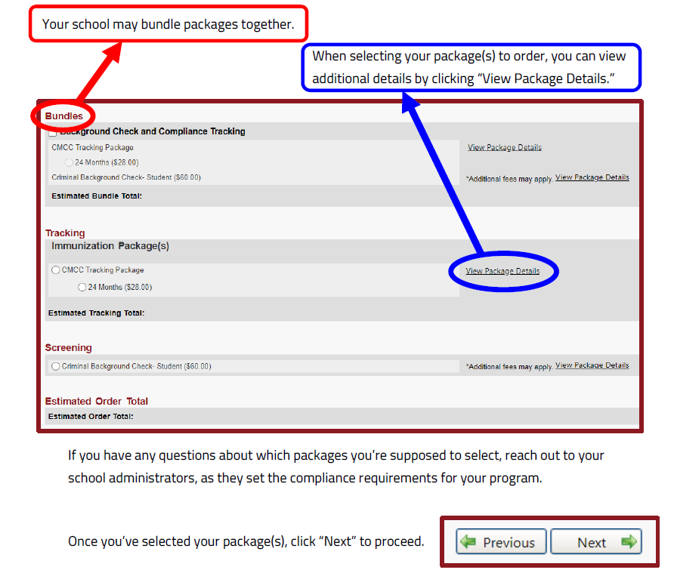
Complio Tracking Subscription To upload your clinical requirement documents and for Complio to track the expiration dates.
Select your program
Click on your Tracking Package
Tracking Packages :
Pharmacy Technician Students-
15 months subscription $35.00
Complio Subscription Video

Slide 6
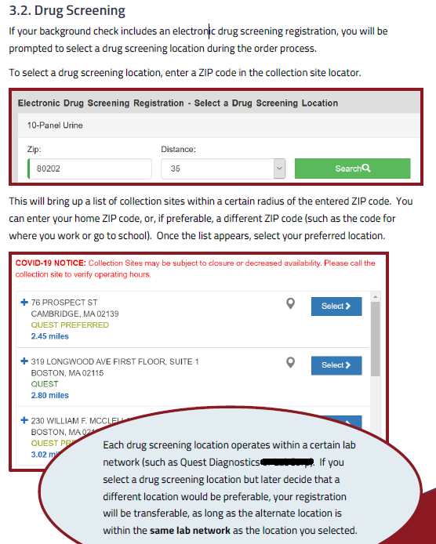
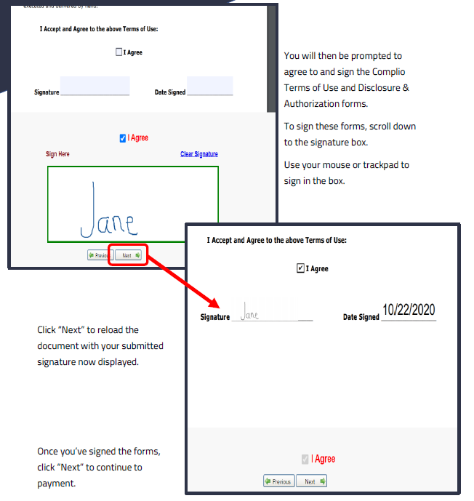
Complio Background & Drug Screen
Once you complete your order through Complio, you will be emailed your AUTHORIZATION FORM to your giant email. You will print or take your mobile device for scanning purposes to Quest Diagnostics. The Quest Diagnostic location you selected during your order is the location to complete your drug screen at, this reduces that chance your results gets lost in the system. Once competed, you will be emailed a copy and so will the Nursing & Allied Health Office. Complio will automatically upload to your Complio account.
Troubleshooting:
Must show your Authorization Form
code for Check-in. You already Paid for
The drug screen, you will NOT need to pay
at Quest Diagnostics.
Must complete Drug Screen before
the Expiration date on Authorization form.
Complio Additional Fees Video
Complio Signing Forms Video
Screening Packages for Allied Health Programs:
Background Screen & Drug Screen: $70.00
Drug Screen: $45.00

Slide 7
Drug Screen
Note: Drug Screen Retake cost $45.00.
Reasons for Drug Screen Retakes:
Diluted Sample
Authorization Form Expired
Unable to produce a Sample
Positive for substance use.

Slide 8
Flagged Results
Background Flagged Results:
Must meet with your program director/ instructor and/or Clinical Coordinator to discussion results and further steps.
Note: Possibly not able to continue the program.
Must have a cleared background screen for clinical placement.
Drug Flagged Results:
Meet with your program director/ instructor and/or Clinical Coordinator to discussion results and further steps.
Re-order & re-take the Drug Screen.
Wait for the substance in your system has left your system, then re-take. Be mindful of your clinical deadline!
Must have a cleared drug screen for clinical placement.

Slide 9
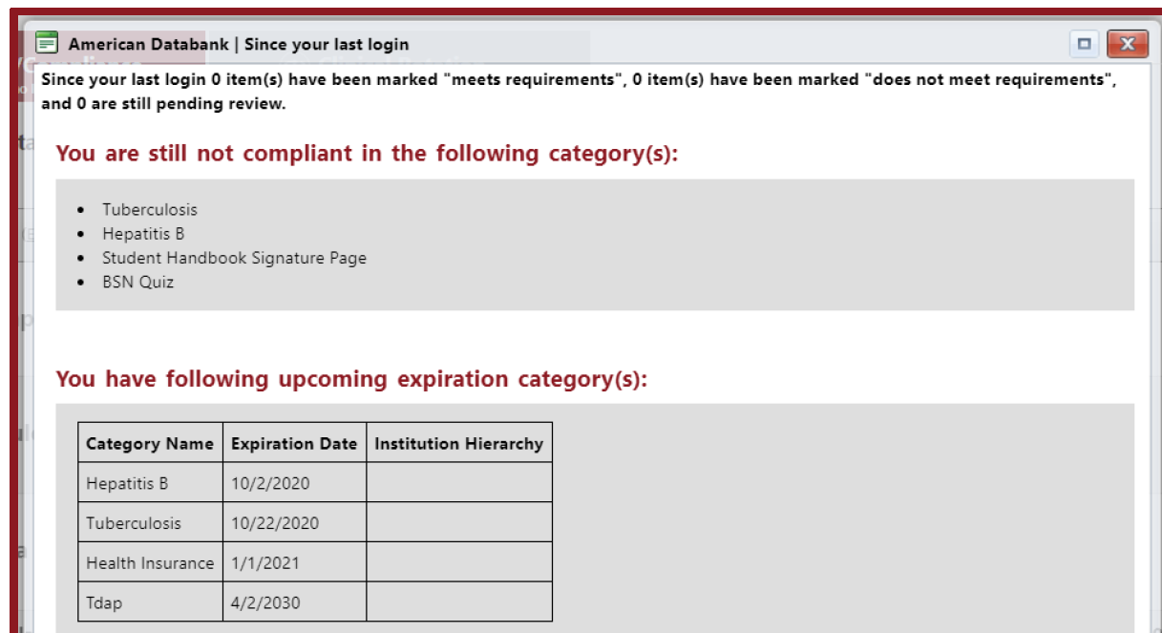
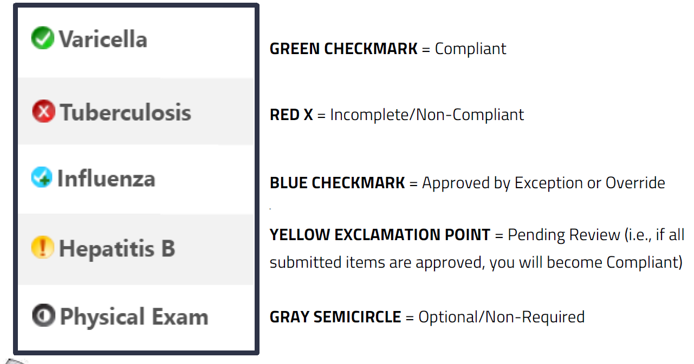
Complio Dashboard
Complio sends you an email notifications whenever there is a change to your compliance status, whenever a submission is rejected, or whenever items are set to expire soon.

Slide 10
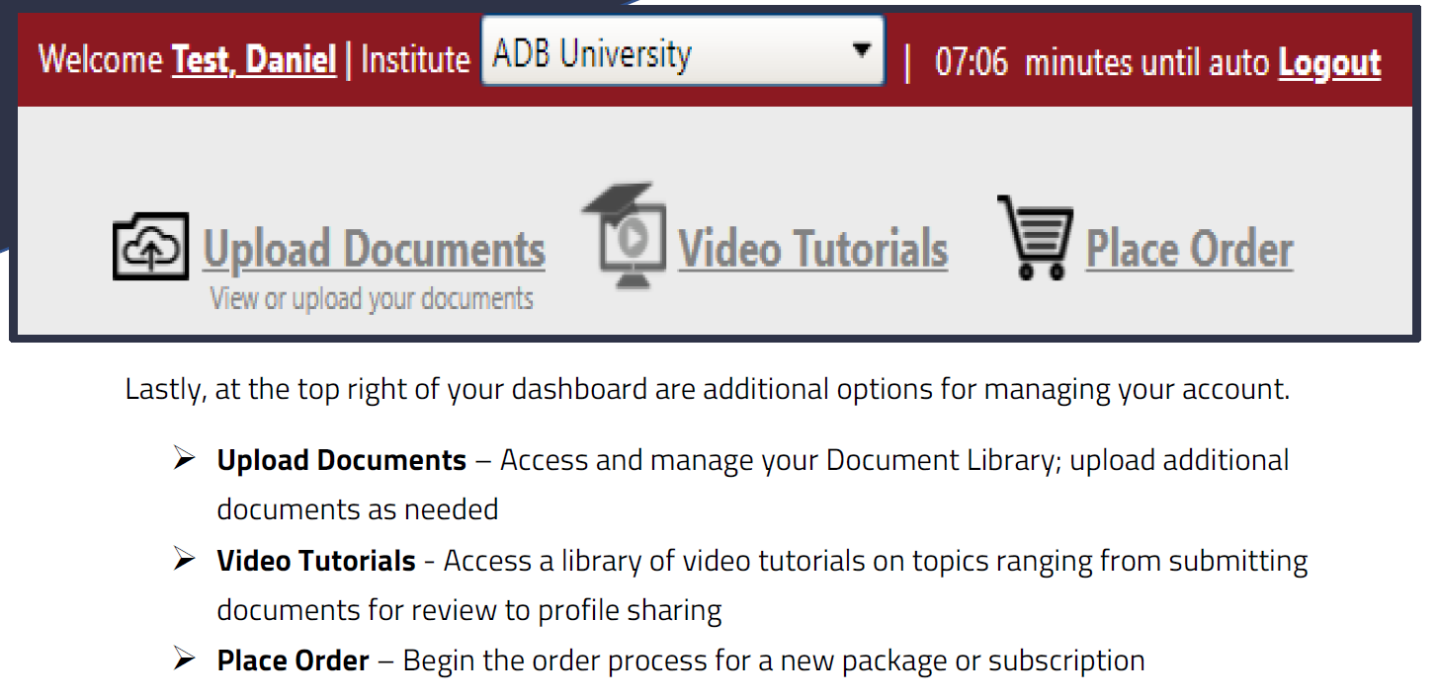
Complio Upload & Entering your Clinical Requirements
Complio Document Upload Video
Complio Data Entry Video
Complio Titer Document Upload Video
Notes of Clinical Requirement documents:
Physical exam must be signed by a Physician or a Nurse Practitioner
Immunization record documents must be from your medical clinic or on your yellow card; high school record are not accepted.
TB Two Steps take two weeks to complete; complete first before receiving any immunization vaccines OR complete a Quantiferon TB Gold Test (Bloodwork).
MMR & Varicella: You will need to have a titer done if you had Chickenpox as a child to show immunity. MMR Titers need to include Measles, Mumps, and Rubella.
COS Health Center: Provide Free Flu Vaccines and TB Two- Step testing. Contact the Health Center at 559-737-6195 for more information regarding times
CPR Cards: Red Cross and Mets guidelines of AHA are not accepted. Only American Heart Association.

Slide 11
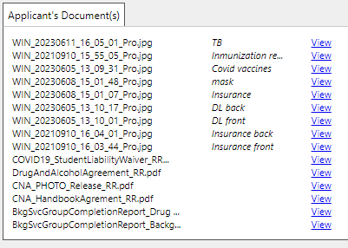
Naming Documents

Slide 12
Immunization Record Example
Your Legal name listed
Provider/ Clinic Name
Vaccination listed with dates administrated.
The clinic verifies all listed information is accurate.
Upload document and tag document for vaccine entries.

Slide 13
Clinical Requirement Example

Slide 14
MMR Clinical Requirements Notes
MMR: Measles, Mumps, Rubella (2 Doses)
Dose 1 and 2 are 4 weeks apart.
Immunization Record:
Complio MMR Entries:
Measles Dose 1: 1/22/2003
Measles Dose 2: 4/18/2006
Mumps Dose 1: 1/22/2003
Mumps Dose 2: 4/18/2006
Same Provider/Clinic and same document.
Rubella Dose 1: 1/22/2003
Rubella Dose 2: 4/18/2006
MMR Titer: 1 report
Complio MMR Titer Entries: 3
Measles Titer
Mumps Titer
Rubella Titer
Titer Results must be Positive
Equivocal or Negative will require booster doses.
Same Provider/ Clinic and same document

Slide 15
Hepatitis B Clinical Requirements Notes
Hepatitis B: 3 dose Series.
Dose 1 and 2 are 4 weeks apart.
Dose 2 and 3 are 5 months apart.
Immunization Record:
Hepatitis B Titer(HbsAb):
1 report & 1 upload entry.
Titer Results must be Positive
Equivocal or Negative will require booster doses.
Complio Hep B Entries:
Hepatitis B Series – 1st: 2/11/2005
Hepatitis B Series – 2nd : 6/8/2005
Hepatitis B Series – 3rd : 3/27/2006
Same Provider/Clinic and same document.

Slide 16
Varicella Clinical Requirements Notes
Varicella (Chickenpox) Vaccine: 2 doses
Dose 1 and 2 are 4 weeks apart.
Immunization Record:
Varicella Titer
1 report & 1 upload entry.
Titer Results must be Positive
Equivocal or Negative will require booster doses.
If you had chickenpox has a child, you need to do a Titer.
Complio Varicella Entries:
Varicella Dose 1: 12/27/2005
Varicella Dose 2: 6/8/2005
Same Provider/Clinic and same document.

Slide 17
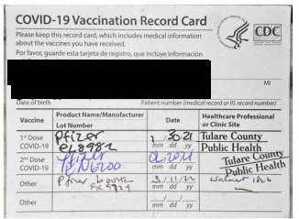
COVID-19 Clinical Requirements Notes
COVID-19 Vaccine: 2 doses & a booster
Dose 1 and 2 are 3 weeks apart.
Dose 2 and booster are 5 months
apart.
COVID-19 Exemptions are NOT Accepted.
If you have questions or concerns, please talk to your program director.
Complio COVID-19 Entries:
COVID-19 Vaccine Dose 1 of 2: 1/30/2021
COVID-19 Vaccine Dose 2 of 2: 2/20/2021
COVID-19 Booster: 3/11/2022
May be more than 1 document, provider/clinic.

Slide 18
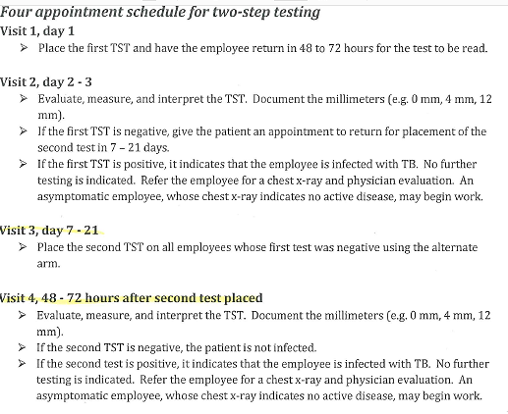
Tuberculosis (TB) Two-Step. Option 1
Your 2nd PPD mut be given 1 to 3 weeks after your 1st PPD.
Two-Step TB Complio Upload:
Healthcare setting? No
PPD 1st: 9/22/2022
PPD 2nd: 9/9/2022
Clinic/ Provider: COS Health Center
Same Document for both entries.

Slide 19
Tuberculosis (TB) Quantiferon TB Gold Test (Bloodwork) Option 2
Quantiferon TB Gold Test Complio Upload:
Healthcare setting? No
Results Must be Negative.

Slide 20
Tuberculosis (TB) Annual
Annual TB Complio Upload:
Healthcare setting? Yes
PPD Annual: 9/22/2022
PPD 2nd: 9/9/2022
Clinic/ Provider: COS Health Center
If you work in a healthcare setting prior to program entry.
2nd year of program.

Slide 21
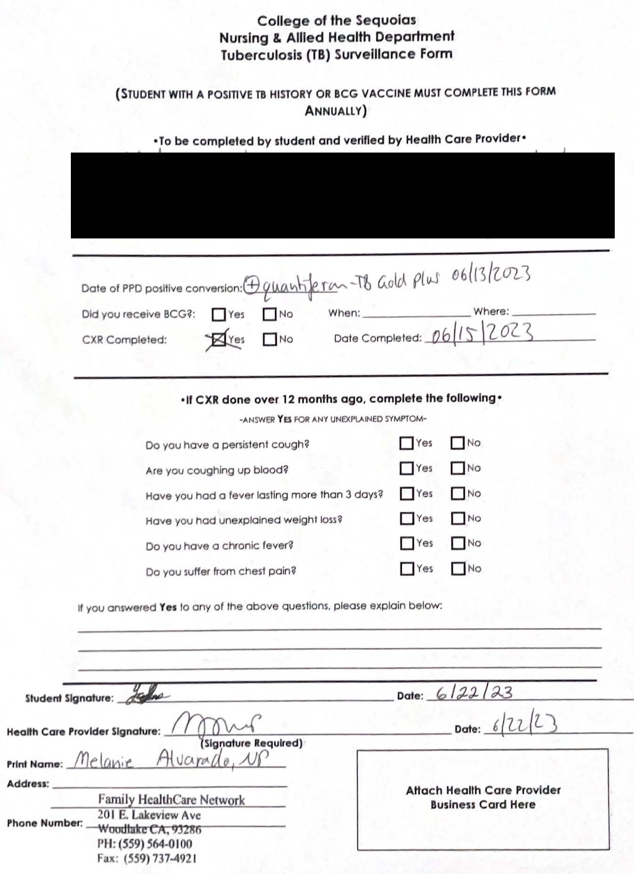
Tuberculosis Positive Results
Complio: both forms must be upload to complete the TB requirement.
Chest X-Ray : Results Must be Negative. Receive from your healthcare provider.
TB Screening Form: Nursing & Allied Health TB Surveillance Form (get from Nursing & Allied Health Administrative Assistant, Angela Iniguez.

Slide 22
Complio Exceptions
Before you Apply for Exception on Complio the following MUST be completed first:
Email your externship instructor, also CC Allied Health Administrative Assistant.
Email response from externship instructor approving exception request with expiration date. Allied Health Administrative Assistant must be cc’d on email.
Submit your Apply for Exception through Complio include screenshot of email approval with request. Email Administrative Assistant, you submitted your exception.
If the following procedure is not followed and automatic denial will be given until the procedure is followed.

Slide 23
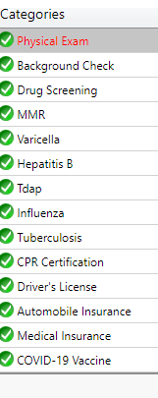
Pharmacy Technician Program
Complio Document Upload
COS Forms submit to Nursing & Allied Office
Photo/Video Release
Informed Consent
Occupational Exposure Control Protocol
Student Health Release Form
Demographics Survey
COS Pharmacy Technician Program Website

Slide 24
PhT Program Contact Information
PhT Director/ Externship Coordinator/ Instructor
PhT Adjunct
Instructor
Allied Health Administrative Assistant
PhT Director:
Email:
Office Number: 559-737-6120
(call only)
Allied Health Administrative Assistant: Angela Iniguez
Email: angelai@cos.edu
Office Number: 559-737-6135
(call or text)
PTA ACCE/ Instructor:
Email:

Slide 25
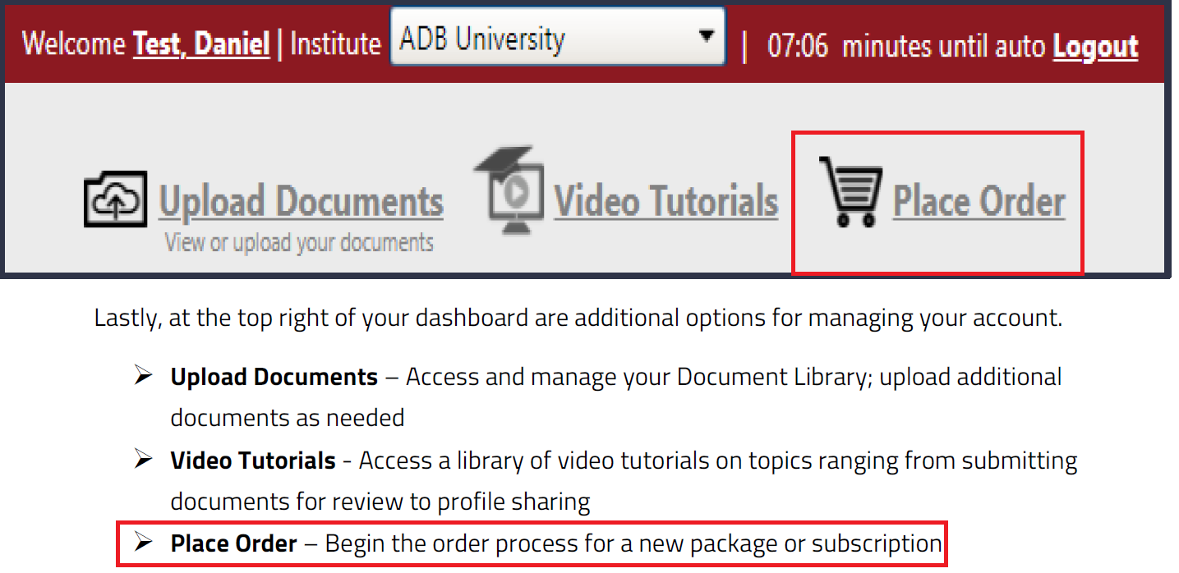
Renew your Complio Subscription
Complio Renew Subscriptions Video
Place Order
Select Your Program
Select Tracking Package for your program.
Enter the months needed to extend your subscription.

Slide 26
Complio Help Appointment with Angela
Must email, call, or text to schedule an appointment with me prior to visiting me in person.
Must have all requirement documentation prior to requesting to schedule an appointment, this save you and me time. ☺
Angela Iniguez
Administrative Assistant
Nursing and Allied Health
(559) 737-6135 (Call or Text)
angelai@cos.edu
College of the Sequoias, John Muir room 125
915 S. Mooney Blvd.
Visalia, CA 93277
Office Hours:
Monday – Friday
7:45am - 12pm; 1pm - 4:45pm
I support the following programs: (125)
PTA program (56)
Pharmacy Technician Program (24)
C.NA Program (45)
EMT Program
HLTH 405 (Rehab Aide) /406 (AHA BLS CPR) Classes
Allied Health Division
Not Tech Savvy?
Confused on how to upload?
Don’t have access to scanner, laptop or desktop?
Don’t know where to start in submitting your documents?
Got an email that your submission rejection? Forward rejection email either via text or email. I will review and respond once complete.

