Slide 1


Complio
American Databank

Slide 2
PhT Program Contact Information
PhT Director/ Externship Coordinator/ Instructor
Allied Health Administrative Assistant
Allied Health Administrative Assistant: Angela Iniguez
Email: angelai@cos.edu
Office Number: 559-737-6135
(call or text)
  PhT Director: Keidra Turk, M.S. Ed., CPhT
  Email: keidrat@cos.edu
  Office Number: 559-737-6120
  (call only)

Slide 3
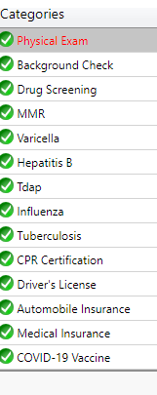
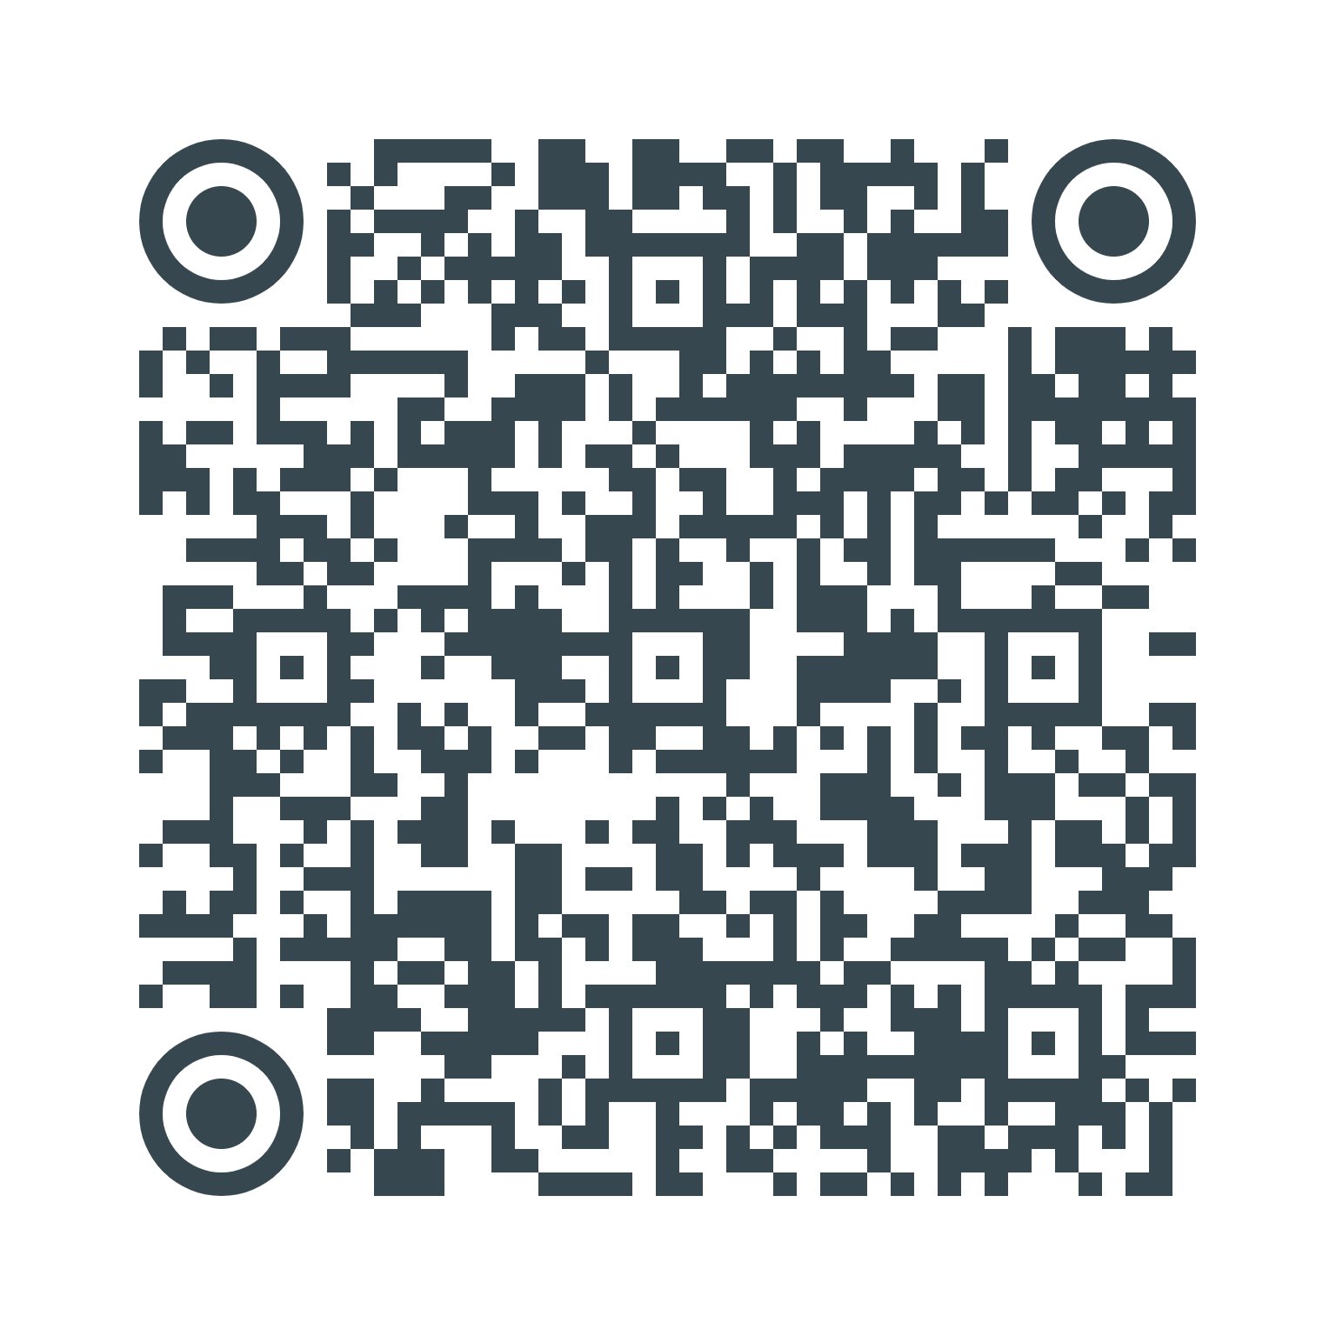
Pharmacy Technician Program
Complio Document Upload: October 15, 2025
COS Forms submit to Nursing & Allied Office: September 17, 2025
Photo/Video Release
Informed Consent
Occupational Exposure Control Protocol
Student Health Release Form
Demographics Survey
Pharmacy Technician Website:

Slide 4
Notes on Requirement Documents
Physical exam must be signed by a Physician or a Nurse Practitioner (COS Health Center)
Immunization record documents must be from your medical clinic or on your yellow card; high school record are not accepted. (check with the COS Health Center for CAIRS2 Immunization Record)
TB Two Steps take two weeks to complete; complete first before receiving any immunization vaccines OR complete a Quantiferon TB Gold Test (Bloodwork).
Varicella: You will need to have a titer done if you had Chickenpox as a child to show immunity. MMR
MMR: Titers need to include Measles, Mumps, and Rubella.
COS Health Center: Provide Free Flu Vaccines and TB Two- Step testing. Contact the Health Center at 559-730-3880 for more information regarding times & other services.
CPR Cards: Red Cross and Mets guidelines of AHA are not accepted. Only American Heart Association. ( recommend Visalia CPR or Central Valley CPR; or COS HLTH 406 Class)

Slide 5
Complio Clinical Requirement Checklist
Criminal Background
Drug Screen; Sample Completed
Physical Exam Form
MMR: 2 Doses or Positive Titer
Varicella: 2 Doses or Positive Titer
Hepatitis B: 3 doses or Positive Titer
Tdap: Renews every 10 years
Annual Flu: Sept. 2024 to Oct. 2024
AHA BLS CPR Card
Driver’s License & Auto Insurance
Medical Insurance Card: front & back OR no Insurance
COVID-19: 2 doses & 1 booster OR 1 Bivalent dose

Slide 6
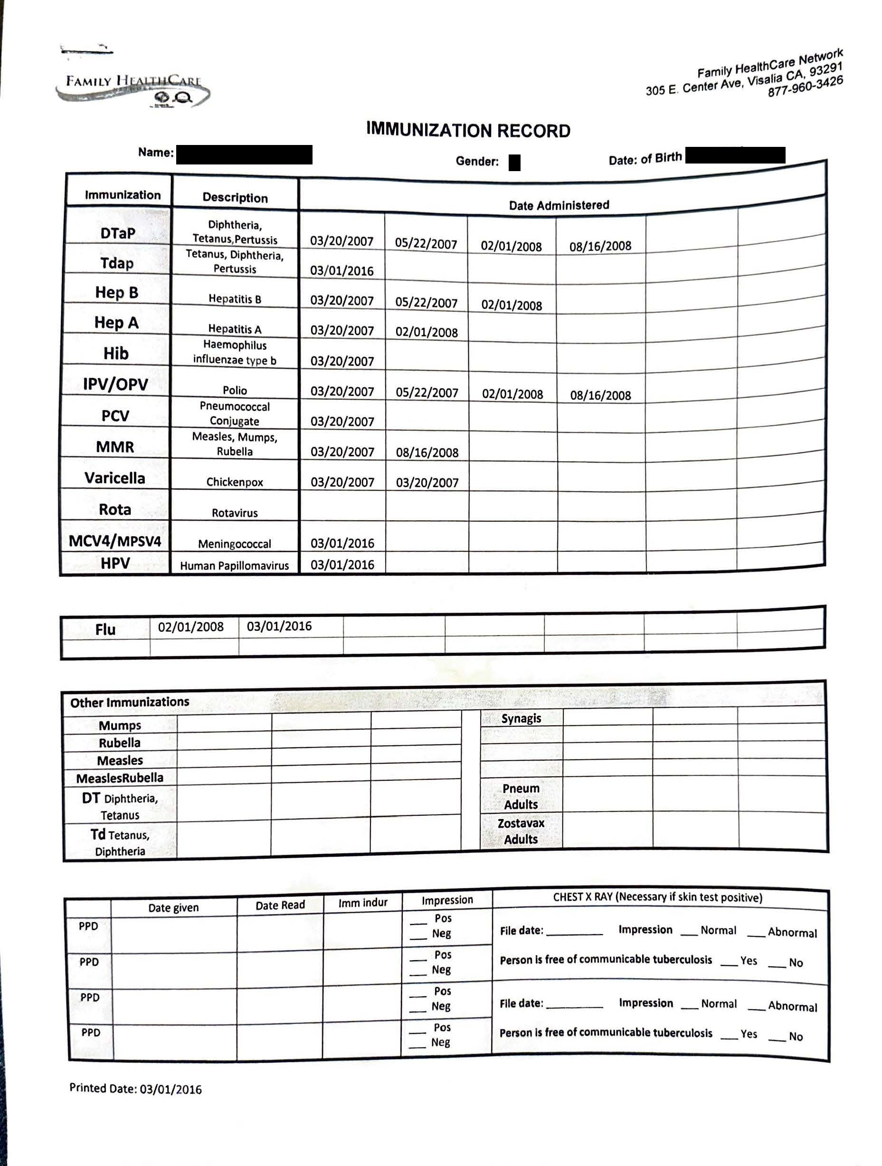
Immunization Record Example
Your Legal name listed
Provider/ Clinic Name
Vaccination listed with dates administrated.
The clinic verifies all listed information is accurate.
Upload document and tag document for vaccine entries.

Slide 7
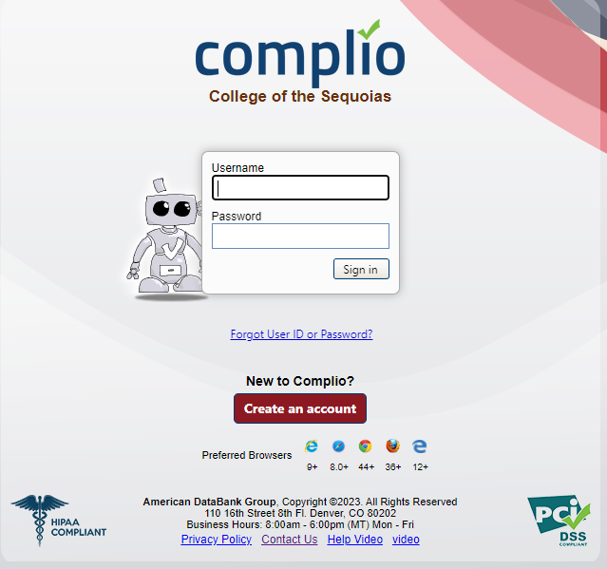
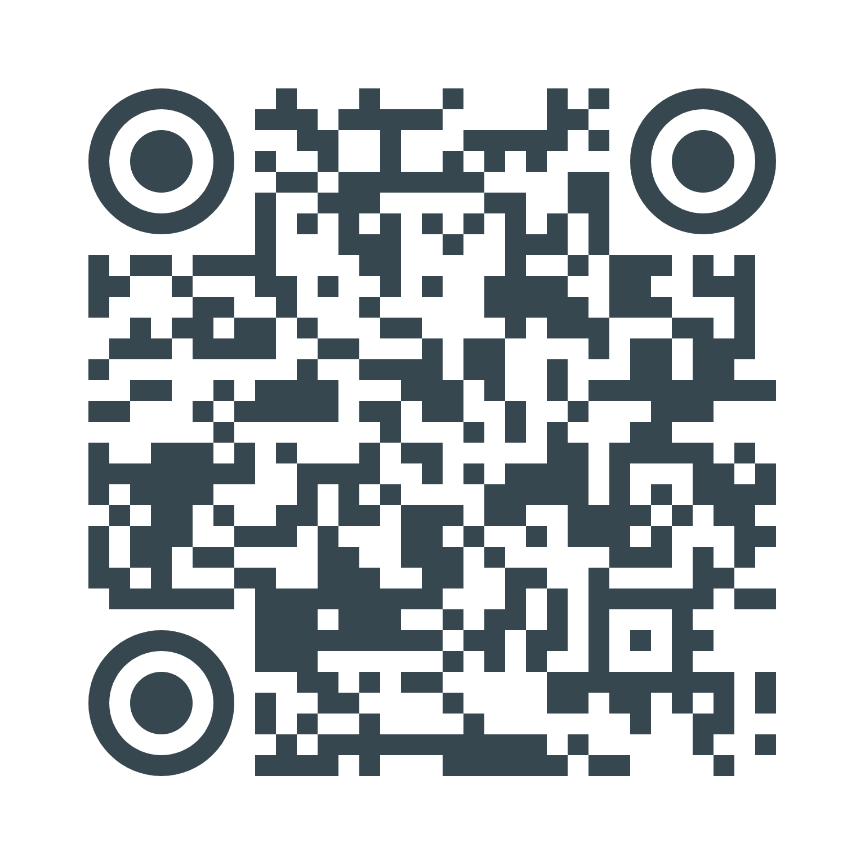
Complio Overview
Complio Overview Video
COS Complio Website:
https://cos.complio.com

Slide 8
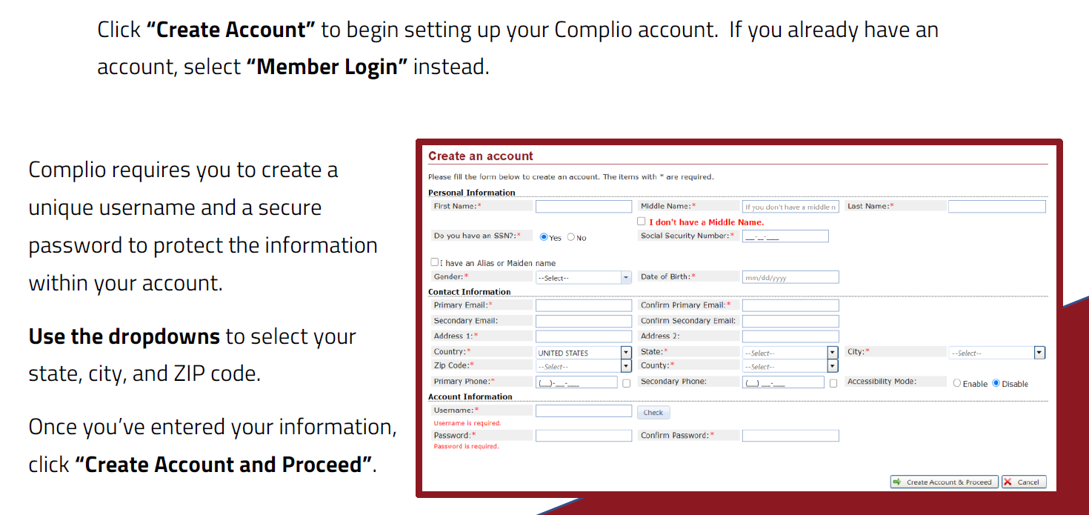
Creating a Complio Account
Use only your COS giant email when creating an account.
Make sure you have access to your giant email.
Make sure you spell your name correctly and enter your social security number correctly.
Do NOT use “!” as a special symbol at the beginning or end of your password. You will have trouble with logging-on

Slide 9
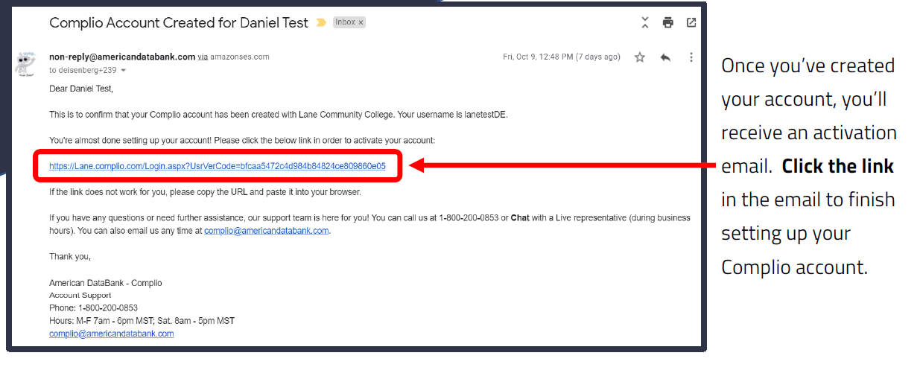
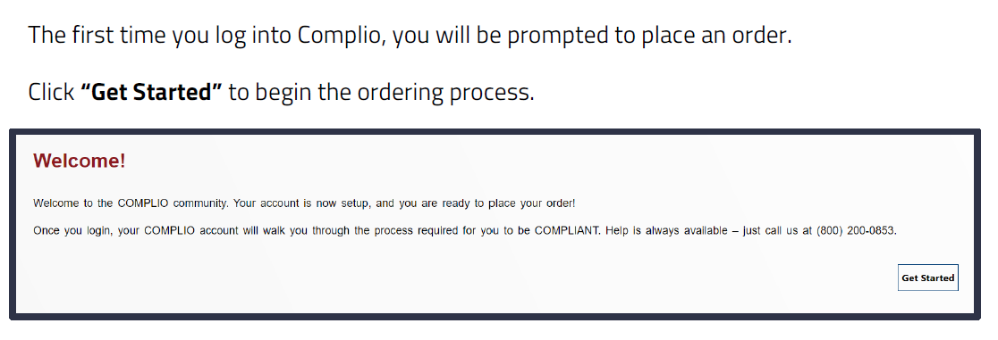
Activate your Complio Account
May need to check your spam folder
Email can take a few minutes to 24 hours to receive.
If you have NOT received it within the 4 hours, you’ll need to call American Databank customer service line.
Email: complio@americandatabank.com
Phone: 1-800-200-0853 or 1-303-573-1130
Once you activate your account, you’ll need to login with your Complio username and password. Trouble signing on: reset your password without a special symbol at the beginning or end of your password.

Slide 10
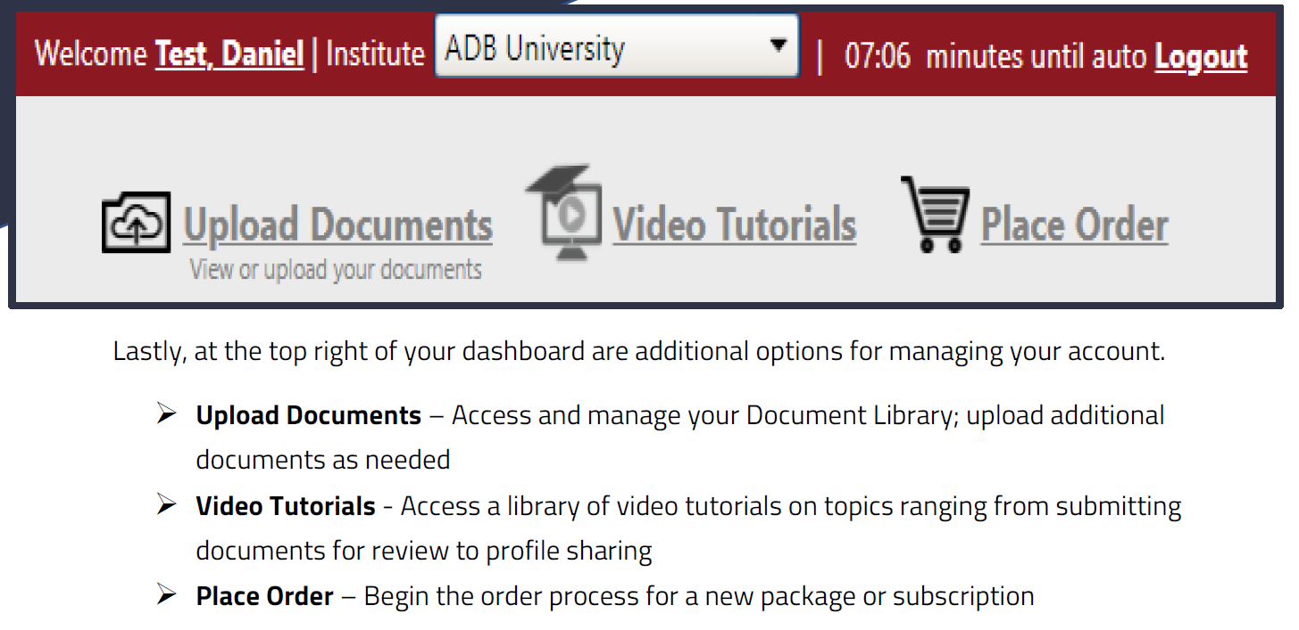
Complio Ordering, Uploading documents & Tutorials
Complio Document Upload Video
Complio Data Entry Video
Complio Titer Document Upload Video

Slide 11
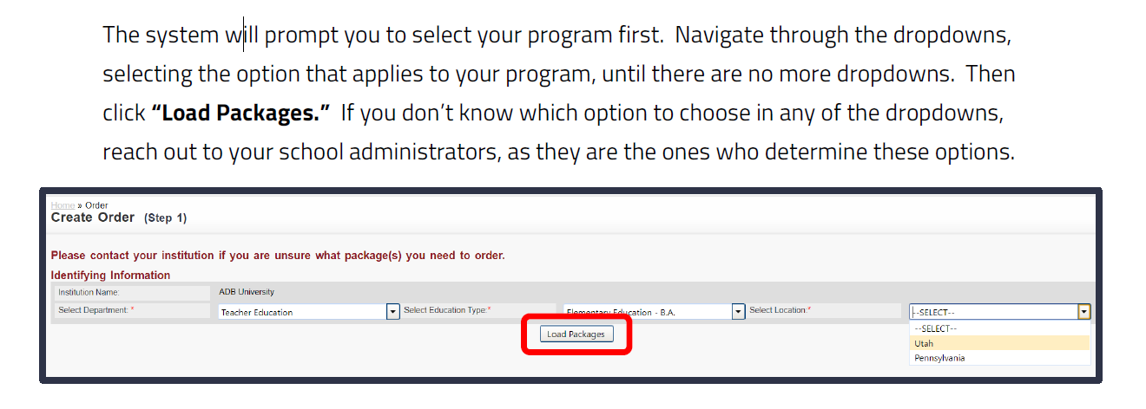
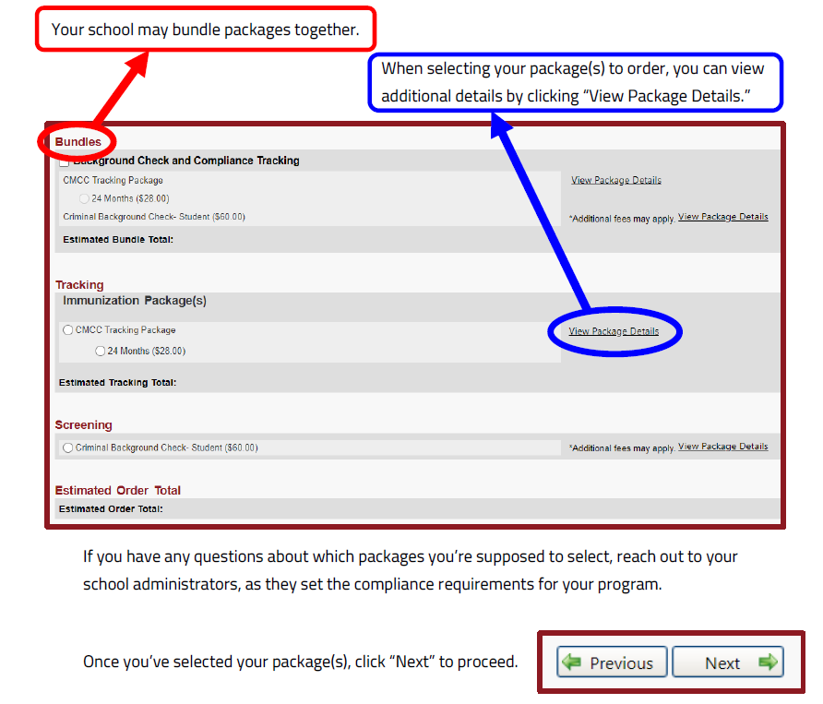
Complio Tracking Subscription
To upload your clinical requirement documents and for Complio to track the expiration dates.
Select your program
Click on your Tracking Package
Tracking Packages :
Pharmacy Technician Students-
15 months subscription $35.00
Complio Subscription Video

Slide 12
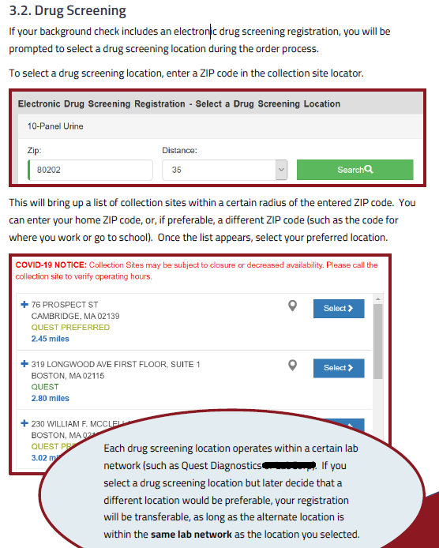
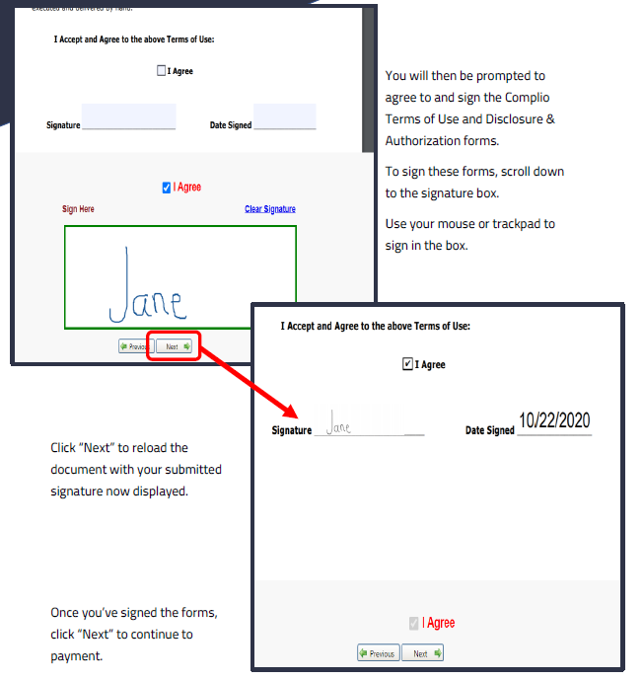
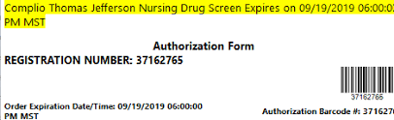
Complio Background & Drug Screen
Once you complete your order through Complio, you will be emailed your AUTHORIZATION FORM to your email registered with Complio. You will print or take your mobile device for scanning purposes to your Collection Site listed on your Authorization Form. You must complete your drug screen at the location on your Authorization form to this reduces that chance your results gets lost in the system. Once competed, you will be emailed a copy and so will the Nursing & Allied Health Office. Complio will automatically upload to your Complio account.
Troubleshooting:
Must show your Authorization Form
code for Check-in. You already Paid for
The drug screen, you will NOT need to pay
at your Collection Site.
Must complete Drug Screen before
the Expiration date on the Authorization
form.
Complio Additional Fees Video
Complio Signing Forms Video
Screening Packages for Allied Health Programs:
Background Screen & Drug Screen: $84.00
Drug Screen: $59.00

Slide 13
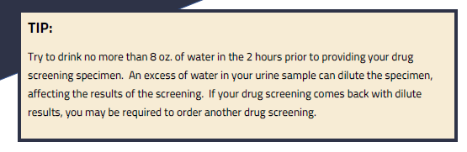
Drug Screen
Note: Drug Screen Retake cost $59.00.
Reasons for Drug Screen Retakes:
Diluted Sample
Authorization Form Expired
Unable to produce a Sample
Positive for substance use.

Slide 14
Flagged Results
Background Flagged Results:
Must meet with your program director/ externship coordinator to discussion results and further steps.
Note: Possibly not able to continue in the program.
Must have a cleared criminal background report for clinical placement.
Drug Flagged Results:
Meet with your program director/ externship coordinator to discussion results and further steps.
Re-order & re-take the Drug Screen.
Wait for the substance in your system to leave your system, then re-take. Be mindful of your clinical deadline!
Must have a cleared drug screen for clinical placement.

Slide 15
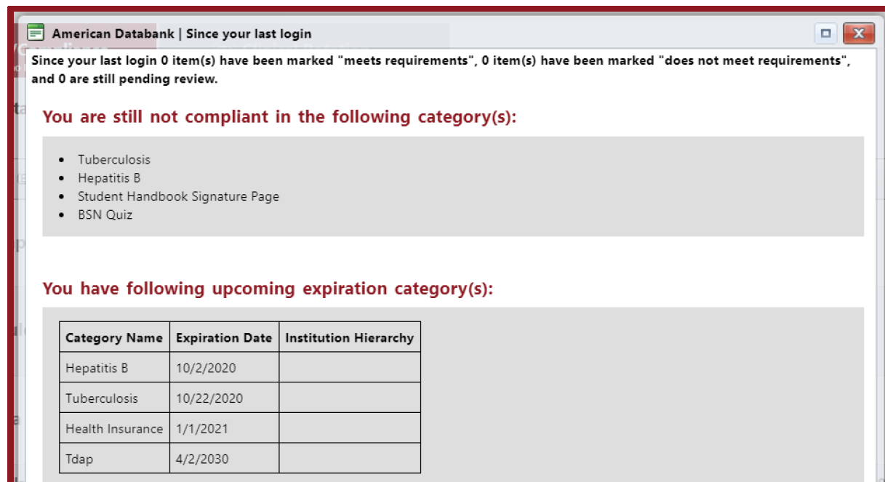
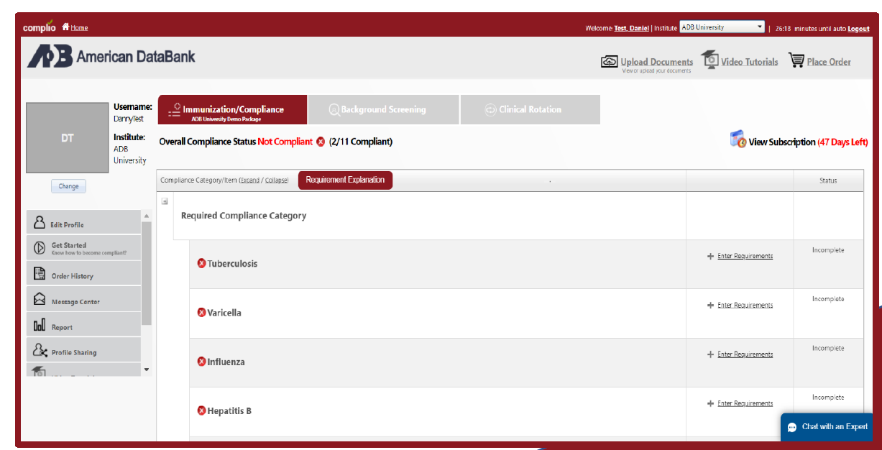
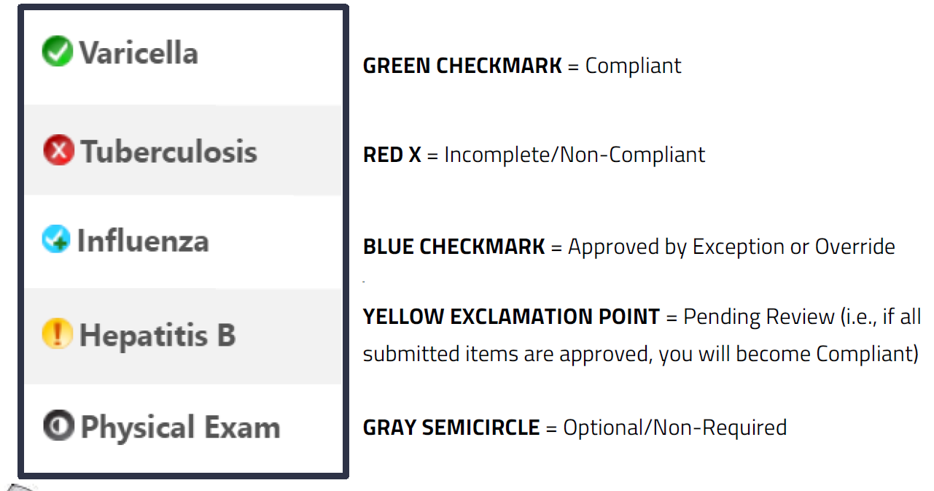
Complio Dashboard
Complio sends you an email notifications whenever there is a change to your compliance status, whenever a submission is rejected, or whenever items are set to expire soon.

Slide 16
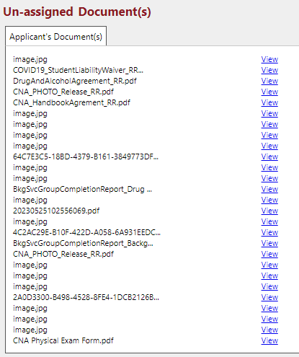
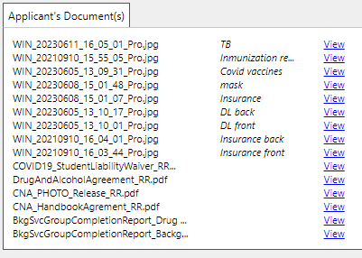
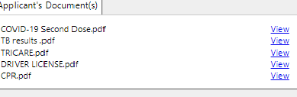
Naming Documents

Slide 17

MMR Clinical Requirements Notes
MMR: Measles, Mumps, Rubella (2 Doses)
Dose 1 and 2 are 4 weeks apart.
Immunization Record:
Complio MMR Entries:
Measles Dose 1: 1/22/2003
Measles Dose 2: 4/18/2006
Mumps Dose 1: 1/22/2003
Mumps Dose 2: 4/18/2006
Same Provider/Clinic and same document.
Rubella Dose 1: 1/22/2003
Rubella Dose 2: 4/18/2006
MMR Titer: 1 report
Complio MMR Titer Entries: 3
Measles Titer
Mumps Titer
Rubella Titer
Titer Results must be Positive
Equivocal or Negative will require booster doses.
Same Provider/ Clinic and same document

Slide 18
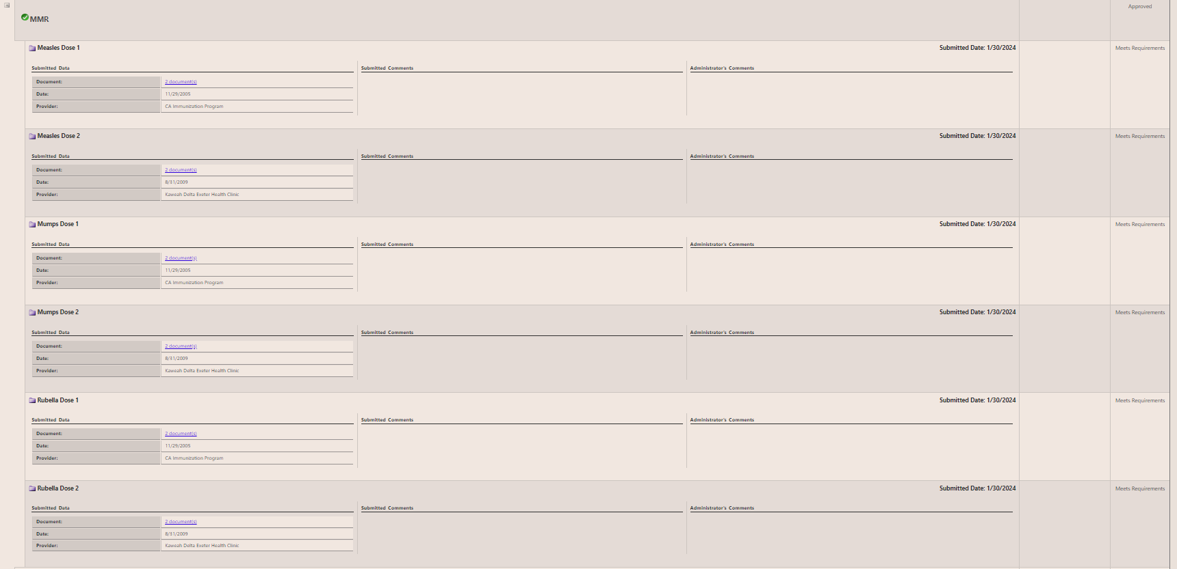
Complio MMR Example

Slide 19

Hepatitis B Clinical Requirements Notes
Hepatitis B: 3 dose Series.
Dose 1 and 2 are 4 weeks apart.
Dose 2 and 3 are 5 months apart.
Immunization Record:
Hepatitis B Titer(HbsAb):
1 report & 1 upload entry.
Titer Results must be Positive
Equivocal or Negative will require booster doses.
Complio Hep B Entries:
Hepatitis B Series – 1st: 2/11/2005
Hepatitis B Series – 2nd : 6/8/2005
Hepatitis B Series – 3rd : 3/27/2006
Same Provider/Clinic and same document.

Slide 20

Varicella Clinical Requirements Notes
Varicella (Chickenpox) Vaccine: 2 doses
Dose 1 and 2 are 4 weeks apart.
Immunization Record:
Varicella Titer
1 report & 1 upload entry.
Titer Results must be Positive
Equivocal or Negative will require booster doses.
If you had chickenpox has a child, you need to do a Titer.
Complio Varicella Entries:
Varicella Dose 1: 12/27/2005
Varicella Dose 2: 6/8/2005
Same Provider/Clinic and same document.

Slide 21
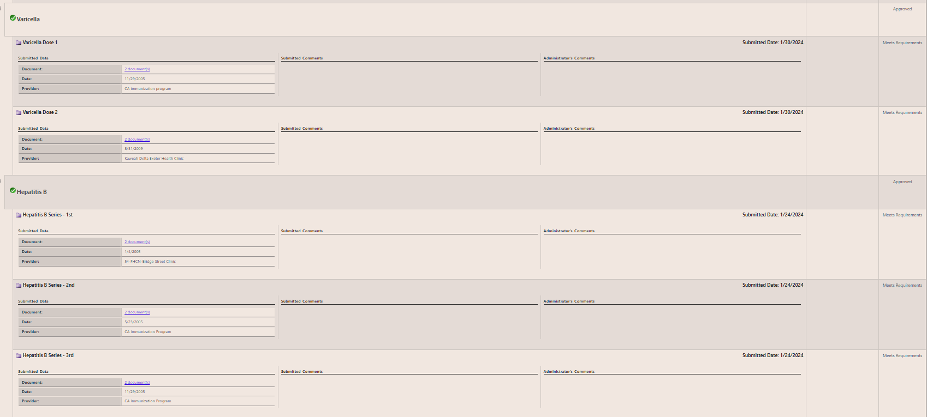
Complio Varicella & Hepatitis B Example

Slide 22
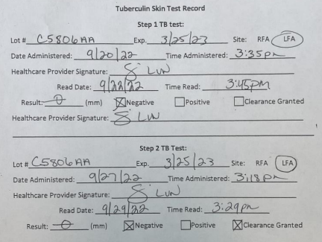
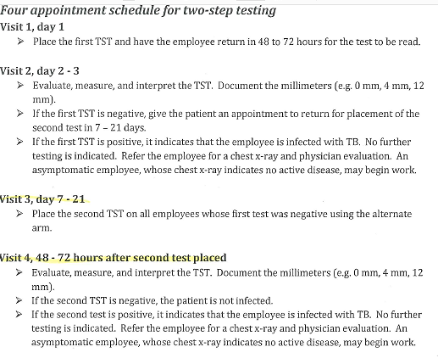
Tuberculosis (TB)
Two-Step.
Option 1
Your 2nd PPD mut be given 1 to 3 weeks after your 1st PPD.
Two-Step TB Complio Upload:
Healthcare setting? No
PPD 1st: 9/22/2022
PPD 2nd: 9/29/2022
Clinic/ Provider: COS Health Center
Same Document for both entries.

Slide 23
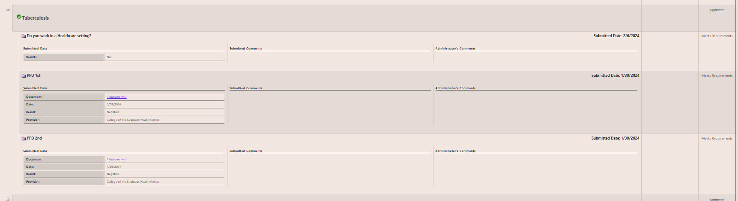
Complio Tuberculosis Two-Step Example

Slide 24
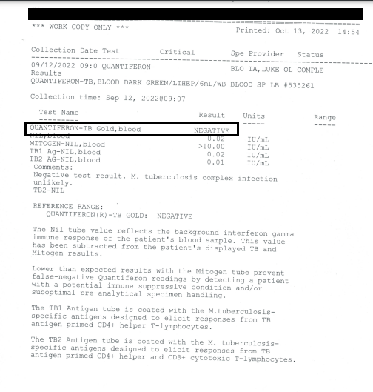
Tuberculosis (TB)
Quantiferon TB Gold Test (Bloodwork)
Option 2
Quantiferon TB Gold Test Complio Upload:
Healthcare setting? No
Results Must be Negative.

Slide 25
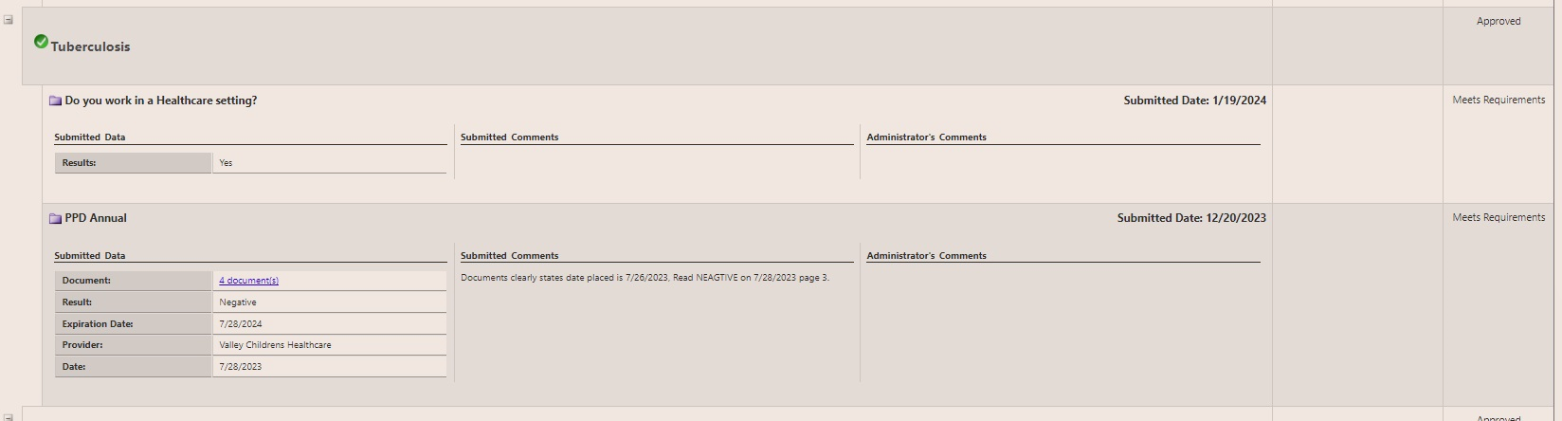
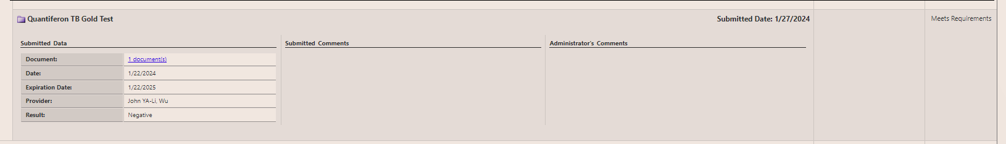
Complio QuantiFERON TB Gold Test Example

Slide 26
Tuberculosis (TB) Annual
Annual TB Complio Upload:
Healthcare setting? Yes
PPD Annual: 9/22/2022
Clinic/ Provider: COS Health Center
If you work in a healthcare setting prior to program entry.
2nd year of program.

Slide 27
Complio Tuberculosis (TB) Annual Example

Slide 28
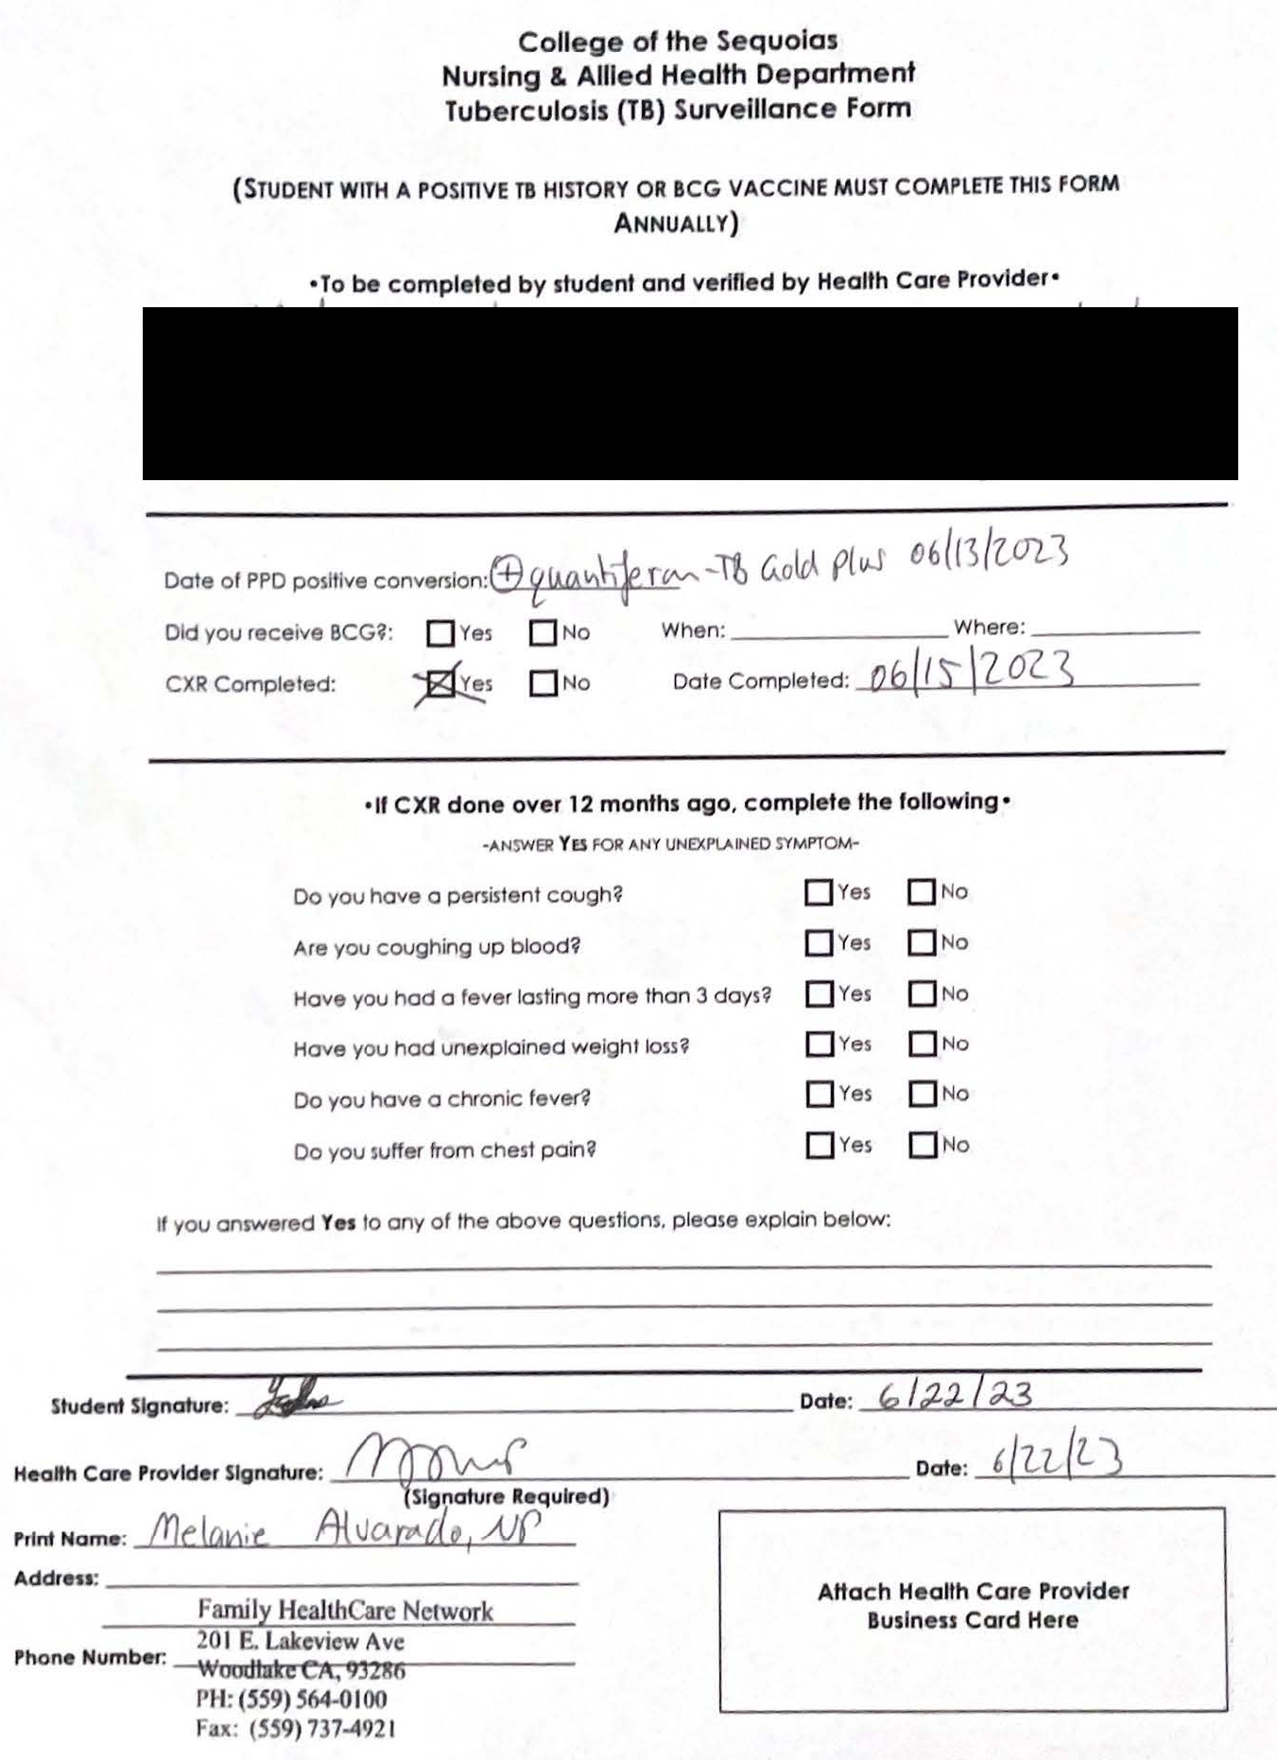
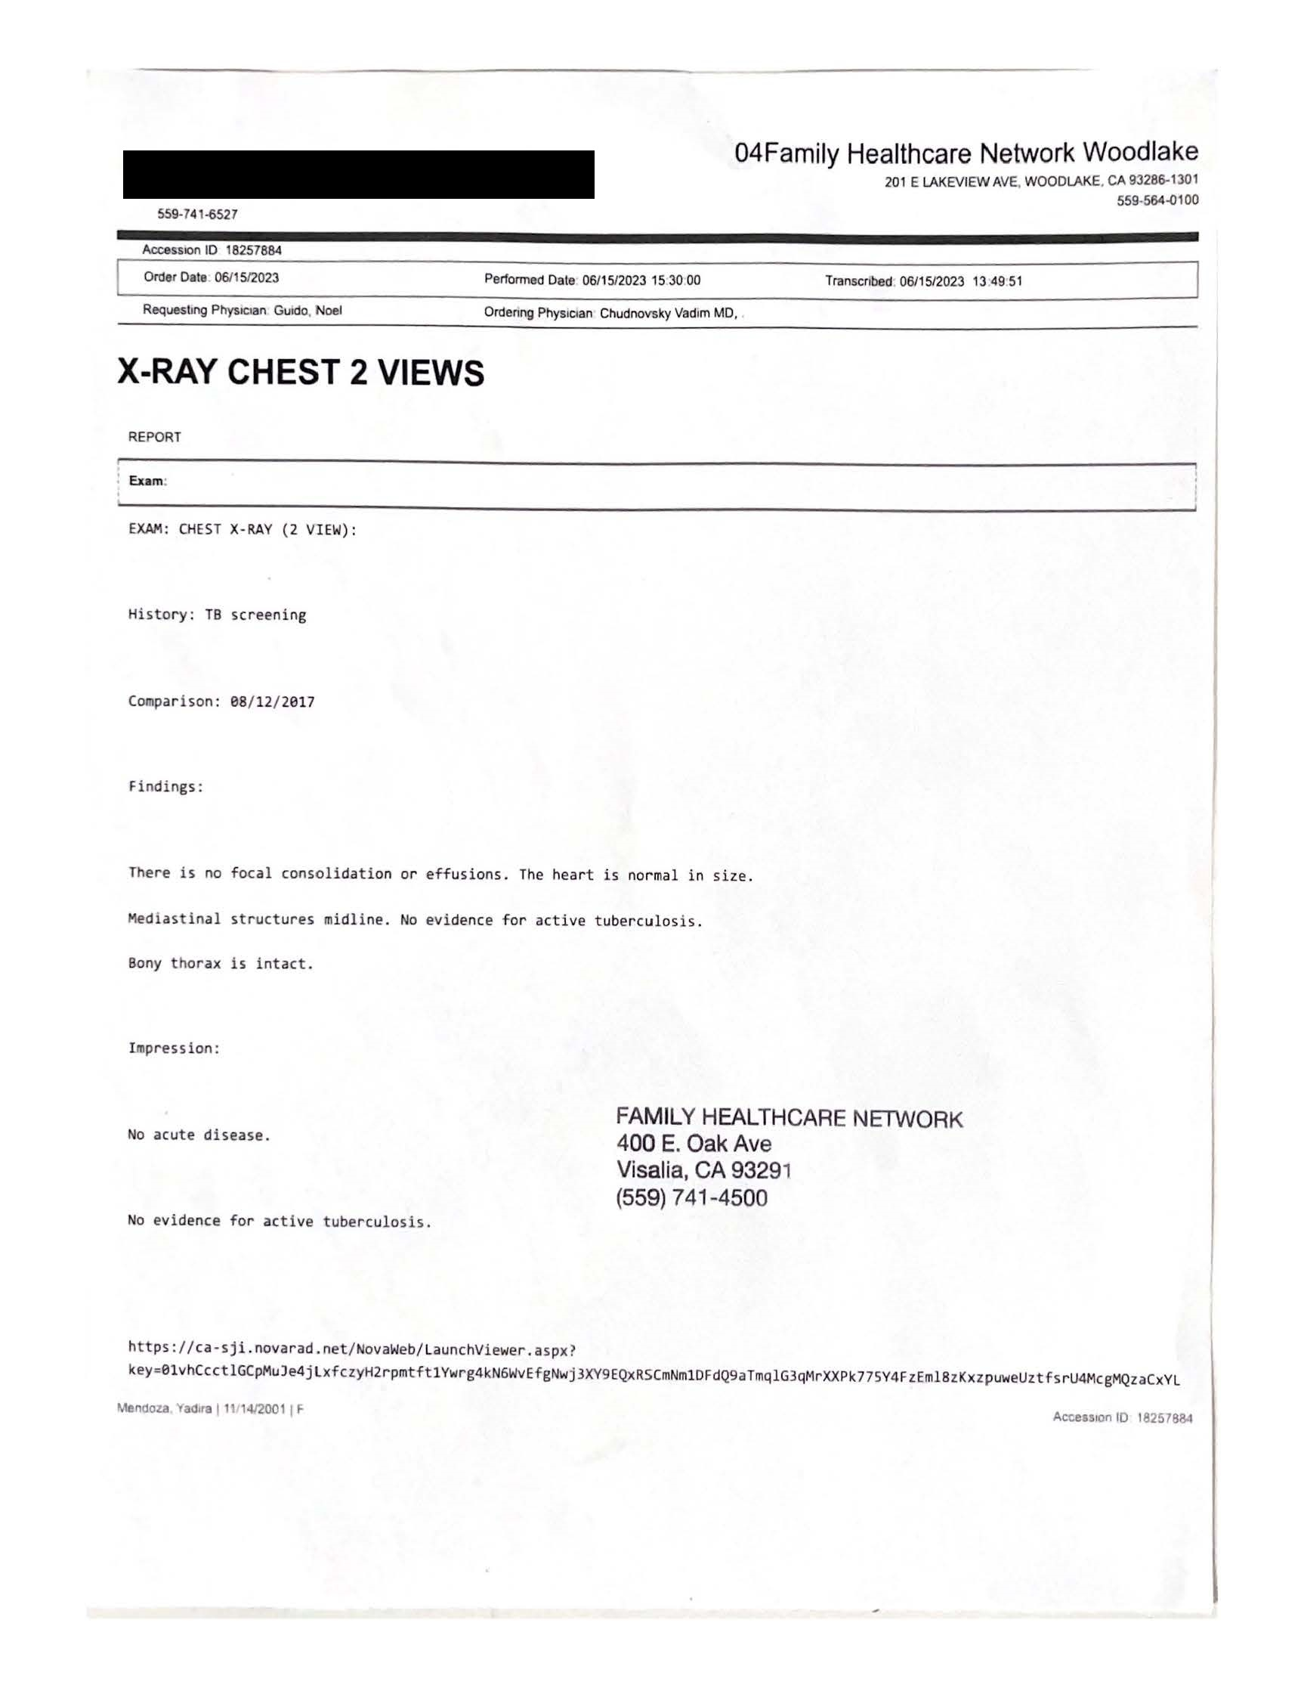
Tuberculosis Positive Results
Complio: both forms must be upload to complete the TB requirement.
Chest X-Ray : Results Must be Negative. Receive from your healthcare provider.
TB Screening Form: Nursing & Allied Health TB Surveillance Form (get from Nursing & Allied Health Administrative Assistant, Angela Iniguez.

Slide 29
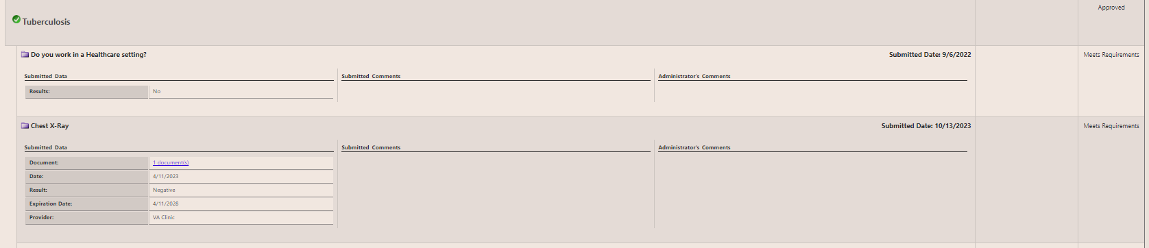

Complio Tuberculosis Positive Example

Slide 30
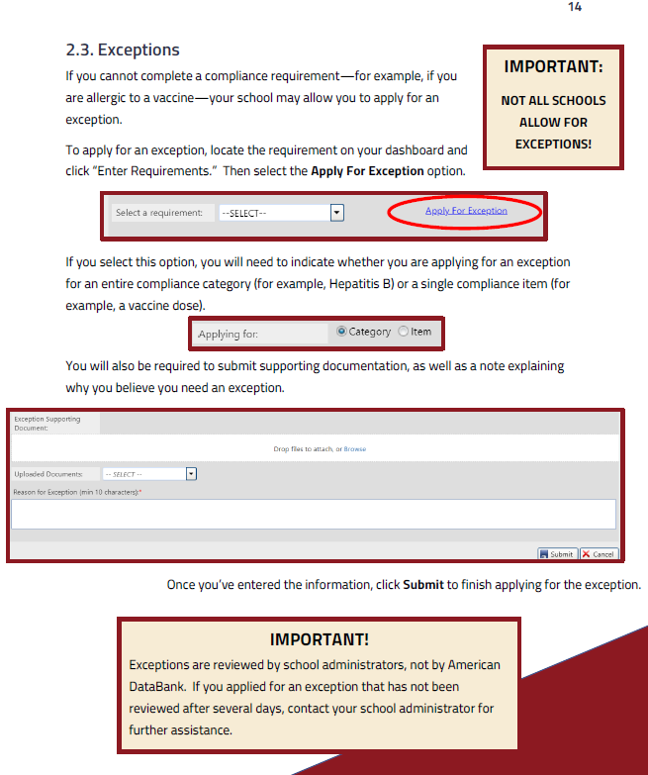
Complio Exceptions
Before you Apply for Exception on Complio the following MUST be completed first:
Email your externship instructor, also CC Allied Health Administrative Assistant.
Email response from externship instructor approving exception request with expiration date. Allied Health Administrative Assistant must be cc’d on email.
Submit your Apply for Exception through Complio include screenshot of email approval with request. Email Administrative Assistant, you submitted your exception.
If the following procedure is not followed and automatic denial will be given until the procedure is followed.

Slide 31
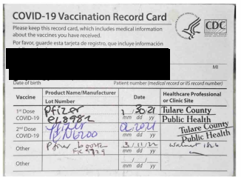
COVID-19 Clinical Requirements Notes
COVID-19 Vaccine: 2 doses & a booster
Dose 1 and 2 are 3 weeks apart.
Dose 2 and booster are 5 months
apart.
2024: only Bivalent vaccine 1 dose for
5-6 months is available on the market.
COVID-19 Exemptions are NOT Accepted.
If you have questions or concerns, please talk to your program director.
Complio COVID-19 Entries:
COVID-19 Vaccine Dose 1 of 2: 1/30/2021
COVID-19 Vaccine Dose 2 of 2: 2/20/2021
COVID-19 Booster: 3/11/2022
May be more than 1 document, provider/clinic.

Slide 32
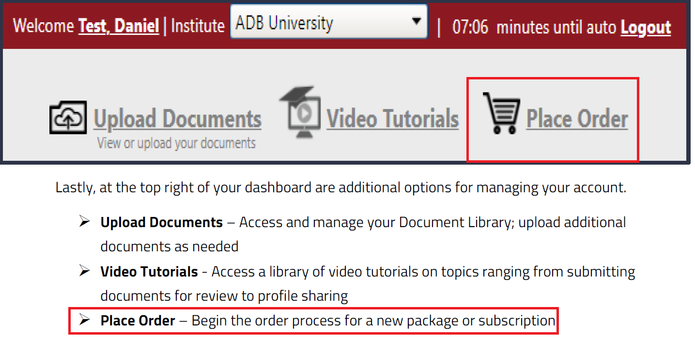
Renew your Complio Subscription
Complio Renew Subscriptions Video
Place Order
Select Your Program
Select Tracking Package for your program.
Enter the months needed to extend your subscription.

Slide 33
Complio Help Appointment with Angela
Must email, call, or text to schedule an appointment with me prior to visiting me in person.
Must have all requirement documentation prior to requesting to schedule an appointment, this save you and me time. ☺
Schedule your appointment online:
As the Nursing & Allied Administrative Assistant:
I support the following programs: (125)
PTA program (56)
Pharmacy Technician Program (24)
C.NA Program (45)
EMT Program
HLTH 405 (Rehab Aide) /406 (AHA BLS CPR) Classes
Allied Health Division
Angela Iniguez
559-737-6135 (call or text)
angelai@cos.edu
Not Tech Savvy?
Confused on how to upload?
Don’t have access to scanner, laptop or desktop?
Don’t know where to start in submitting your documents?
Got an email that your submission rejection? Forward rejection email either via text or email. I will review and respond once complete.

Slide 34
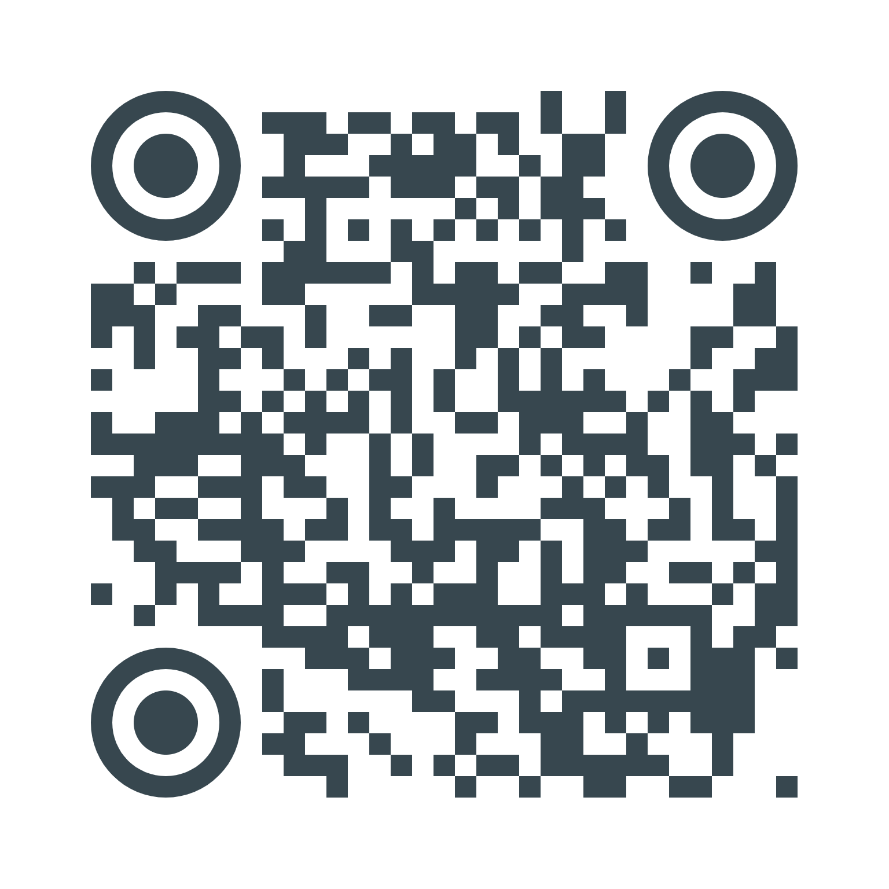
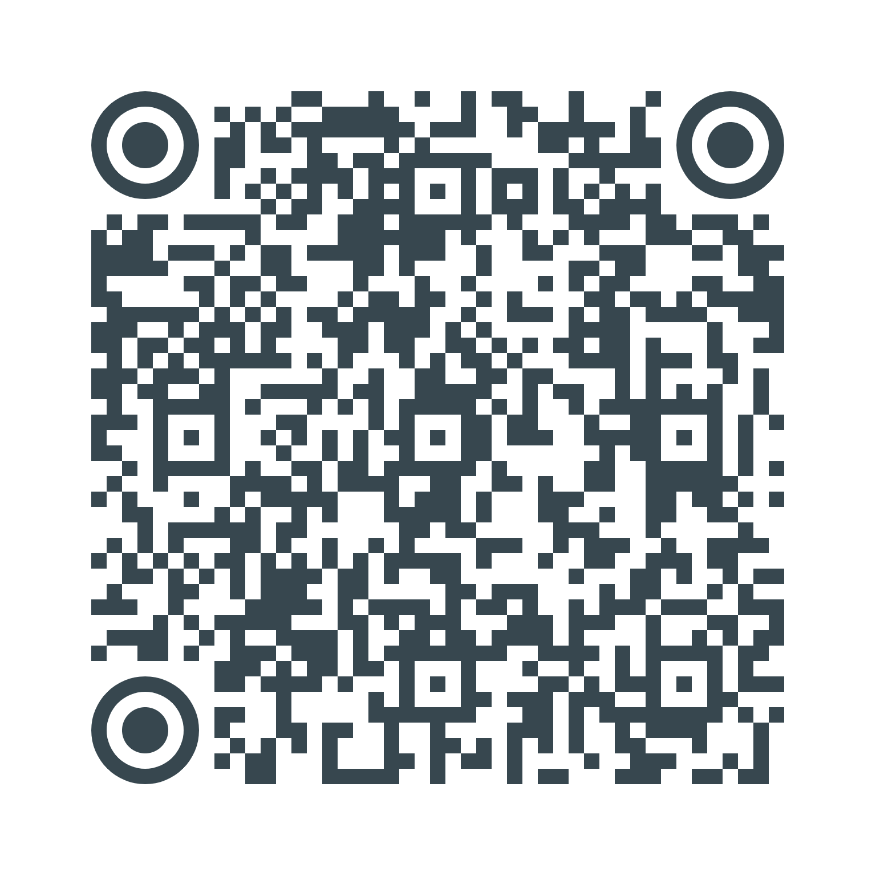
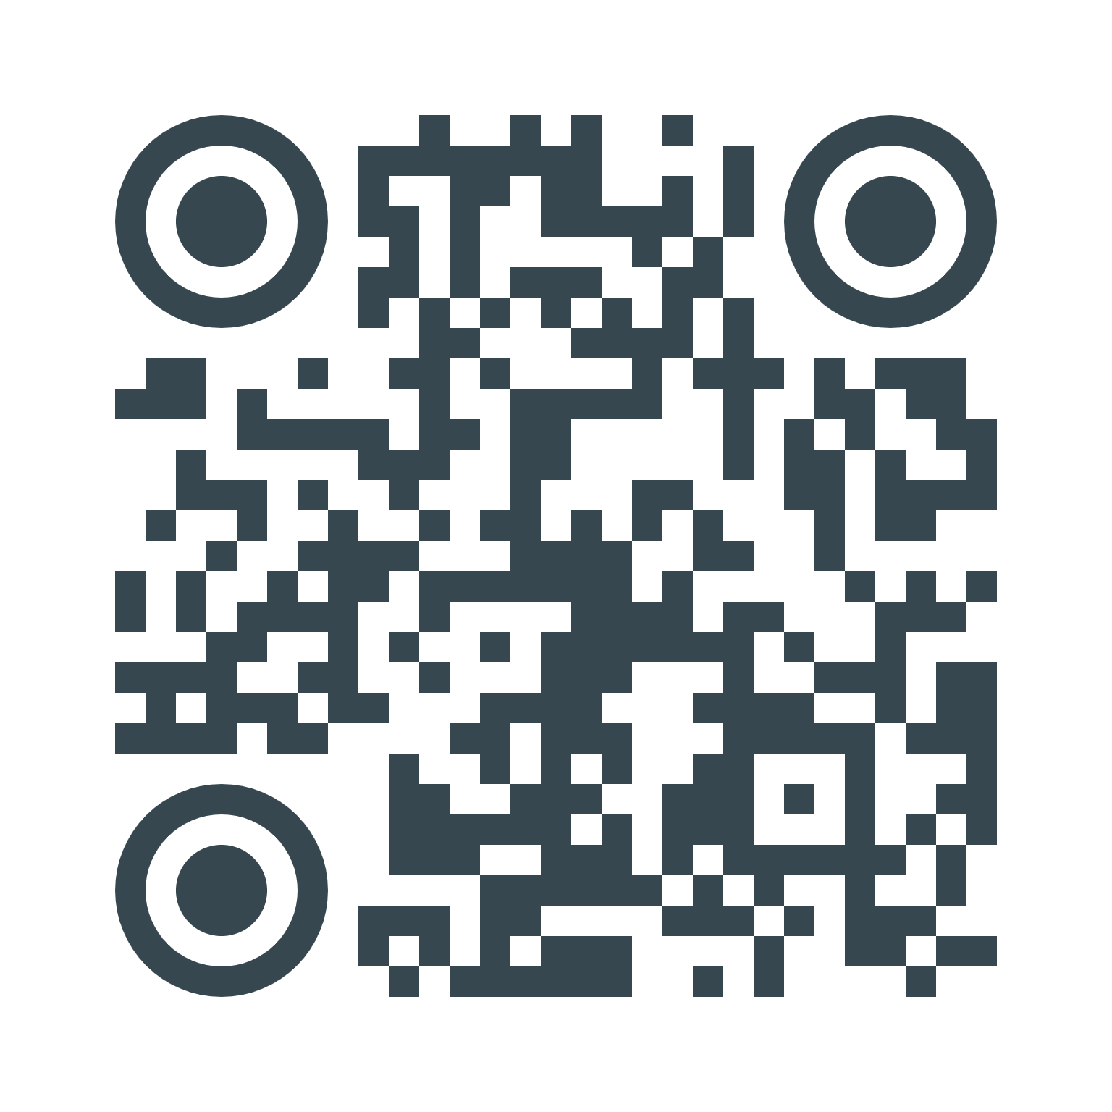
Post Program Resources
GED Transcripts:
High School Transcripts:
Self Query Order:

