Slide 1



Hiring Committee Equivalency Guide
The Process at College of the Sequoias

Slide 2
Slideshow Section Menu
If you are new to the equivalency process, please scroll through this entire slideshow. You can skip to specific sections through the links below.
Overview of the Process
Web Documents and Forms
Hiring Committee Specifics
Applicant Forms and Instructions
For questions about how the Equivalency process works or if there is confusion about any of the forms or instructions, please reach out to the Equivalency Committee Chair. The Chair is listed on the Equivalency Committee website: COS Home > About Us > Governance > Academic Senate > Equivalency.

Slide 3
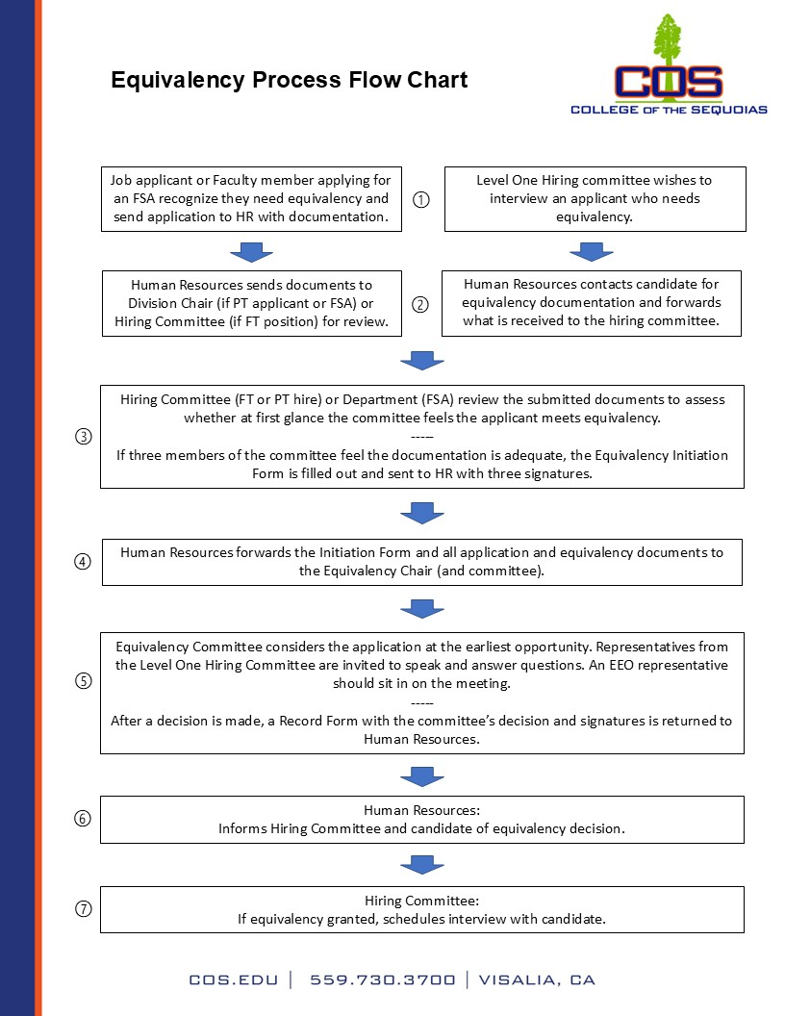
Overview of the Process
For most job applicants, the process begins when a hiring committee wishes to interview an applicant for a position but determines the applicant’s qualifications do not match minimum qualifications as defined by the Chancellor’s Office of the California Community Colleges. Some applicants may have sent in equivalency documentation with their application.
If the applicant has not already submitted documentation, the hiring committee must ask HR to reach out to the candidate requesting they submit the documentation asserting their qualifications are equivalent to the minimum. The relevant documents can be found at COS Home > About Us > Human Resources > Equivalency.
The hiring committee should review the documents submitted, decide whether they feel the candidate meets equivalency at first glance, then complete an Equivalency Initiation Form and send it to Human Resources (HR).
Upon receipt, HR will forward the documents to the Equivalency Committee for consideration, which will report its decision back to HR. If equivalency is granted, the hiring committee may interview the applicant.
The grant of equivalency is not a guarantee of hire and before the applicant can be hired, their equivalency must be also be recognized by the COS Board of Trustees (Education Code §87359a).

Slide 4
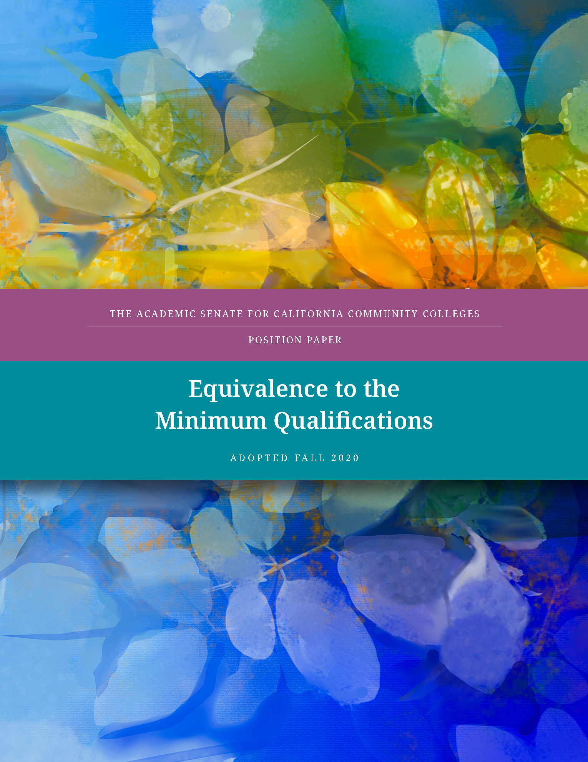
Additional Considerations
Education Code §87359 (a), as quoted in the Academic Senate for California Community Colleges (ASCCC) 2020 position paper, reads, “No one may be hired to serve as a community college faculty… unless the governing board determines that he or she possesses qualifications that are at least equivalent to the minimum qualifications specified” (italics added). This definition is the basis for the process.
The ASCCC adds as guidance that an “applicant should be expected to provide evidence of equivalent preparation that is as reliable and objective as a transcript… Evaluating experience depends on the candidate’s ability to provide objective, detailed information from sources other than the candidate’s statements about what exactly the candidate did.”
COS AP 7211 notes that the District does not accept equivalency granted by another institution and that foreign degree equivalency must be determined by a credentials evaluation service through HR.

Slide 5
Principles
The ASCCC “believes that faculty members must exemplify to their students the value of an education that is both well-rounded and specialized” and lists the following principles among others:
Equivalency promotes diversity by broadening the applicant pool.
Equivalent to the minimum qualifications means equal to the minimum qualifications, not nearly equal.
Applicants must provide evidence that they have attained the breadth of coursework or experience equal to the general education component of an earned associate’s or bachelor’s degree.
Applicants must provide evidence demonstrating attainment of the skills and knowledge provided by specialized coursework required for the degree listed in the Disciplines List.
Faculty members exemplify to their students the value of an education that is both well-rounded and specialized and has consistently defined degree parameters. Faculty should act as models for students by demonstrating a breadth of general education knowledge consistent with a Bachelor’s degree (for Master’s equivalency) or an Associate’s degree (for Non-Master’s equivalency) and a depth of knowledge that is discipline specific.
Eminence should not be used as the sole criteria for granting equivalence (ASCCC Resolution 10.01 SP09).
No provisional or conditional equivalency should exist.

Slide 6
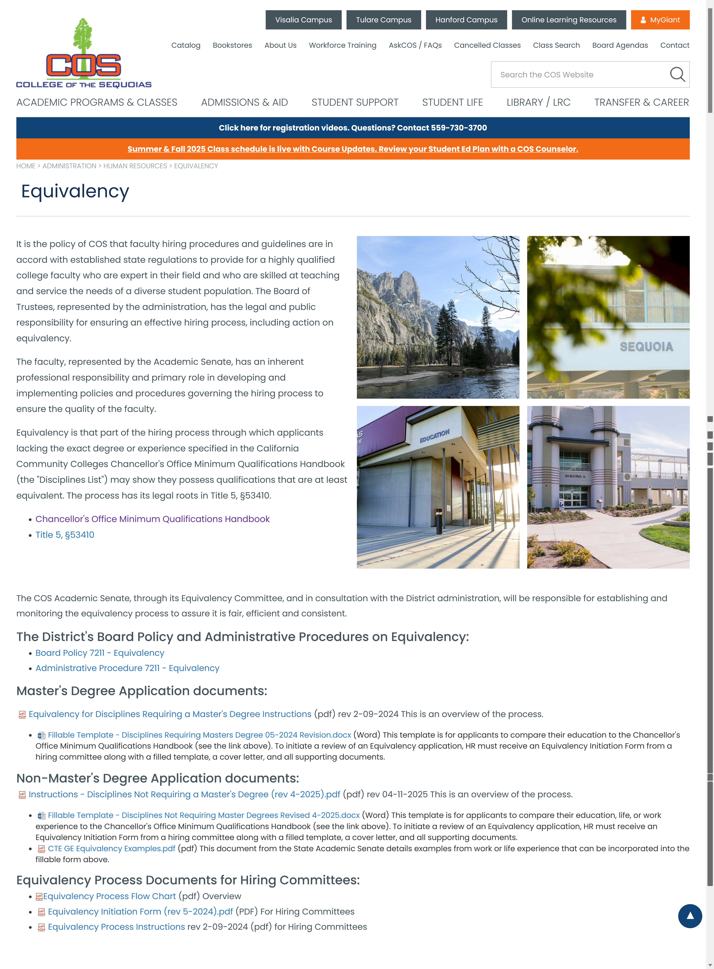
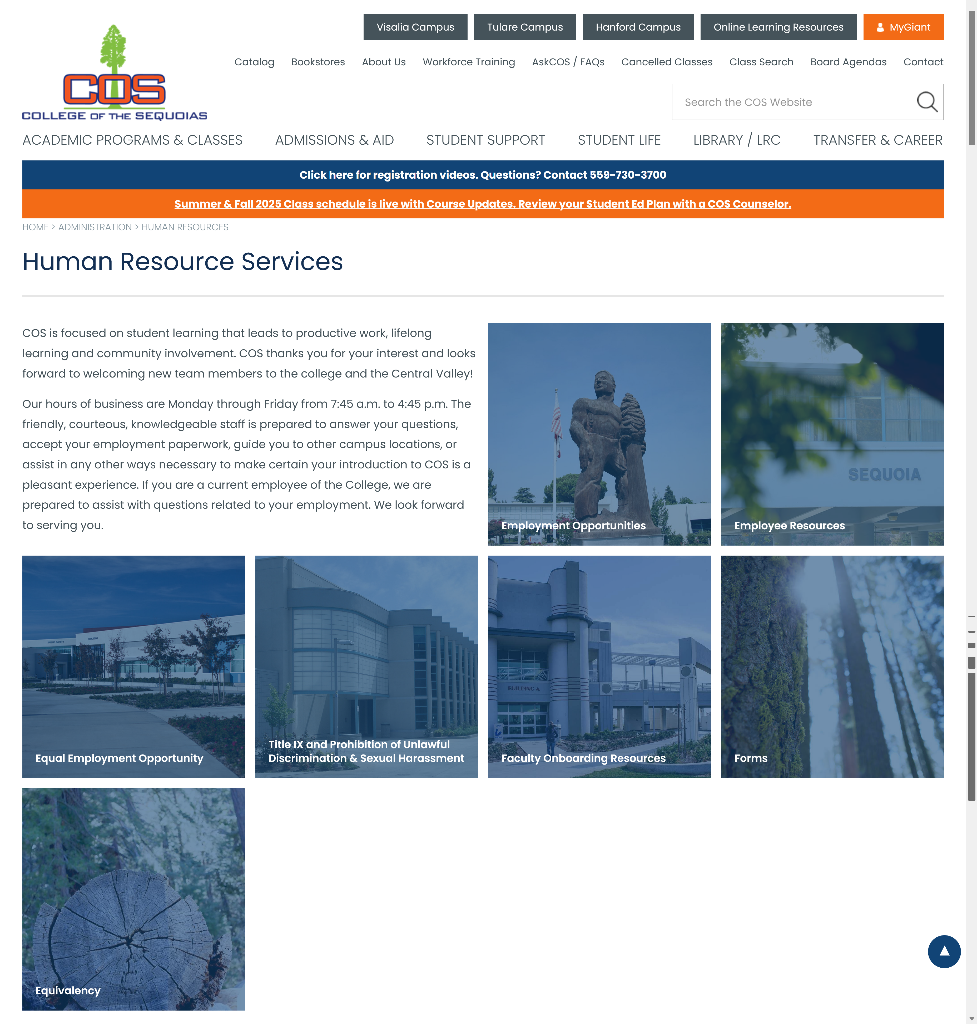
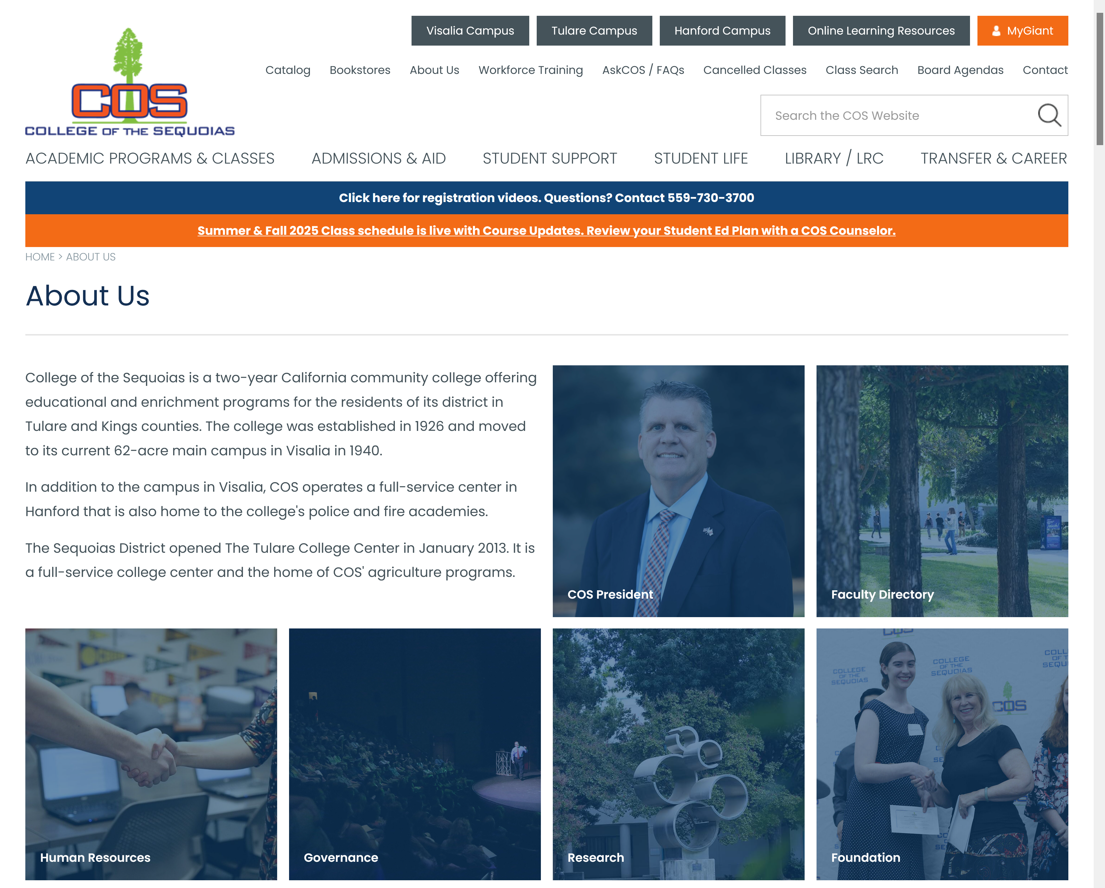
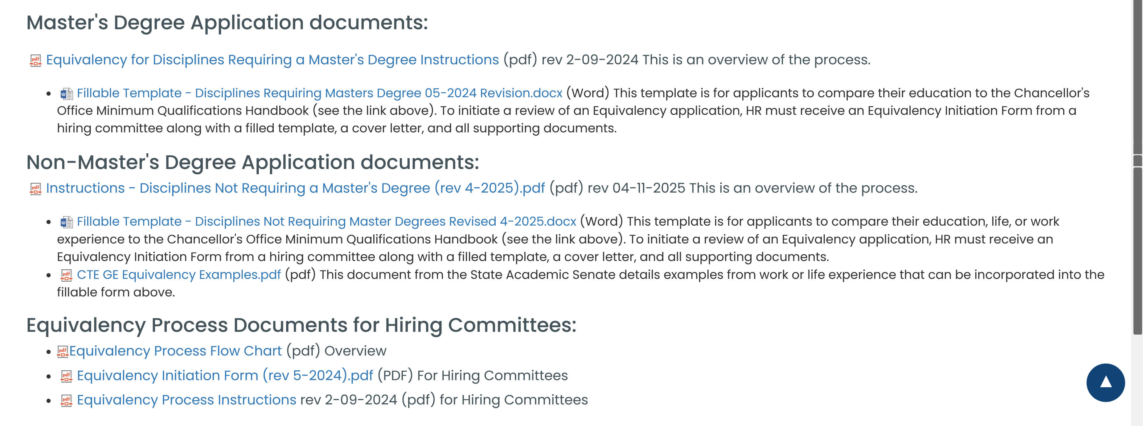
Documents for Equivalency
Navigate to the Human Resources Equivalency Page:
On the COS Home Page, click About Us
Click on the Human Resources link
Click the Equivalency link
Scroll to the bottom of the page
The application documents are different for Master’s degree equivalency and Non-Master’s equivalency.
Hiring Committee documents and instructions are at the very bottom
Click to the next slide for more detail

Slide 7
Instructions and Forms
The image below illustrates the options available to applicants and hiring committees. Download the instructions for Hiring Committees and the fillable form that will need to be returned to Human Resources.

Slide 8
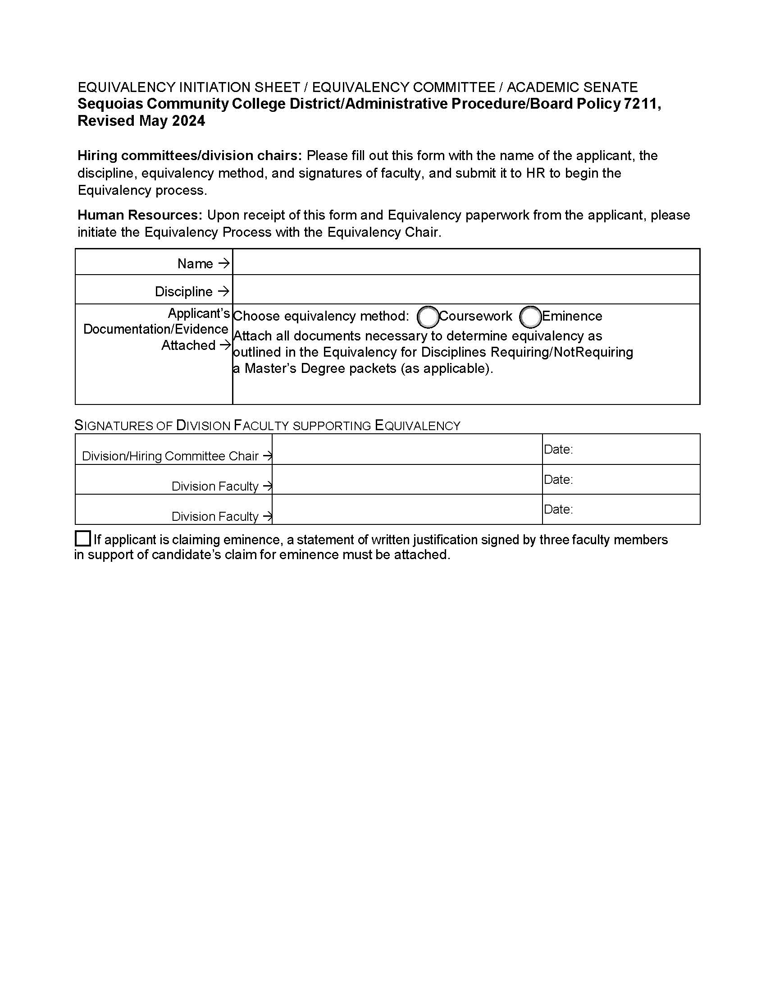
Hiring Committee Fillable Form
The Level One Hiring Committee must review the equivalency documents an applicant has submitted before filling out this form. Make sure all applicable boxes are filled out.
The document requires three signatures from hiring committee faculty attesting they believe the applicant meets equivalency.
If the applicant is claiming eminence in a field, there are special requirements listed in AP 7211 to consider and the hiring committee must submit a written justification in support.
Eminence alone is not enough to meet equivalency: the applicant must also have the breadth of general education knowledge consistent with a Bachelor’s degree (for Master’s equivalency) or an Associate’s degree (for Non-Master’s equivalency).
If the hiring committee is satisfied the candidate meets equivalency, the form should be sent to HR asap.

Slide 9
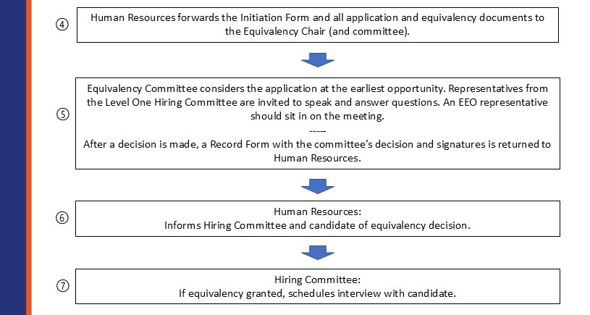
Moving Things Along
To manage this all in a reasonable timeline, get the Initiation Form in to an HR representative ASAP.
As soon as there is agreement among hiring committee faculty, send in the form.
The Equivalency Committee will meet within two weeks of receiving the documentation from HR but can attempt to meet sooner if necessary. No interview can be scheduled until there is an outcome.

Slide 10
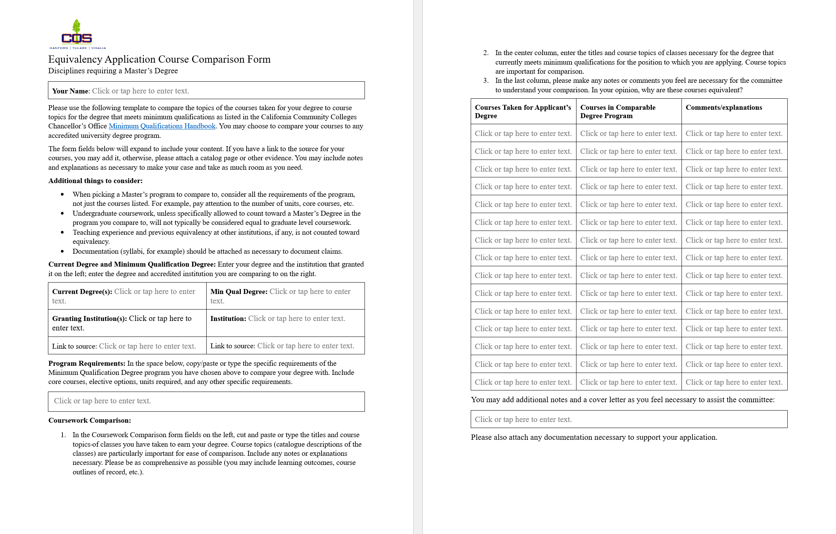
Applicant Forms
In both the Master’s and Non-Master’s forms, the form fields will expand to include all the information entered. Use these forms to compare your credentials to the minimum qualifying credentials from another institution (or to work experience for non-Master’s applicants).
The next slides have detailed instructions. The links below will take you directly to the relevant section:
Master’s Equivalency
Non-Master’s Equivalency

Slide 11
The Master’s Form Page 1
Some aspects of this form should be self-explanatory and are not addressed here, but some important items will be highlighted in this slideshow.
By “Current Degree” this form asks that you fill in the degree (or degrees) you actually have. “Granting Institution” is where your degree(s) came from and a link to the program is desirable.
“Min Qual Degree” is the degree or degrees you will be comparing your education to. You may choose to compare your education to the minimum qualifying degree from any accredited institution of higher education. “Institution” is where you have chosen to compare and a link to the program is desired.
“Program Requirements” is a form field in which all the requirements for the minimum qualifying program(s) you have chosen to compare to can be listed. You should note “core” courses, whether electives allow for undergraduate coursework, and any other specifics.
The committee is not bothered by long entries and in fact would prefer to have too much information than not enough.

Slide 12
The Master’s Form Page 2
The rest of the form is where the actual comparison takes place.
In the first column, you are asked to list all the courses you took for the degree conferred upon you. Don’t just list titles, include the units achieved, a detailed summary of topics, and any context from the course to aid your comparison.
The second column is where you will enter the courses for the program you have chosen to compare to. In the row next to your course, enter a course from the minimum qualifying institution that you feel it compares to. Again, include as much detail as possible, including units, course topics, context, etc.
The third column allows you to add any additional information you think applies to this course comparison that may not be obvious from the first two columns.
Some courses may not compare and it is okay to have extra entries in some rows of the first column. What is important is that all entries in the second column do compare to entries in the first column.

Slide 13
Finishing the Master’s Form
Continue through the form until you have listed all the required courses for the program you are comparing to (and their comparisons).
Because no form is perfect, there is room at the end of the form for any additional comparisons, information, context, and detail that you feel will help the committee make a favorable decision.
Important note: the committee must have physical evidence of all claims made in the form about units, courses, course topics, context, etc. This can include, but is not limited to transcripts, course syllabi, letters from professors or administrators, web links to information, and other documentation.
Make sure these documents are provided to COS HR and wherever possible include an identifying statement that coincides with a particular claim made in the form so the committee can easily recognize it.
---------------------------------------------
Return to the Menu page

Slide 14
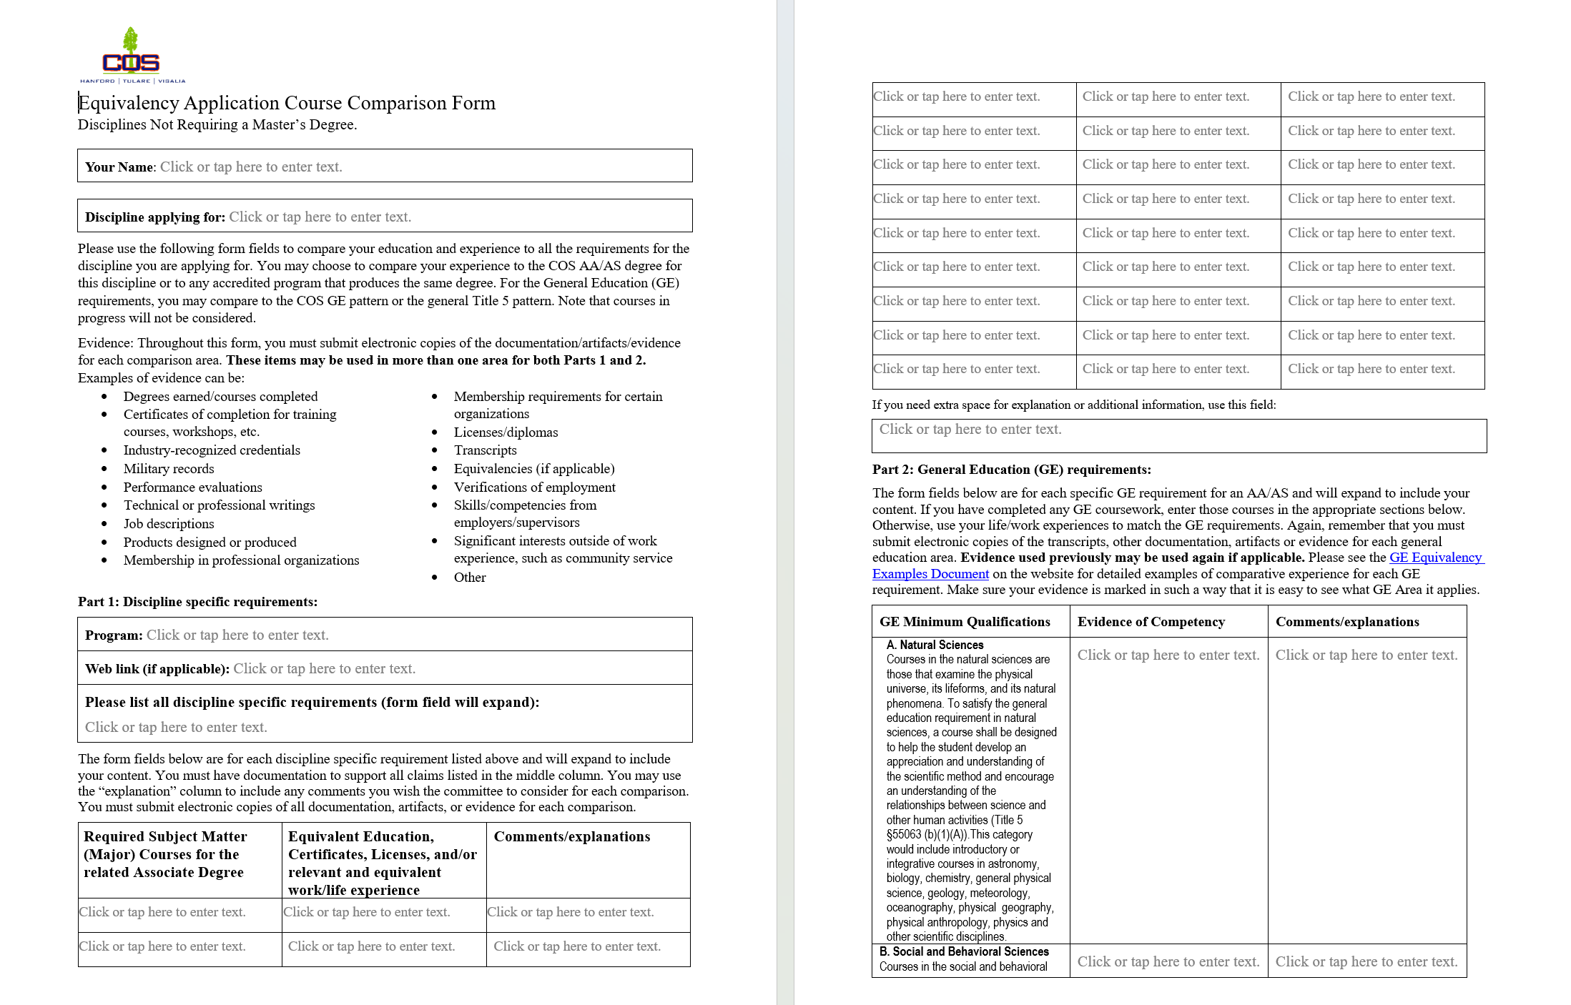
The Non-Master’s Form
This form differs from the Master’s form mainly in what it asks you to compare.
The form is designed to be self-explanatory, and all form fields will expand to accept all information you include.
Read the instructions carefully, especially the types of evidence you can use and where you can use it.
You can use any combination of accredited coursework and life/work experience in this form.

Slide 15
The Non-Master’s Form Part 1
Some important information is highlighted here.
Read through the types of evidence you can use to compare your experience to the minimum qualifying education requirements for the position applied for. Make sure you have physical evidence you can submit to back up your claims.
In Part 1, start by listing the program you will be comparing your experience to, with a web link if possible, and list the discipline-specific requirements of that program (not including GE requirements). Make sure to list any electives, internships, and other requirements (if any).
In the first column of the three-column part, list each course required for the related Associate’s Degree in each row.
In the second column, list the evidence you have that your experience meets the course requirements for that row. Add any comments and context in the third column as you feel necessary. Remember, the committee is not bothered by long entries and in fact would prefer to have too much information than not enough.

Slide 16
The Non-Master’s Form Part 2
Part 2 is for applicants who also need to present evidence that their experience meets Title 5 General Education requirements.
For this part, please download a copy of the ASCCC GE Equivalency Examples document from the COS HR Equivalency webpage. The document lists a number of real-world examples that could help you compare your experience to the GE.
In Part 2 of the form, note that the GE requirements are pre-filled in the first column.
In the second column, list the evidence you have that your experience meets the GE requirements for that row. If using work/life experience, make sure to include the length of time spent actively engaged in the activity (and remember the committee needs documentation supporting your claims). Add any comments and context in the third column as you feel necessary.

Slide 17
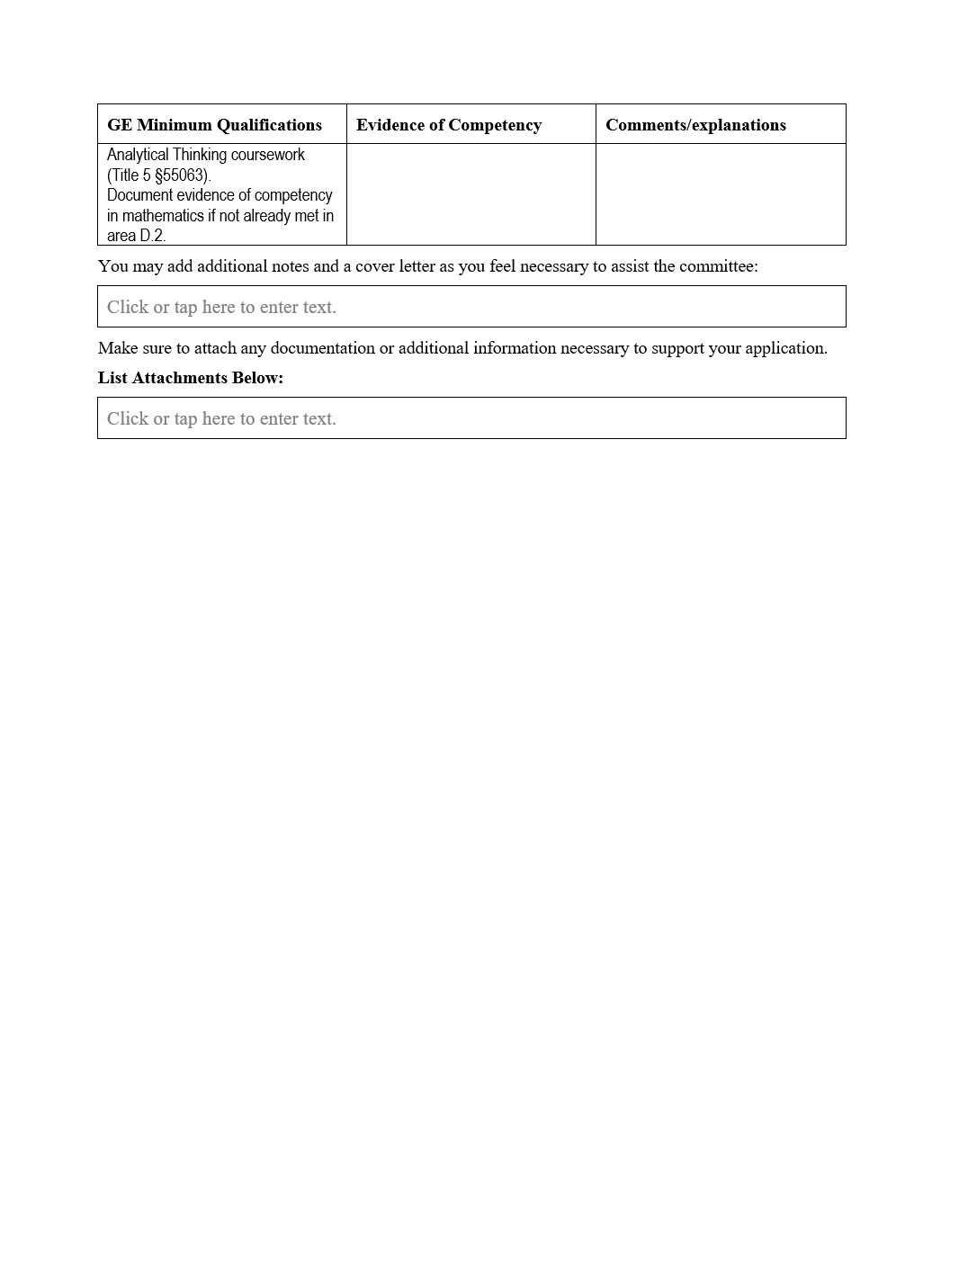
The Non-Master’s Form End
Like the Master’s Form, there is space here at the end of the form to add any extra information you feel will help the committee make a favorable decision.
Because a Non-Master’s applicant may have a diverse list of evidence documents, the committee encourages the applicant to add a list of such documents here so the committee can be sure they have the complete application.
It would be helpful if each document is clearly identified and in some way references where in the form it applies.
---------------------------------------------
Return to the Menu page

