Slide 1




Slide 2


Slide 3

What has happened so far?
August
Strategic Plan was presented in the context of the Master Plan to the entire District at Convocation.
Institutional Planning and Effectiveness Committee (IPEC) recruited for Task Force membership.
September
Task Force co-chairs were identified.
Task Force membership was finalized.
Task Force members were trained on the semester-long process for drafting the Strategic Plan.
Each Task Force reviewed its goal area and progress made on the objectives and actions from the previous Strategic Plan.

Slide 4

Chancellor’s Office Vision for Success
Increase by 2022
Reduce/Decrease
Awards: associates degrees, credentials, certificates (20%)
Transfers to UC/CSU (35%)
CTE Employment for exiting students (from 60% to 69%)
Equity Gaps for all groups (40% within 5 years; eliminate within 10 years)
Regional Achievement Gaps (closing regional achievement gaps in places with the lowest educational attainment within 10 years)
Average Number of Units-to-Degree (from 87 units to 79 units

Slide 5
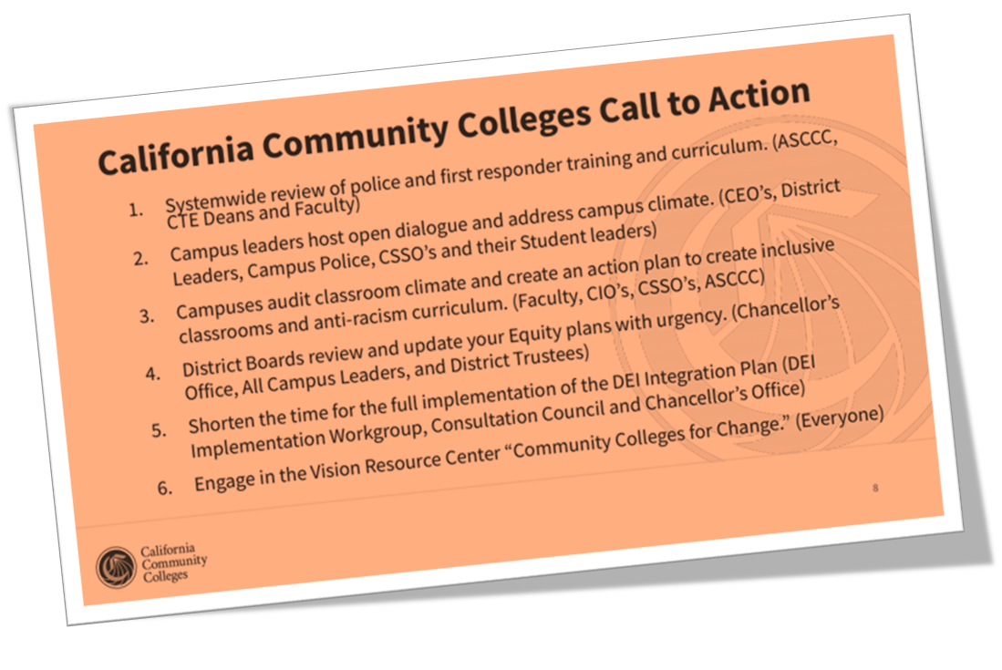

Slide 6

What have we learned from COVID-19 and how can we use that knowledge to improve COS?
Student technology and internet access
Online learning
Community workforce needs
Student childcare needs
Mental health challenges and supports
Community influence

Slide 8

What is the purpose of the Strategic Plan?
Four year plan to include:
District Objectives and corresponding Actions that will be undertaken to achieve the District Goals.
Assessment of how effective the Actions are in moving the District toward achieving the District Objectives.

Slide 9
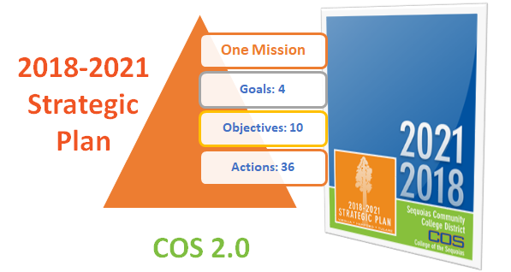

Slide 11
Mission
Goals
Objectives
Actions
S.M.A.R.T. Objectives
Specific | Who is the target population? What will be accomplished?
Measurable | Is the objective quantifiable? Can it be measured? How much change is expected?
Achievable | Can the objective be accomplished in the proposed time frame with the available resources and support?
Relevant | Determine the reason behind the established goal. Does the objective relate to the goal?
Time-Bound | Does the objective propose a timeline when the objective will be met?

Slide 13
Summit Format
Presentation of goal area and progress made on 2018-2021 objectives
Q&A session via chat
Complete survey & break
10-20 minutes
10 minutes
10 minutes
The survey link for each goal will be posted in the chat when each presentation begins.
You have from the time the presentation begins until the end of the break period to submit your survey for each goal (30-40 minutes).

Slide 15
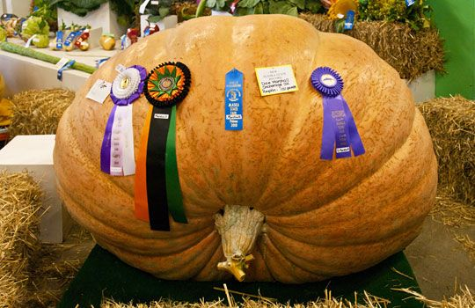
Goal 2
Student Success
College of the Sequoias will improve the rate at which its students complete degrees, certificates, and transfer objectives.

Slide 16
Objective 2.1
Increase the percentage of students who earn an associate degree or certificate (CTE and non-CTE) by 5 percentage points over three years.
Actions:
  2.1.1 - Complete implementation of DegreeWorks District-wide.
  2.1.2 - Identify and categorize areas of study (meta-majors).
  2.1.3 - Automate the application process for degrees and certificates.
  2.1.4 - Implement best practices for increased CTE completion and success (e.g. Tutoring, contextualized math and English, counseling).

Slide 17
Progress on Objective 2.1
Increase the percentage of students who earn an associate degree or certificate (CTE and non-CTE) by 5 percentage points over three years.
One of the actions for this objective has been completed (2.1.3) and three are ongoing, meaning the responsibility for continued work on that objective is assigned to a specific department and institutionalized.
Recommendation: Keep this objective with possible revisions
  e.g. dividing CTE and non CTE degrees and certificates, addressing “rate of completion”, shortening the numbers of units and semesters until graduation, etc.
Notes:
- As part of the “Vision for Success,” the Chancellor’s Office has outlined new goals, the first of which is “[to] increase by at least 20 percent the number of CCC students annually who acquire associates degrees, credentials, certificates, or specific skill sets that prepare them for an in-demand job” over five years.
1. DegreeWorks’ degree audit tool is fully implemented and used by both counselors and evaluators to complete graduation applications. Students have access to Degree Works on their MyGiant portal to audit their progress at any time.
The implementation of DegreeWorks tool is the student education plan is still in progress.
2. Meta Major areas of study have been created and sent through governance process for approval. Two summits were held with faculty, staff, students and administrators to develop Meta Majors.
3. The degree and certificate application have been automated via DegreeWorks.
4. Tutorial task force has met 4 times and will recommend a stakeholder advisory group that will include CTE faculty representatives to provide ongoing input and feedback to improve tutorial support services. Math tutorial staff provided embedded tutoring support on a trial basis in Welding, and is in discussions to expand the use of embedded tutoring to support math related CTE for fall.

Slide 18
Objective 2.2
Increase the number of students who transfer to four-year institutions by 10 percent over three years.
Actions:
2.2.1 - Contact students who become transfer-prepared and provide support to complete transfer.

Slide 19
Progress on Objective 2.2
Increase the number of students who transfer to four-year institutions by 10 percent over three years.
The action for this objective has been marked as ongoing.
Recommendation: Keep this objective and revise the language to reflect our current four-year cycle.
  Some ideas that were mentioned were to consider volume of successful students opposed to a rate and keep in mind external factors (COVID-19, CSU constraints, etc.)
Notes:
ReGroup emails and texts are sent to transfer-prepared students reminding them to see a counselor to complete their transfer application. The first transfer “Signing Day” was held to promote a culture of transfer. CSU Bakersfield, Sacramento, and Fresno Pacific partner with the Transfer Center to host targeted transfer events for students in addition to the ongoing partnerships with Fresno State, and our annual Transfer Day which hosts dozens of 4-year universities.

Slide 20
Objective 2.3
By 2021, increase the percentage of students who complete transfer-level English by 15 percentage points and transfer-level math by 10 percentage points within their first year.
Actions:
2.3.1 - Implement multiple measures to maximize student placement into transfer-level English and math.
2.3.2 - Shorten the developmental course sequence in English so that students can complete transfer-level English within one year.
2.3.3 - Shorten the developmental course sequence in math so that students can complete transfer level math within one year.

Slide 21
Objective 2.3
By 2021, increase the percentage of students who complete transfer-level English by 15 percentage points and transfer-level math by 10 percentage points within their first year.
Actions (continued):
2.3.4 - Shorten the developmental course sequence in ESL so that students can complete transfer-level English within three years.
2.3.5 - Train faculty in accelerated instruction.
2.3.6 - Integrate and align peer academic support programs (embedded tutoring, Writing Center tutors, math tutors, supplemental and augmented instruction).

Slide 22
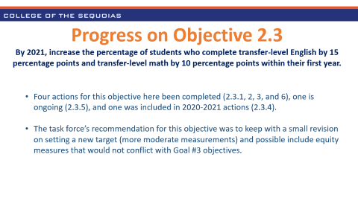
Progress on Objective 2.3
By 2021, increase the percentage of students who complete transfer-level English by 15 percentage points and transfer-level math by 10 percentage points within their first year.
Four actions for this objective here been completed (2.3.1, 2, 3, and 6), one is ongoing (2.3.5), and one was included in 2020-2021 actions (2.3.4).
Recommendation: Keep with small revisions
  Possibly set a new target with more moderate measurements and also possibly include equity measures that would not conflict with Goal #3 objectives.
Notes:
Because of AB 705 there is no longer a developmental math and English sequence offered at COS. All students are eligible for a transfer level math and English course.
4. Guidance on ESL guided self placement has come out later. Faculty, administrators and staff are working on curriculum and placement for implementation by Fall 2021.
6. Oversight of supplemental instruction has moved fully to Educational Support Services Dean, which allows collaboration on training and flexibility in providing alternate supports such as augmented instruction when funding concerns come into play.

Slide 23
Objective 2.4
By 2021, increase the percentage of CTE students who achieve their employment objectives by 5 percentage points (job closely
related to field of study and median change in earnings)..
Actions:
2.4.1 - Create a comprehensive career development program that prepares students for employment.
2.4.2 - Embed soft skills into CTE curriculum and provide training for faculty.

Slide 24
Progress on Objective 2.4
By 2021, increase the percentage of CTE students who achieve their employment objectives by 5 percentage points (job closely
related to field of study and median change in earnings).
One of the actions on this objective was completed (2.4.1) and one is ongoing (2.4.2).
Recommendation: Keep it
  In order to avoid relying on external data that frequently change without warning, one possible action could be providing better metrics.
Notes:
1. The Transfer & Career Center is the hub for all career education services from entrance to completion. These include career exploration, resume workshops, career fairs, and other career services for students. Career Services are represented on all three District Campuses with a Director on the Visalia Campus. Additionally, three coordinators serve on each campus. Each coordinator also works with students and faculty on the respective campus setting up specific activities such as employer visits to classrooms, tours of industry, career fairs, mock interviews, resume workshops and other career education activities, including connecting students to local and regional internships.
2. Faculty and staff have attended workshops and training on embedding soft skills.

Slide 25
Goal 2
Q&A Session
Please type your questions
in the chat and the presenters
will answer them aloud.

Slide 26
Break Time
Please take a moment to complete and submit your Goal 2 survey if you have not yet done so. We will resume after 10 minutes.
FLEX sign-in link is in the chat.

Slide 27
Summit Format
Presentation of goal area and progress made on 2018-2021 objectives
Q&A session via chat
Complete survey & break
10-20 minutes
10 minutes
10 minutes
The survey link for each goal will be posted in the chat when each presentation begins.
You have from the time the presentation begins until the end of the break period to submit your survey for each goal (30-40 minutes).

Slide 29
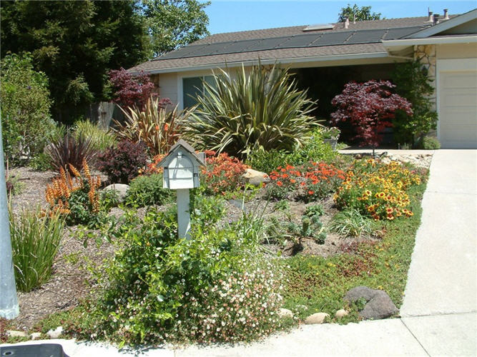
Goal 4
Sustainability
College of the Sequoias Board of Trustees, administration, faculty, and staff will engage in best practices and staff development to sustain effective operational systems for institutional assessment and continuous improvement.

Slide 30
Objective 4.1
Increase the use of data for decision-making at the District and department/unit level.
4.1.1 - Increase the effective use of data in unit program reviews.
4.1.2 - Assess the District’s progress of all actions on the objective.

Slide 31
Progress on Objective 4.1
Increase the use of data for decision-making at the District and department/unit level.
4.1.1 Progress – This action has been included in the 2020-2021 actions.
  Units have continuing access to many sources for data including: Chancellor’s Office Data Mart, COS Giant Fact Book and Tableau which includes a lot of disaggregated data which allows users to view the information with attention on disproportionately impacted groups to improve equity. Using data is stressed in Program Review training, O&A trainings and open office hours, and senior management training activities such as ‘Data Time’ at Management Council.
Recommendation: Keep the objective!

Slide 32
Objective 4.2
Improve organizational effectiveness by strengthening operations of and communication between District departments, divisions, and constituents.
4.2.1 - Implement an awareness campaign highlighting different departments and services.
4.2.2 - Ensure that the District website content is current and relevant.

Slide 33
Progress on Objective 4.2
Improve organizational effectiveness by strengthening operations of and communication between District departments, divisions, and constituents.
4.2.1 Progress – This action has been included in the 2020-2021 actions.
  Departments, programs or student services are now more frequently requesting for their areas to be featured on social media, COSeNews, and Press Releases. Social Media feeds to the home page of the COS website.
4.2.2 Progress – This action is listed as ongoing.
  Since the launch of new website in Spring 2019, continuous webpage audits have occurred to assure content is up to date and relevant. Feedback will be provided each semester by the responsible parties related to respective area webpages.
Recommendation: Keep the objective with some revisions to Action 4.2.1.

Slide 34
Objective 4.3
Increase professional development opportunities for and participation of District employees in support of improving operational effectiveness.
4.3.1 - Implement a Professional Development Plan for the coordination, alignment, and management of professional development activities and new employee orientation.

Slide 35
Progress on Objective 4.3
Increase professional development opportunities for and participation of District employees in support of improving operational effectiveness.
4.3.1 Progress – This action was included in the 2020-2021 actions.
  There is not yet a District professional development plan in place, however, an IC work group has created a new faculty onboarding resource shell in Canvas.
Recommendation – Keep the objective!
  This action should be continued to implementation.

Slide 36
Goal 4
Q&A Session
Please type your questions
in the chat and the presenters
will answer them aloud.

Slide 37
Break Time
Please take a moment to complete and submit your Goal 4 survey if you have not yet done so. We will resume after 20 minutes.
FLEX sign-in link is in the chat.

Slide 39
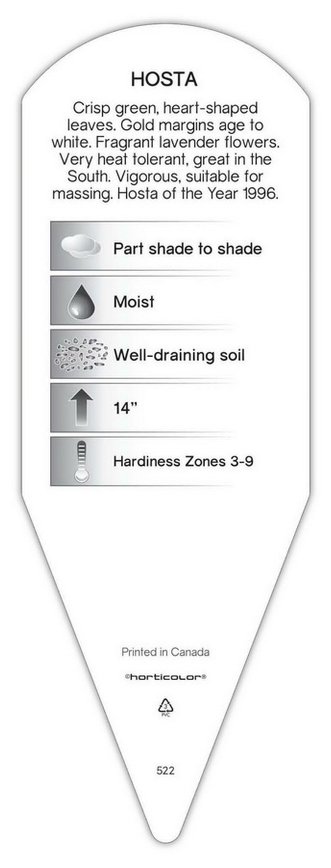
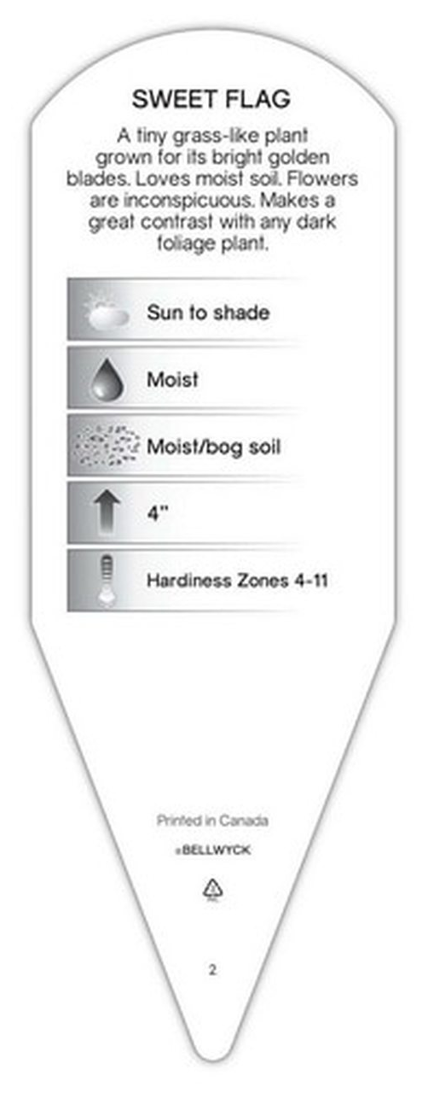
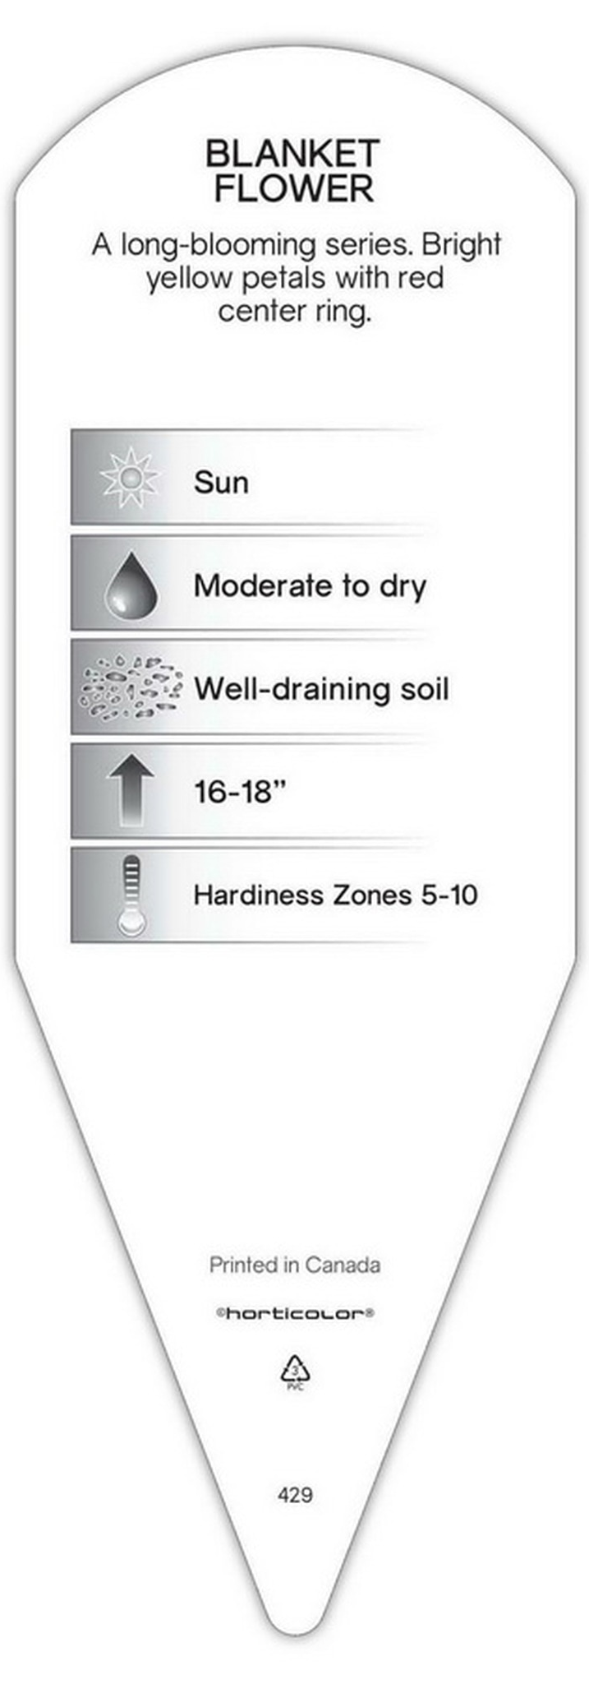
Goal 3
Student Equity
College of the Sequoias will strategically tailor and implement academic programs and student services that match the unique needs of its student population and the demands of ongoing changes in workforce development.

Slide 40
Objective 3.1
By 2021, increase the placement rates into transfer-level English by 10 percentage points and transfer-level math by 15 percentage points for targeted groups that fall below the District average.
Actions
3.1.1 - Determine which groups fall below the District’s placement rates into transfer-level English and math.
3.1.2 - Implement best practices to increase placement rates for targeted groups.

Slide 41
Progress on Objective 3.1
By 2021, increase the placement rates into transfer-level English by 10 percentage points and transfer-level math by 15 percentage points for targeted groups that fall below the District average.
Action 3.1.1 was included in the 2020-2021 actions and Action 3.1.2 was listed as ongoing.
  AB 705 played a major role in the placement rates into transfer-level English and Math. In compliance with AB 705, English increased by 40 percentage points and Math increased by 35 percentage points.
    These increases are exclusive to English and Math without support.
    English
      District average 41% - 81% (+40%)
      African American, 35%- 88% (+53%)
      Hispanic, 36%-79% (+43%)
      White, 56%-89% (+33%)
    Math
      District average 16% - 51% (+35%)
      African America, 10%-42% (+32%)
      Hispanic, 13%-48% (+35%)
      White, 22%-63% (+41%)
Recommendation: Remove 3.1 (AB 705)

Slide 42
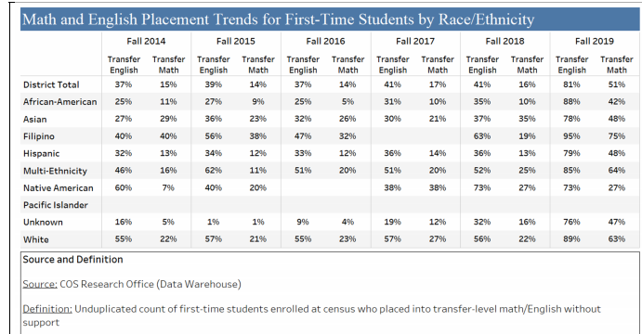
Progress on Objective 3.1
By 2021, increase the placement rates into transfer-level English by 10 percentage points and transfer-level math by 15 percentage points for targeted groups that fall below the District average.

Slide 43
Objective 3.2
By 2021, increase the percentage of students in targeted groups who complete transfer-level English (by 10 percentage points) and transfer-level math (by 5 percentage points) within their first year.
Actions
3.2.1 - Determine which groups fall below the District’s completion rates in transfer-level English and math.
3.2.2 - Implement best practices/interventions to increase completion rates for targeted student groups.
3.2.3 - Improve/increase collaboration between District faculty and feeder high school teachers to better align high school exit and college entry standards.

Slide 44
Objective 3.2
By 2021, increase the percentage of students in targeted groups who complete transfer-level English (by 10 percentage points) and transfer-level math (by 5 percentage points) within their first year.
Action 3.2.1 was completed, Action 3.2.2 is ongoing, and Action 3.2.3 was included in the 2020-2021 actions.
  AB 705 played a major role in the completion rates for transfer-level English and Math. In compliance with AB 705, English increased by 11 percentage points and Math increased by 16 percentage points.
  English (18-19)
    District average 38% - 49% (+11%)
    African American, 14%- 42% (+28%)
    Hispanic, 36%-49% (+13%)
    White, 46%-54% (+8%)
  Math (18-19)
    District average 15% - 31% (+16%)
    African America, 5%-30% (+25%)
    Hispanic, 14%-31% (+17%)
    White, 19%-33% (+14%)
Recommendation: Revise 3.2

Slide 45
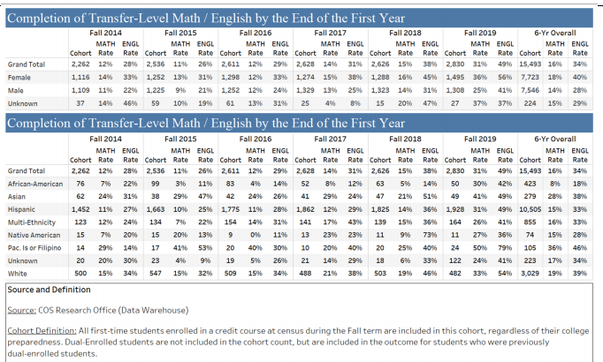
Progress on Objective 3.2
By 2021, increase the percentage of students in targeted groups who complete transfer-level English (by 10 percentage points) and transfer-level math (by 5 percentage points) within their first year.

Slide 46
Considerations for Objective 3
3.1 - By 2021, increase the placement rates into transfer-level English by 10 percentage points and transfer-level math by 15 percentage points for targeted groups that fall below the District average.
3.2 - By 2021, increase the percentage of students in targeted groups who complete transfer-level English (by 10 percentage points) and transfer-level math (by 5 percentage points) within their first year.
  COVID-19
  Online Learning
  Social Climate
  Equity Plan
  Vision for Success
  Other relevant efforts for Equity

Slide 47
Goal 3
Q&A Session
Please type your questions
in the chat and the presenters
will answer them aloud.

Slide 48
Break Time
Please take a moment to complete and submit your Goal 3 survey if you have not yet done so. We will resume after 10 minutes.
FLEX sign-in link is in the chat.

Slide 50
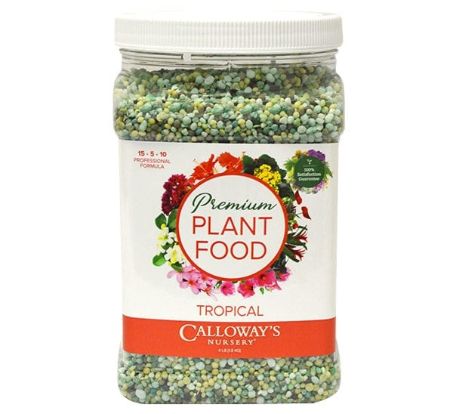



Goal 1
Growth
College of the Sequoias will increase student enrollment relative to population growth and educational and workforce development needs.

Slide 51
Objective 1.1
The District will increase FTES 1.75% over the three years.
Actions
  1.1.1 - Implement best practices for student fulltime enrollment, graduation, or transfer in two-year.
  1.1.2 - Develop a plan to reduce attrition rates from application to enrollment.
  1.1.3 - Implement student centered schedule planning to maximize full-time enrollment. (Student Education Plan data, previous semester classes, placement data, etc.).
  1.1.4 - Increase opportunities to maximize concurrent and dual enrollment.
  1.1.5 - Assess the District’s progress of all actions on the objective.
WSCH = Weekly Student Contact Hours
How are FTES (Full-Time Equivalent Students) calculated?
(30 x 3 x 17.5 hrs/unit)
525 WSCH
Example: A 3-unit class with 30 students would be 3 FTES. = 3 FTES

Slide 52
Progress on Objective 1.1
The District will increase FTES 1.75% over the three years.
  Action 1.1.1 is ongoing, Action 1.1.2 is completed, and Actions 1.1.3 and 1.1.4 were included in the 2020-2021 actions.
    The District experienced a 2.7% growth in FTES from 2018-19 (10,380) to 2019-20 (10,655). Over the past six years, the District’s FTES has increased 19%.
  What are we doing different?
    Improving communication/outreach with feeder high school students.
    Encouraging students to take 12+ units per semester.
    Increasing awareness of educational support services (SSP, Tutoring, Financial Aid, EOPS, Degree Works, T&CC).
    Improving course scheduling through Guided Pathways and Meta Majors.
    Increasing opportunities to maximize concurrent and dual enrollment.

Slide 53
Considerations for Objective 1.1
The District will increase FTES 1.75% over the three years.
  Projections, Uncertainties, Limitations, etc.
  Population growth, demographics, etc.
    Control growth through course offerings
  Workforce demands (current and projected) – Do COS programs align?
  AB 705
  Guided Pathways
  K12 Strong Work Force
  College & Career Indicators
  State funding
    Annual funding allocations are based on enrollment projections (FTES)
  COVID-19 impact
  Physical capacity of District facilities
    Evaluate course offerings prioritizing courses needed for transfer/certificates.
    Compare enrollment rates to room assignments by department
  Are hybrid/online classes the future?
    State funding formula would need to be revised to support this model.

Slide 54
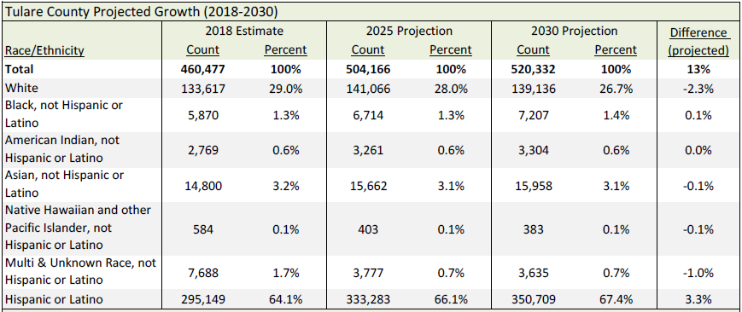
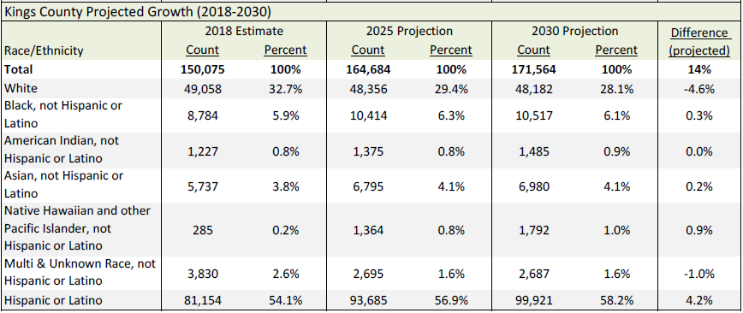
Data for Objective 1.1
The District will increase FTES 1.75% over the three years.
  Projected Population Growth & Demographics
Source: COS Giant Fact Book
TULARE COUNTY Projected Growth (2018-2030)
KINGS COUNTY Projected Growth (2018-2030)

Slide 55
Data for Objective 1.1
The District will increase FTES 1.75% over the three years.
  Projected Workforce Demands
Source: COS Giant Fact Book
TULARE COUNTY 2012-2022 Comparison of Growing Occupations by Entry Level Education
Entry Level Education | Fastest Growing (New Jobs from Industry Growth) | Growth and Jobs |  | Largest Growing (New Jobs and Replacement Needs) | Jobs
 | Construction Managers | 22.7% or 50 jobs |  | General and Operations Managers | 810
 | General and Operations Managers | 19.2% or 350 jobs |  | Elementary School Teachers, Except Special Education | 670
 | Administrative Services Managers | 16.7% or 50 jobs |  | Substitute Teachers | 580
 | Kindergarten Teachers, Except Special Education | 13.0% or 60 jobs |  | Secondary School Teachers, Except Special and CTE | 460
 | Registered Nurses | 20.5% or 390 jobs |  | Registered Nurses | 840
 | Preschool Teachers, Except Special Education | 12.1% or 40 jobs |  | Preschool Teachers, Except Special Education | 140
 | Telecommunications Equipment Installers and Repairers, Except Line Installers | 52.4% or 110 jobs |  | Heavy and Tractor‐Trailer Truck Drivers | 1,330
 | Heavy and Tractor‐Trailer Truck Drivers | 28.2% or 820 jobs |  | Nursing Assistants | 740
 | Nursing Assistants | 27.6% or 400 jobs |  | Medical Assistants | 370
 | Medical Assistants | 25.6% or 200 jobs |  | Licensed Practical and Licensed Vocational Nurses | 250
 | Dental Assistants | 19.4% or 60 jobs |  | Automotive Service Technicians and Mechanics | 240
 | Computer User Support Specialists | 12.5% or 40 jobs |  | Teacher Assistants | 910
 | Teacher Assistants | 11.7% or 300 jobs |  | Bookkeeping, Accounting, and Auditing Clerks | 180
 | Bookkeeping, Accounting, and Auditing Clerks | 0.6% or 10 jobs |  | Computer User Support Specialists | 80
Bachelor's Degree
Associate's Degree
Postsecondary
Non-degree Award
Some College,
No Degree

Slide 56
Data for Objective 1.1
The District will increase FTES 1.75% over the three years.
  Projected Workforce Demands
Source: COS Giant Fact Book
KINGS COUNTY 2012-2024 Comparison of Growing Occupations by Entry Level Education
Entry Level Education | Fastest Growing (New Jobs from Industry Growth) | Growth and Jobs |  | Largest Growing (New Jobs and Replacement Needs) | Jobs
 | Probation Officers and Correctional Treatment Specialists | 30.4% or 70 jobs |  | Registered Nurses | 530
 | Adult Basic and Secondary Education and Literacy Teachers and Instructors | 30.0% or 30 jobs |  | Elementary School Teachers, Except Special Education | 270
 | Accountants and Auditors | 27.6% or 80 jobs |  | Substitute Teachers | 260
 | Registered Nurses | 25.9% or 280 jobs |  | Secondary School Teachers, Except Special and CTE | 200
 | Mental Health and Substance Abuse Social Workers | 25.0% or 30 jobs |  | General and Operations Managers | 170
 | Preschool Teachers, Except Special Education | 28.6% or 40 jobs |  | Agricultural and Food Science Technicians | 80
 | Agricultural and Food Science Technicians | 21.4% or 30 jobs |  | Preschool Teachers, Except Special Education | 80
 | Psychiatric Technicians | 44.4% or 40 jobs |  | Heavy and Tractor-Trailer Truck Drivers | 230
 | Licensed Practical and Licensed Vocational Nurses | 25.8% or 80 jobs |  | Licensed Practical and Licensed Vocational Nurses | 170
 | Nursing Assistants | 16.0% or 40 jobs |  | Nursing Assistants | 100
 | Heavy and Tractor-Trailer Truck Drivers | 14.9% or 110 jobs |  | Dental Assistants | 60
 | Dental Assistants | 12.5% or 20 jobs |  | Automotive Service Technicians and Mechanics | 50
 | Teacher Assistants | 15.6% or 100 jobs |  | Teacher Assistants | 250
 |  | - |  | Bookkeeping, Accounting, and Auditing Clerks | 40
Bachelor's Degree
Associate's Degree
Postsecondary
Non-degree Award
Some College,
No Degree

Slide 57
Recommendation for Objective 1.1
The District will increase FTES 1.75% over the three years.
  Recommendation: Keep the objective with revisions.
    Adjust the language of the Objective to reference an "average" increase of 1.75% over the three-year term.
    Separate actions by campus
    Separate actions by demographics, specifically "traditional" vs. non-traditional students
    Separate goals for CTE vs. non-CTE
    Full-time vs. part-time attendance – A primary focus on FT attendance fails to acknowledge that so many of our students simply can't attend FT due to jobs, family responsibilities, etc.

Slide 58
Goal 1
Q&A Session
Please type your questions
in the chat and the presenters
will answer them aloud.

Slide 59
Break Time
Please take a moment to complete and submit your Goal 1 survey if you have not yet done so. We will resume after 10 minutes.
FLEX sign-in link is in the chat.

Slide 61
What happens next?
Your feedback will be used by the task forces to draft the
2021-2025 Strategic Plan objectives and actions over the next couple of months.
In the Spring semester, Institutional Planning and Effectiveness Committee will consult with Senior Management, the Board of Trustees, Institutional Program Review Committee, Deans Council, Budget Committee and the Academic Senate Executive Board to finalize the Strategic Plan draft before it is sent for final approval through District Governance Senate.
The final version will be presented to the Board of Trustees in
May/June of 2021 and take effect in July 2021.

Slide 62

Please take a moment
to complete the
Summit Evaluation
(link in chat)
FLEX sign-in link is in the chat.

Slide 63
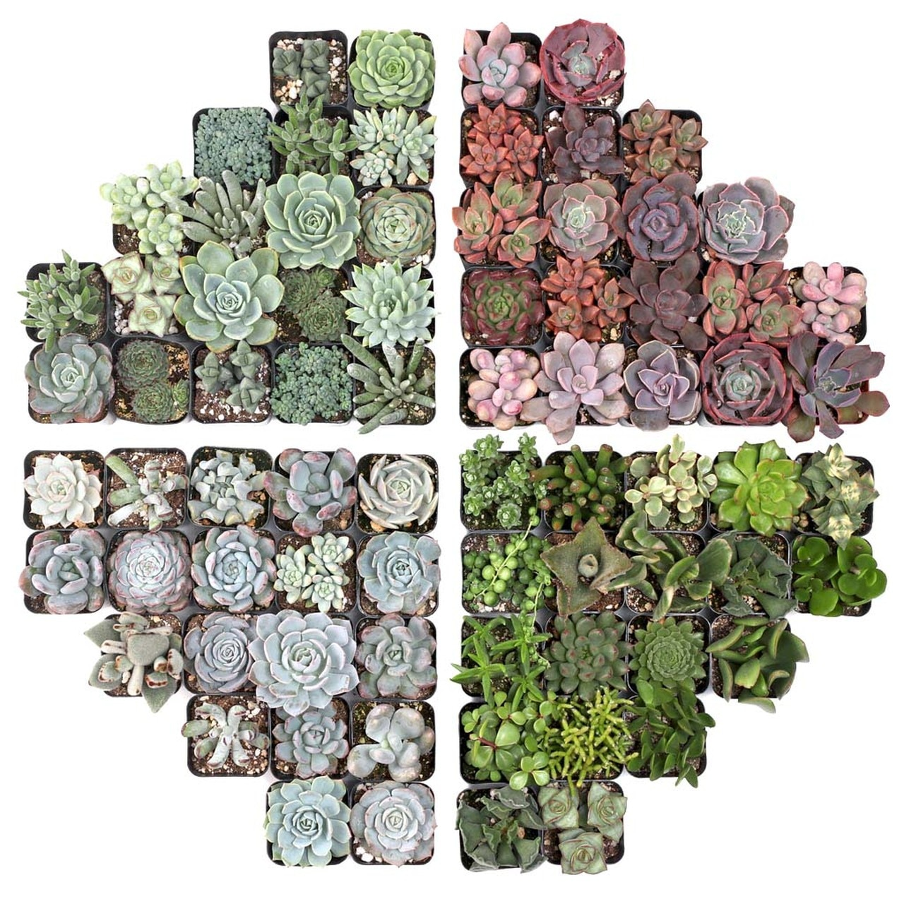
Time for
Prizes!

Slide 64
Thank you for
your attendance
and feedback!
Evaluation and FLEX sign-in links are in the chat.

